Slide 1
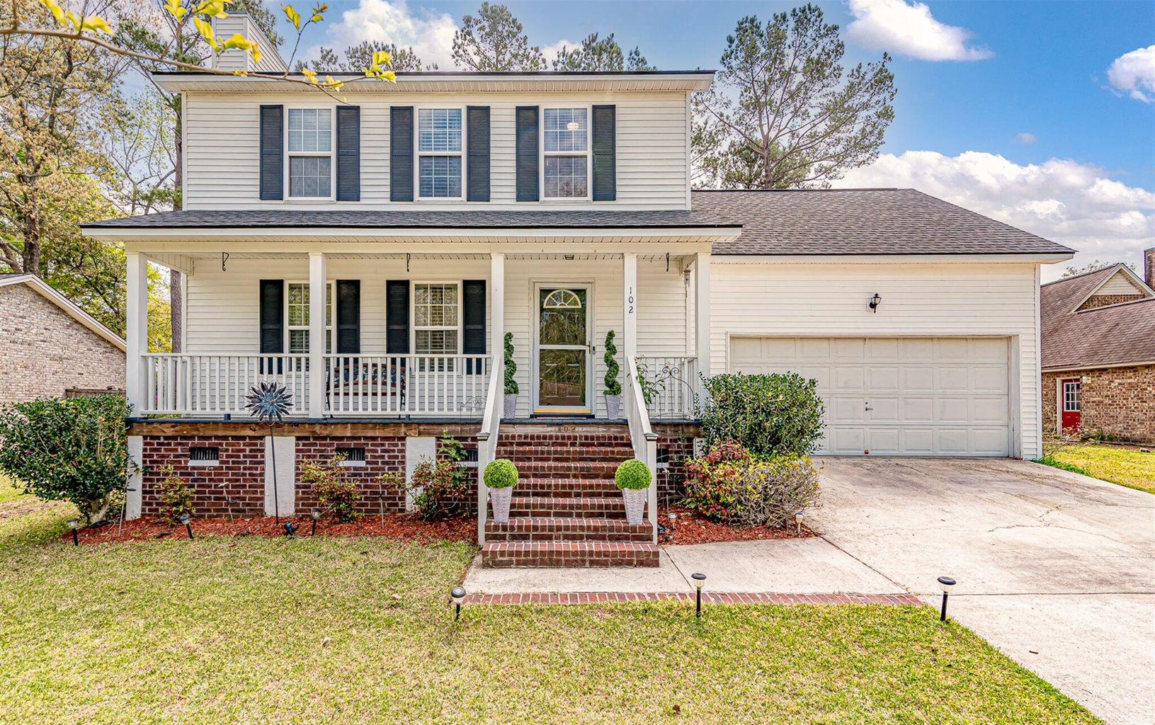
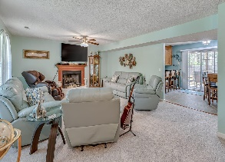
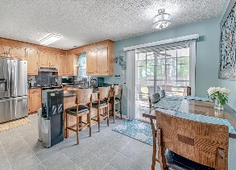
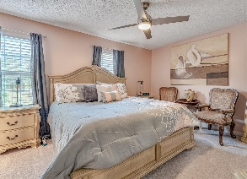
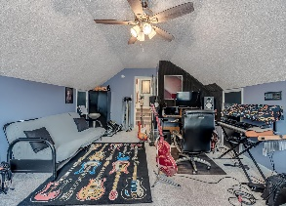
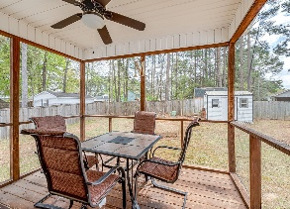
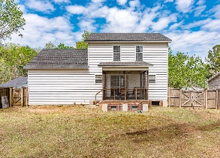


4 Bedrooms Screened Porch Fenced Yard No HOA
102 Outrigger Court
Marlin Estates ~ Summerville, SC 29485
MLS# 21008476 ~ $245,000
Summerville 4 bedroom 2.5 bathroom two story home with a screened porch, large private fenced in backyard, full front porch, storage shed, and No HOA. Quietly nestled away on a cul-de-sac street, this charming home has been carefully maintained by the original owner! The main first floor is composed of a large open living room, kitchen, dining area, half bath, and direct outside access to the screened porch. All four bedrooms are upstairs including the master bedroom with a private ensuite full bathroom. A new roof was installed approximately 5 years ago, and within the past year the home has had all New Carpet and Fresh Paint throughout. New ceramic tile in the kitchen and all bathrooms. The backyard is large and features a privacy fence, storage shed / small workshop area, and double gate access. No HOA and No Flood Insurance. Conveniently located off Bacons Bridge Road 165 and close to downtown Summerville, I-26, 78, 17A, Dorchester Road, and abundant restaurants, grocery stores, shopping, and schools. This is a house that instantly feels like a home the moment you enter and has been well cared for over the years. Schedule your showing today!
Jerod Coulter, ABR, REALTOR
(843) 513-3741
jerod@realtor.com | www.HomesOfMountPleasant.com
The Boulevard Company, LLC | 35 Broad Street | Charleston, SC 29401

