Slide 1
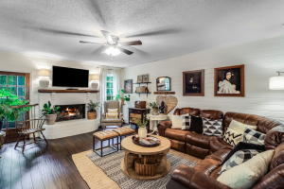
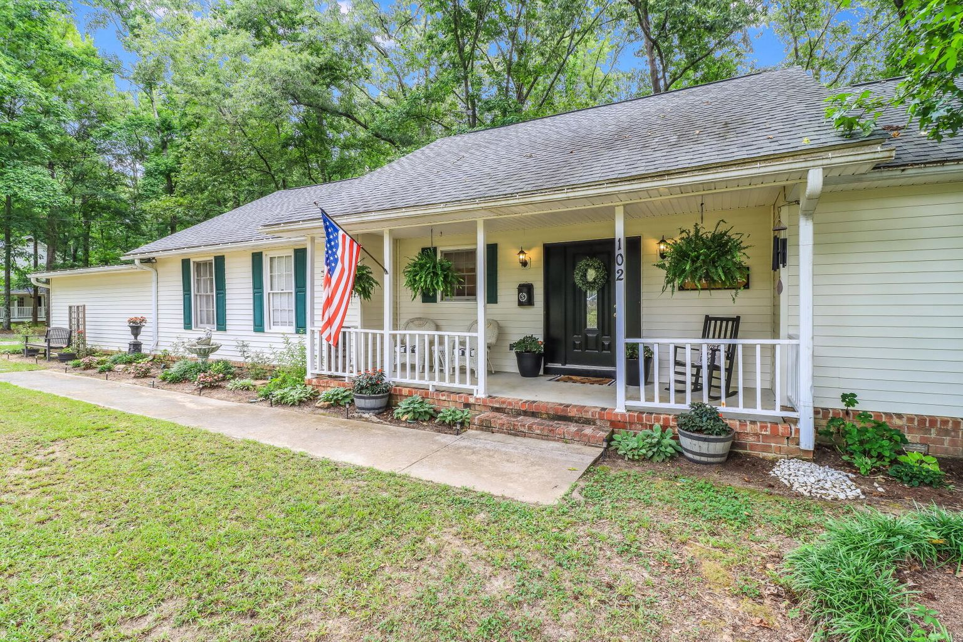
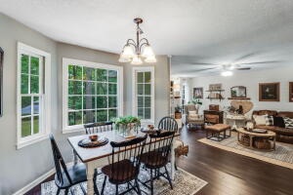
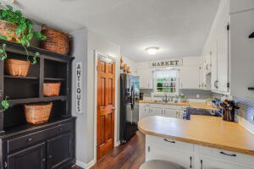
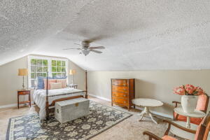
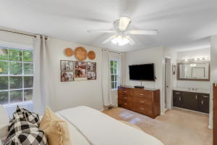
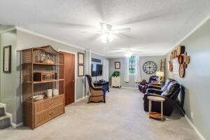
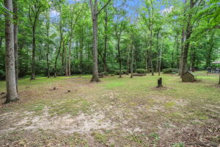
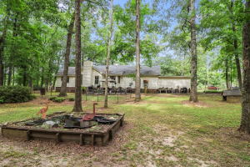


102 Paris Lane Caire Yelleau | Summerville, SC 29483 MLS# 21018418 | $415,000
Price Improvement! No HOA!
1.69 Acres!
SCHEDULE YOUR SHOWING TODAY!
Welcome home to this beautiful 4 bedroom, 3 bathroom ranch, with 2242 sq ft of living space, on 1.69 acres. This home has an amazing, desirable location in Summerville. Close to town and many amenities, yet quiet and peaceful. Approaching the home you will get a true feeling of southern country living. Mature landscaping, and a large front porch make a perfect combination to sit out on those rocking chairs and enjoy the scenery. Enter the home into a spacious foyer that leads into a large family room. Shiplap walls, a large brick surround fireplace, and engineered bamboo flooring make this family room very appealing. Off the family room is the wonderful kitchen and a separate dining area. Pull up a stool at the peninsula to grab a quick bite to eat or entertain a dinner party in the generously sized separate dining area. Enjoy ample amounts of kitchen accessory storage in the beautiful white wood cabinets. This home has dual masters, both with wonderful en-suites. Two additional bedrooms and one additional full size bathroom are included in this home. The attached frog can be used as a guest bedroom, kid play area or whatever fits your lifestyle. If you like to take your living or entertaining outdoors this is the home for you! Sitting on 1.69 acres of mature landscaping and privacy you have endless opportunity to make it your own! Don't miss out on this beautiful home in a desirable location, schedule your showing as soon as possible!!
Brandon Ray
(843) 499-1928
brandon.ray@carolinaone.com
www.therightrayhome.com
Carolina One Real Estate
900 N Main St
Summerville, SC 29483

