Slide 1
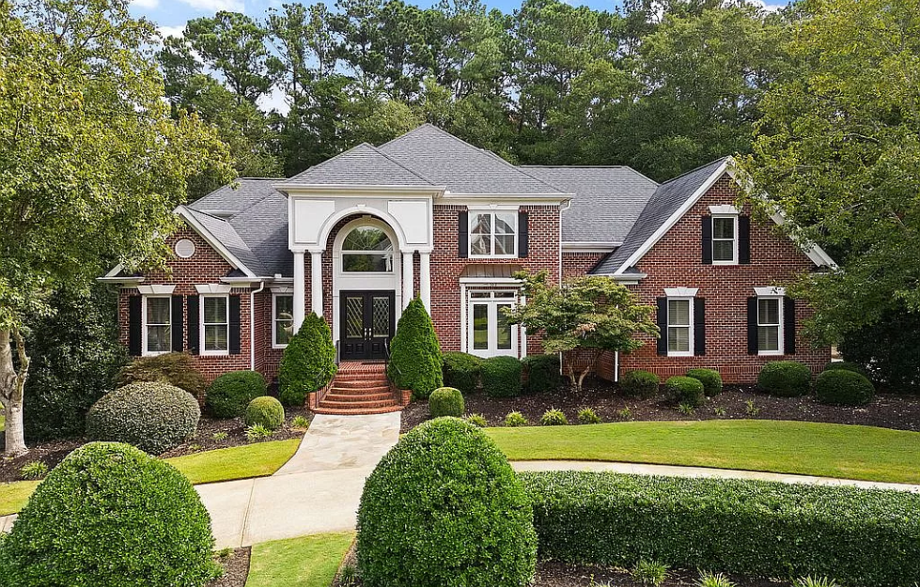
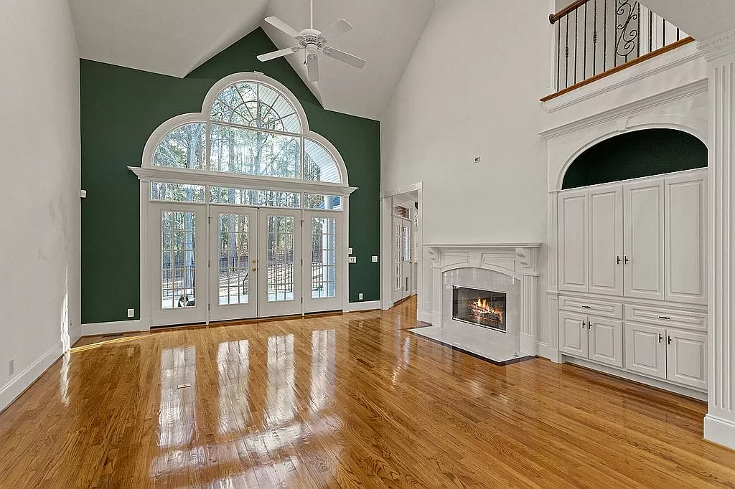







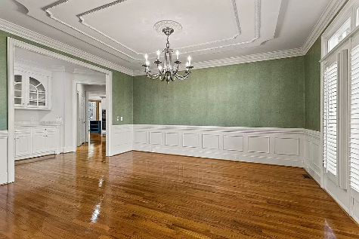
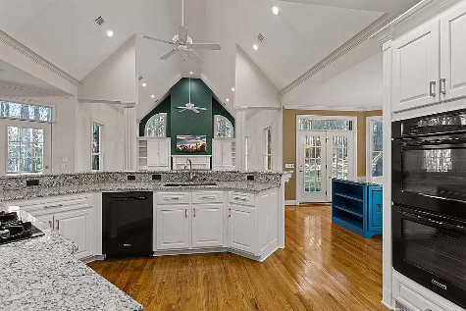
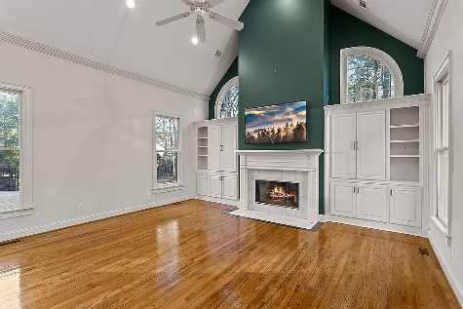
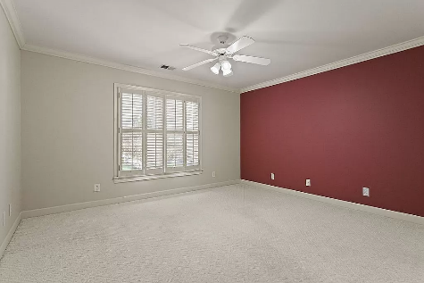
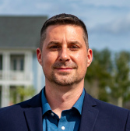
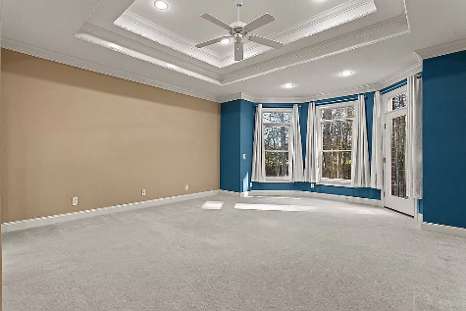
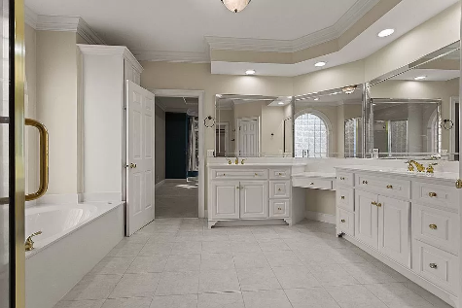
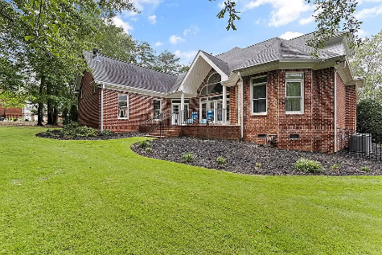
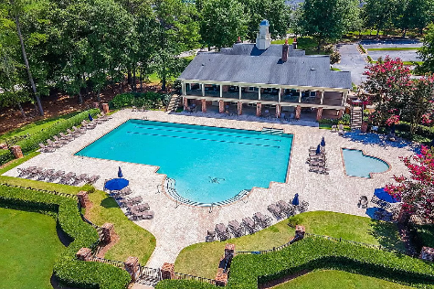
102 Regents Gate Ct
Kingsbridge
Simpsonville, SC 29681
Gated Executive Community
Open House
Sat 10-12 & Sun 10-12
4 BED
5 BATH
5,560 SF
$1,500,000
Escape to a world of beauty and tranquility as the circular driveway beckons to the upscale Kingsbridge custom home. The home sits on nearly an acre on a fenced wooded lot. Enter through double front wood and glass front doors, notice a beautiful crafted wrought iron and oak staircase to second level. Notice large rooms throughout the home. Kitchen boasts built-in cabinets, eat at kitchen granite bar or granite island. Walk-in pantry with plenty of shelves. Family room with more built-in cabinets has cozy gas fireplace. Charming living room has gas fireplace and double French doors to 2nd patio. Master bedroom has bay windows and door to the back patio. Walk-in master has abundant storage. Home office could be another bedroom by adding a closet. Oak floors grace all levels except carpeted bedrooms. Upstairs has three large bedrooms with walk-in closets, separate 3 baths, large bonus room and loft with built-in cabinets. Many rooms have wood plantation shutters. Garage and laundry room have built-in storage cabinets. The security gated Kingsbridge community provides an impressive club house available for parties. Other amenities include 4 tennis courts, pool and exercise room.
VIEW ZILLOW LISTING
FOR SALE BY OWNER
(908) 963-5976 | cforrest333@gmail.com
Matt Kimes
843-860-1669 | mattkimeshomes@gmail.com
www.mattkimeshomes.com

