Slide 1
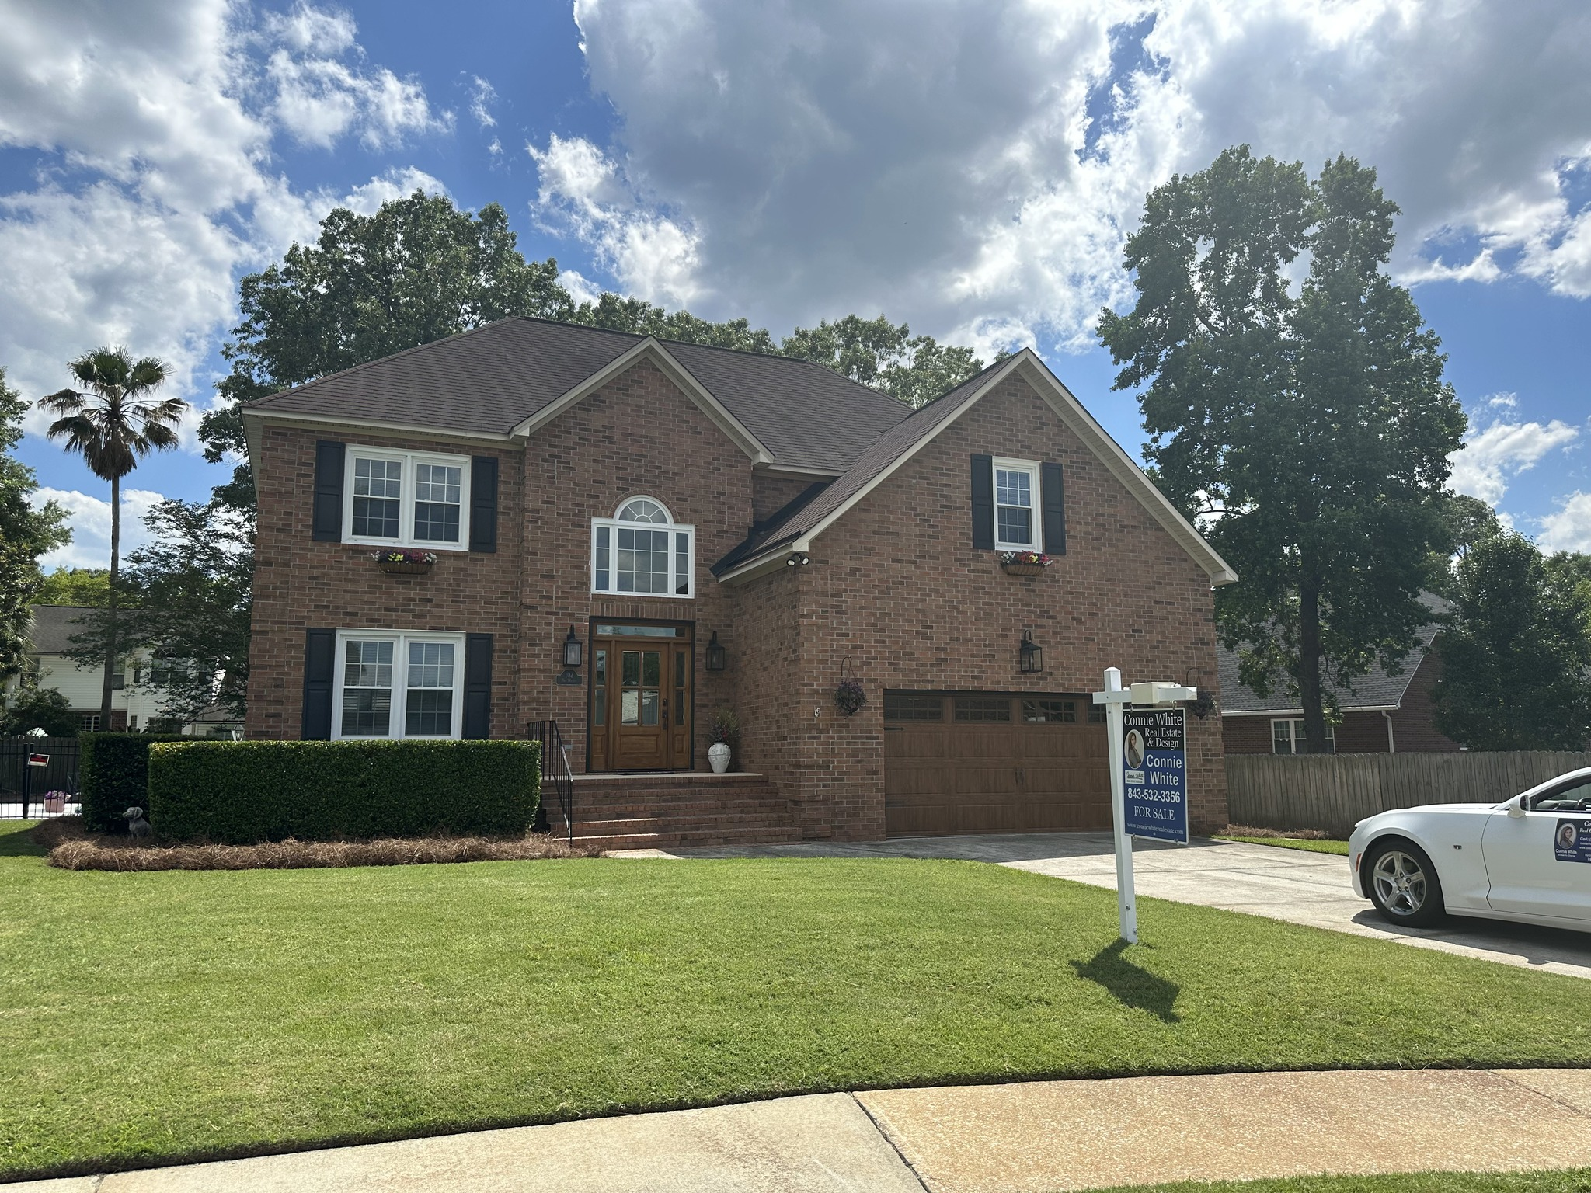


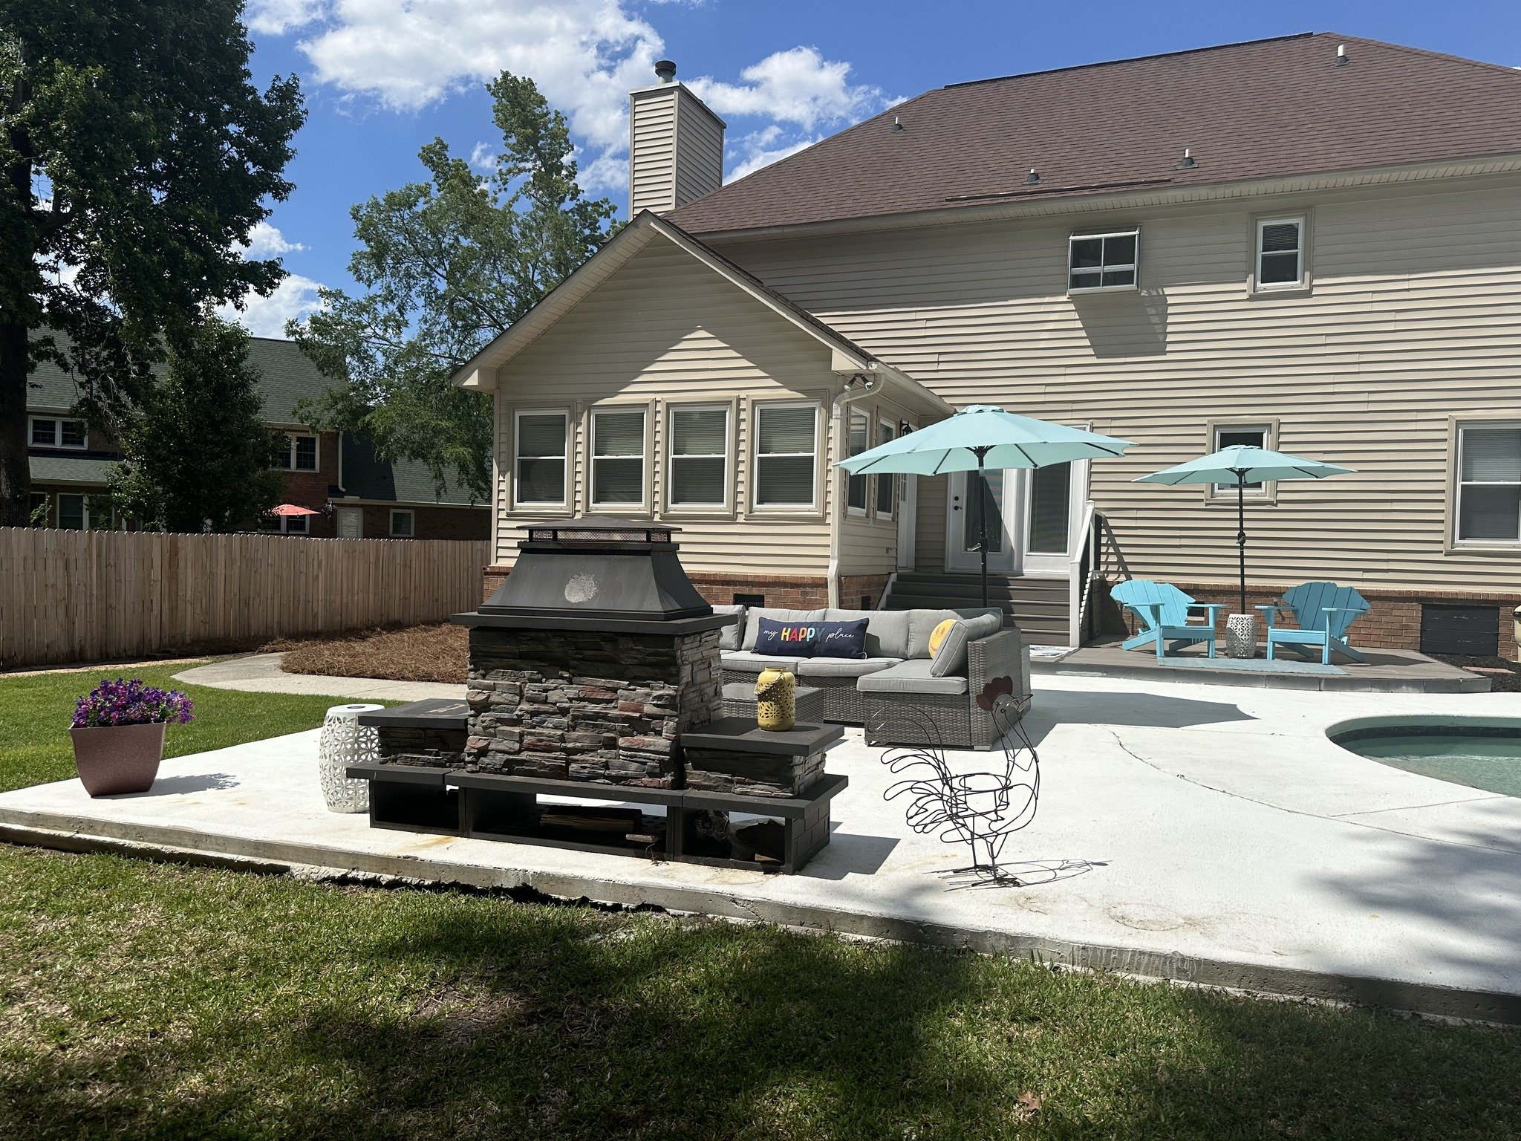
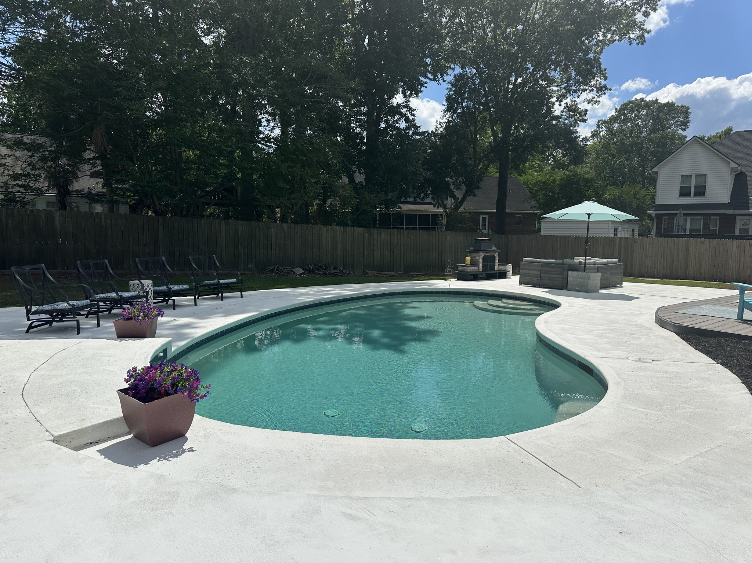
COMING SOON
102 SIX POINT CT
CROWFIELD | GOOSE CREEK
Connie White
843-532-3356
connie@conniewhiteteam.com
www.conniewhiterealestate.com

