Slide 1
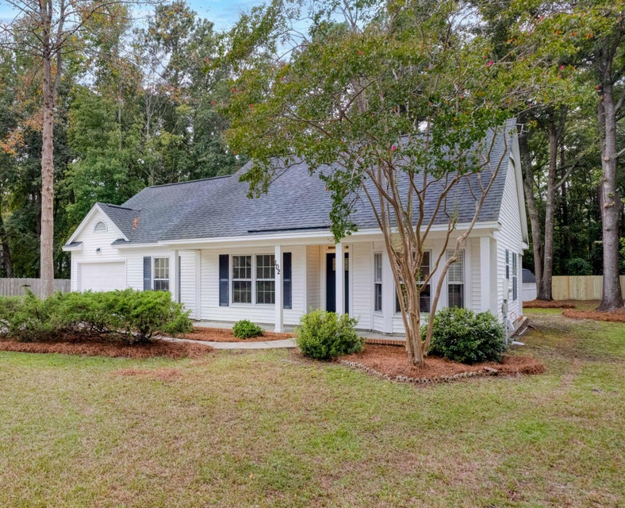
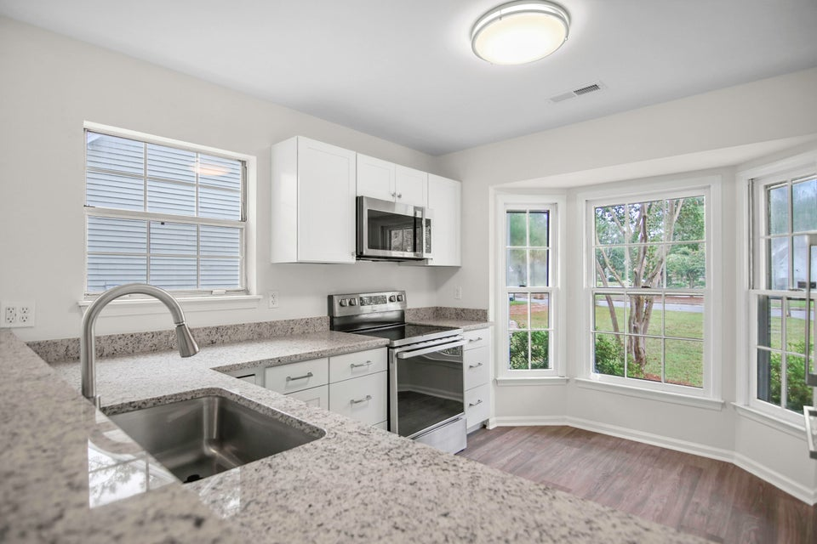
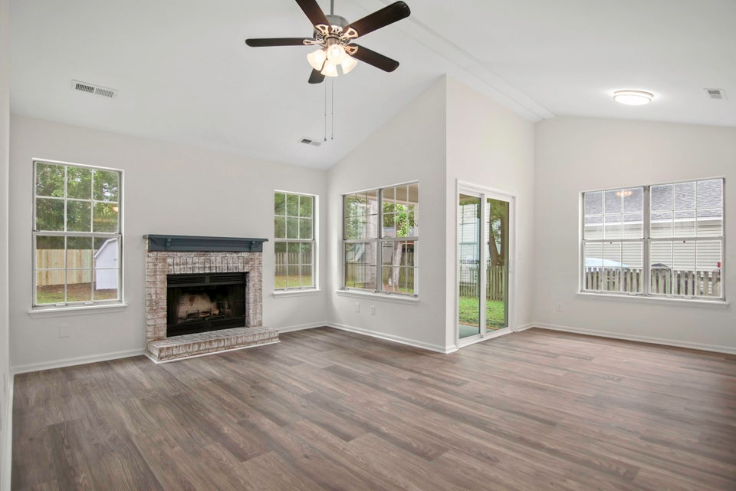




DISCOVER AFFORDABLE
CHARM AND COMFORT:
YOUR PERFECT HOME AWAITS!
102 St Benets Place
Summerville Place
MLS# 24023572 | $350,000
Fall in love with this charming 3-bedroom, 2-bath home located on a quiet cul-de-sac at 102 St Benets Place! This home features a beautifully restored kitchen with bay window, new custom cabinetry, White granite countertops, and brand new appliances. The interior highlights a high cathedral ceiling with fresh paint and new laminate flooring throughout. Two full bathrooms have been remodeled to fit your needs. The inviting living room includes a fireplace and new sliding door leading outside to a private patio. The large enclosed backyard is perfect for family activities, entertaining or peaceful, quiet enjoyment. Additionally, the enclosed garage serves as a versatile family room. Great schools such as Span, Alston and Ft. Dorchester are located nearby. Come by and see for yourself!
Susan Stanley
843-323-5573
susancstanley@gmail.com
1,500 SF
3 BEDS
2 BATH

