Slide 1
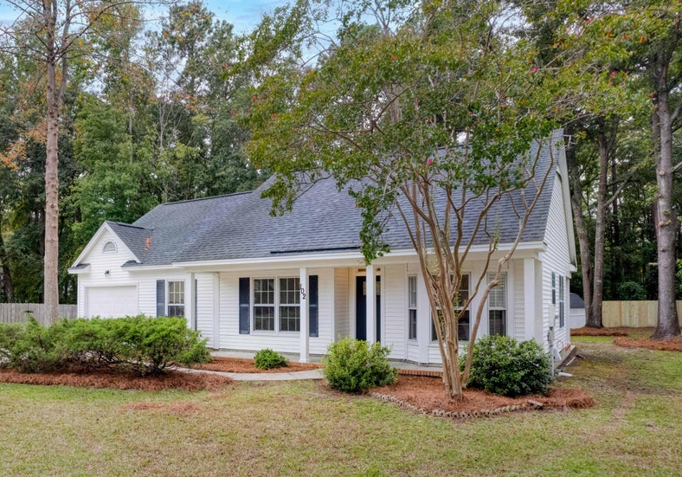
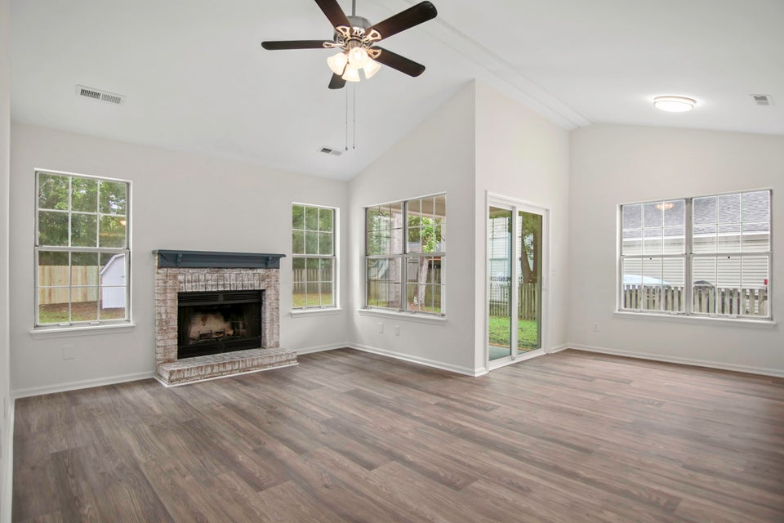
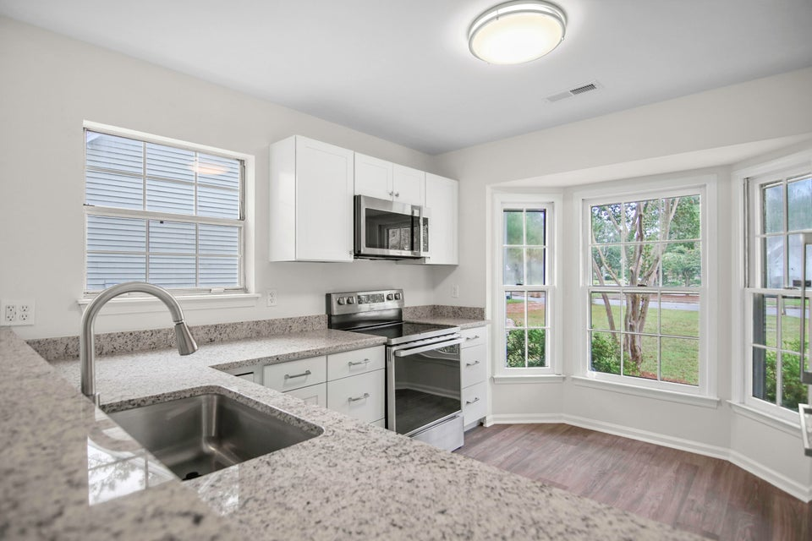
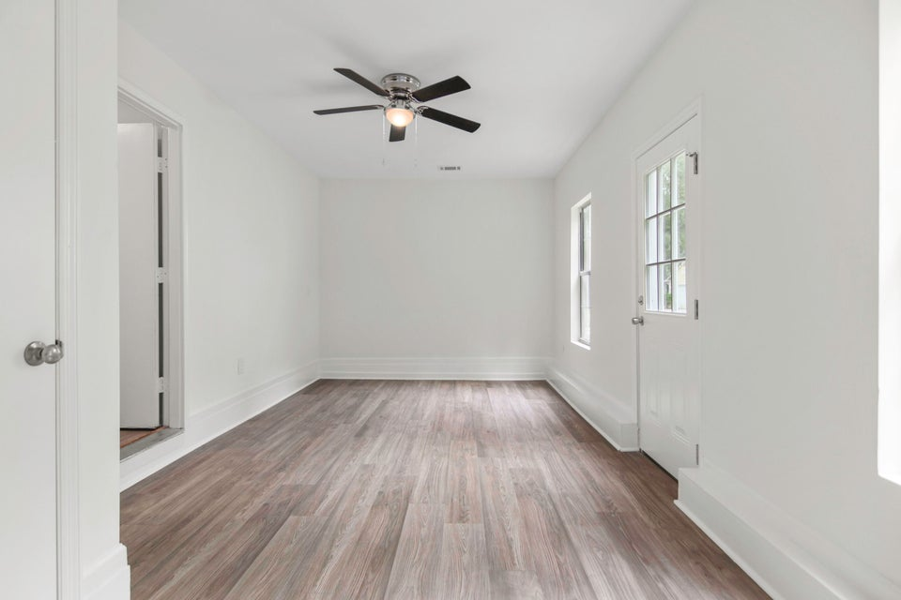
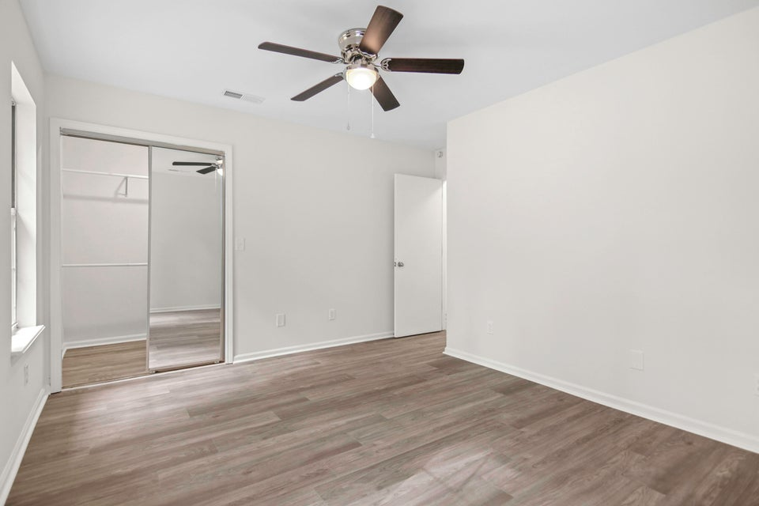




AFFORDABLE CHARM & COMFORT ON QUIET CUL DE SAC:YOUR PERFECT HOME AWAITS!
102 St Benets Place
Summerville Place
MLS# 24023572
NEW PRICE! $329,900
Welcome to this charming, fully renovated 3 bedroom, 2 bath home located on a quiet cul-de-sac at 102 St Benets Place! This home features a beautifully restored kitchen with Bay window, new custom cabinetry, ''Dallas White'' granite countertops, and brand new appliances. The interior highlights a high cathedral ceiling with fresh paint and new laminate flooring throughout. 2 full bathrooms have been remodeled to fit your needs. The inviting living room includes a fireplace and new sliding door leading outside to a private patio. The large enclosed backyard is perfect for family activities, entertaining or quiet, peaceful enjoyment. Additionally, the enclosed garage serves as a versatile family room. Great schools are located nearby.
Susan Stanley
843-323-5573
susancstanley@gmail.com
1,500 SF
3 BEDS
2 BATH

