Slide 1
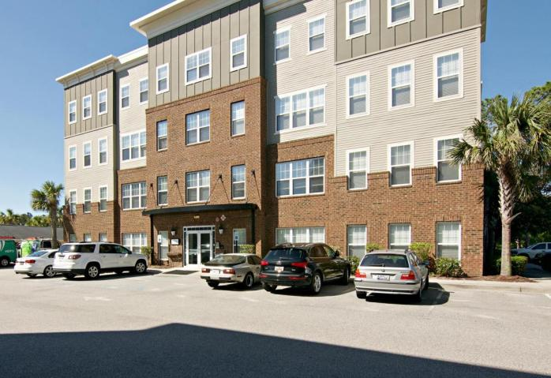
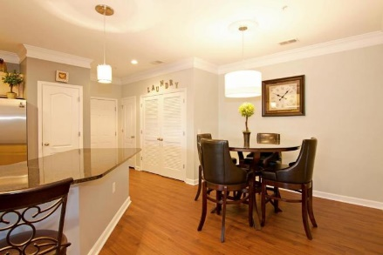
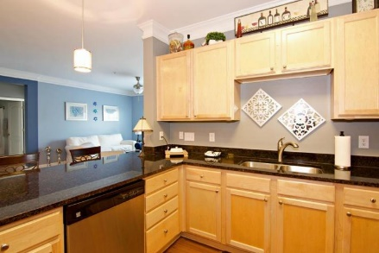
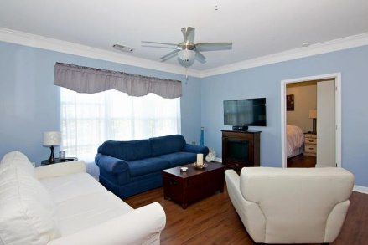
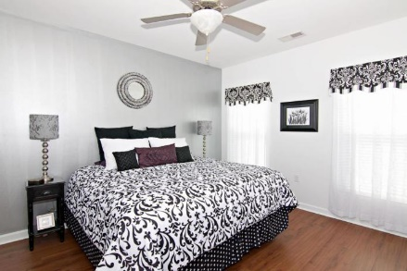
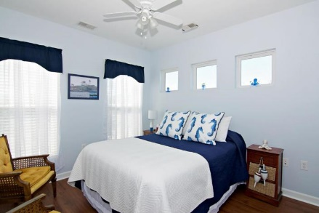
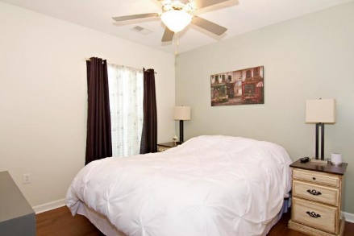
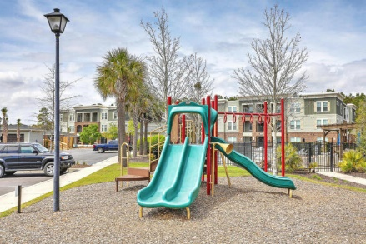
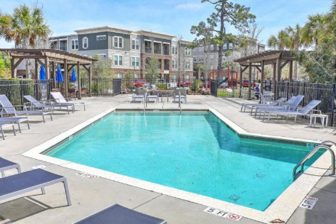


Limited Time Offer!!!
½ Off The First Month’s Rent With One Year Lease!
1030 Jack Primus Road #8306
Palmetto Place | Charleston, SC 29492 | MLS# 18026274 | $1,500
$25 monthly discount to Teachers, Firefighters, Law Enforcement and Military!
Come see this wonderful unit today! Beautiful luxury condo that lives like a house. Elevators to each floor - this is a 3rd floor unit. Large and elegant kitchen and breakfast bar with granite counters. Gorgeous wood laminate floors throughout....lovely crown molding.....dining area...Living Room with built in desk space....Large bedrooms and closets....2 full baths....open and spacious. Great space for entertaining and enjoying. New WASHER AND DRYER INCLUDED!
AgentOwned Charleston Group
902 Savannah Hwy
Charleston, SC 29407-7802
Listed By
Susan Weeks
(843) 813-0495
AgentOwned Charleston Group
Contact for Showings
Maryanne Maffei
917-468-8480
pleasantliving2020@gmail.com

