Slide 1
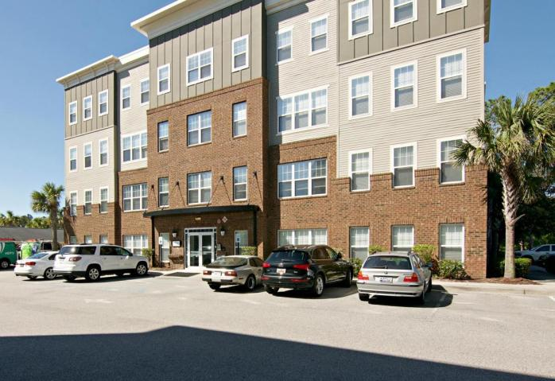
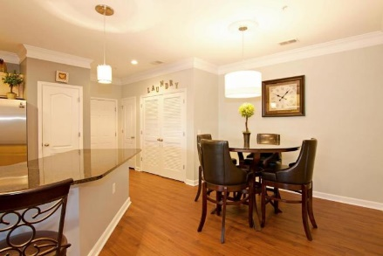
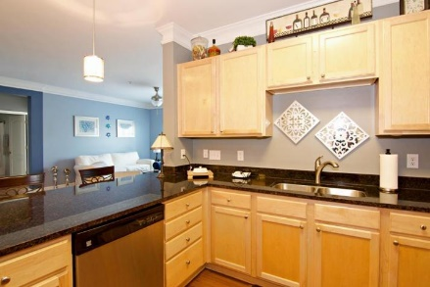
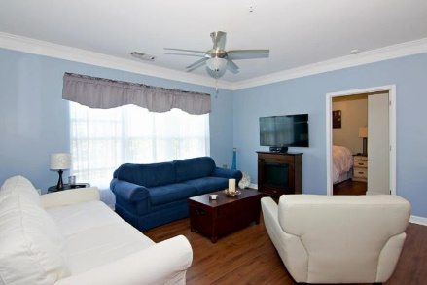
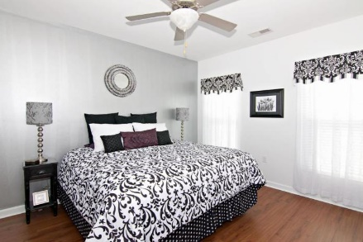
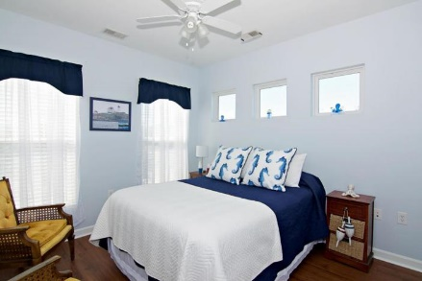
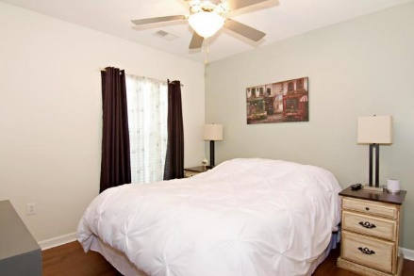
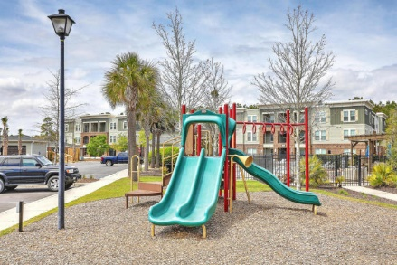
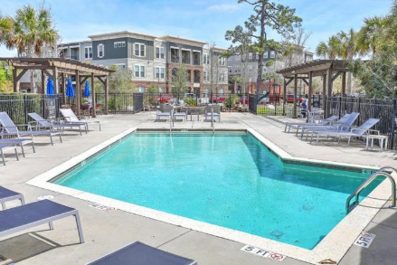


Spacious 3BR/2BA Charleston Condo!
1030 Jack Primus Road #8306
Palmetto Place | Charleston, SC 29492 | MLS# 18026274 | $1,500
Beautiful luxury condo that lives like a house.
Elevators to each floor - this is a 3rd floor unit. Large and elegant kitchen and breakfast bar with granite counters. Gorgeous wood laminate floors throughout....lovely crown molding.....dining area...Living Room with built in desk space....Large bedrooms and closets....2 full baths....open and spacious. Great space for entertaining and enjoying.
WASHER AND DRYER INCLUDED!
AgentOwned Charleston Group
902 Savannah Hwy
Charleston, SC 29407-7802
Listed By
Susan Weeks
(843) 813-0495
AgentOwned Charleston Group
Contact for Showings
Maryanne Maffei
917-468-8480
pleasantliving2020@gmail.com

