Slide 1
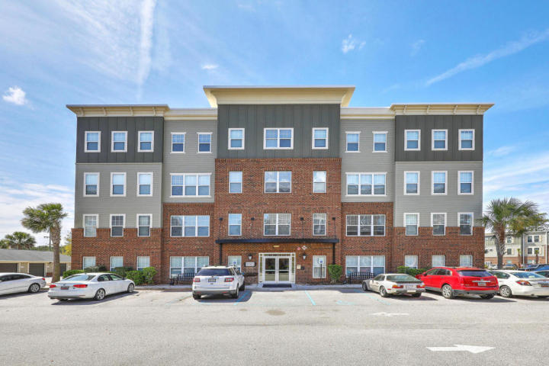
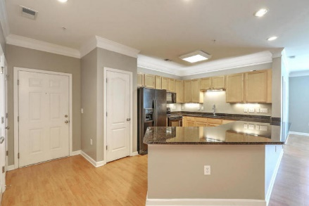
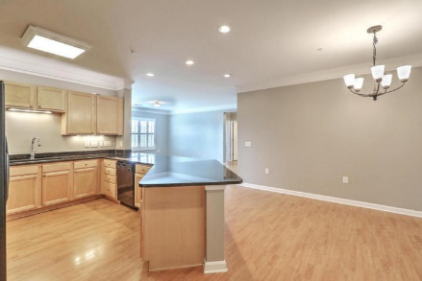
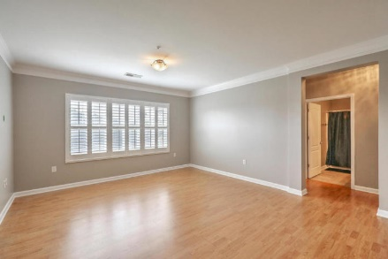
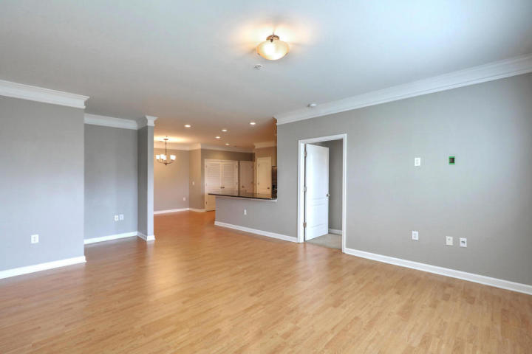
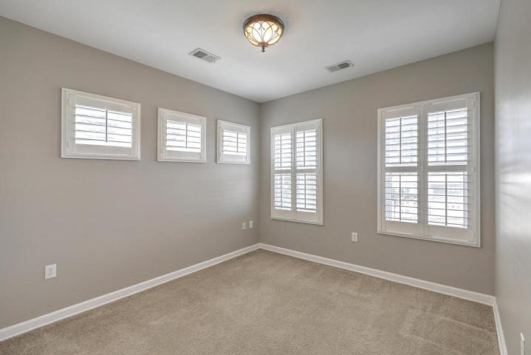
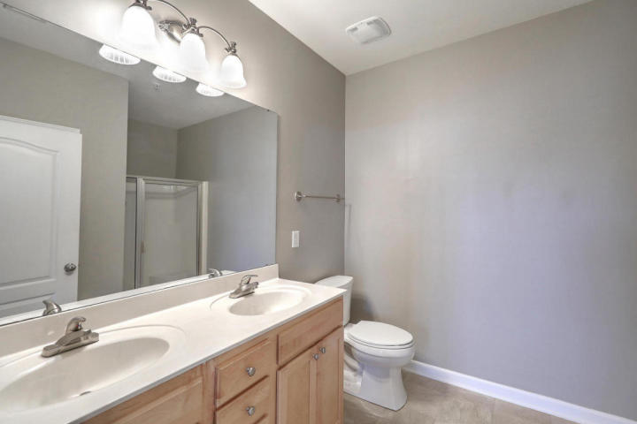
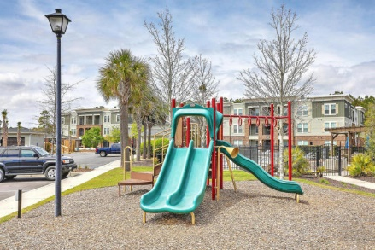
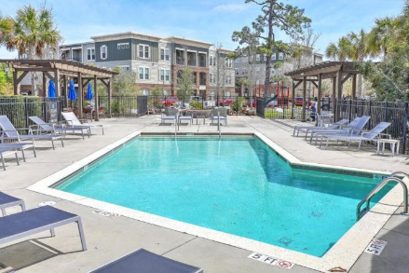


Spacious 3BR/2BA Charleston Condo
WITH GARAGE!
1030 Jack Primus Road #8403 + Garage
Palmetto Place | Charleston, SC 29492 | MLS# 18024469 | $1,600
Beautiful like-new condo that lives like a house. Roomy and tasteful. Large open kitchen with huge granite island. Large dining area, large living room. Bright and sunny. Custom plantation shutters on all windows. Wood laminate flooring in main rooms and carpet in bedrooms. Separate Laundry Room with cabinetry. Closet organizers in all bedroom closets. This is on the top floor for optimum privacy...with an elevator to get you there! Comes with a GARAGE too! For your car or extra storage and room for your toys! GATED community and neighborhood pool. Exercise area and club house. Maintenance included. Come see this lovely place...looks like a luxury hotel as you enter this Security Coded front door of the building.
AgentOwned Charleston Group
902 Savannah Hwy
Charleston, SC 29407-7802
Listed By
Susan Weeks
(843) 813-0495
AgentOwned Charleston Group
Contact for Showings
Maryanne Maffei
917-468-8480
pleasantliving2020@gmail.com

