Slide 1

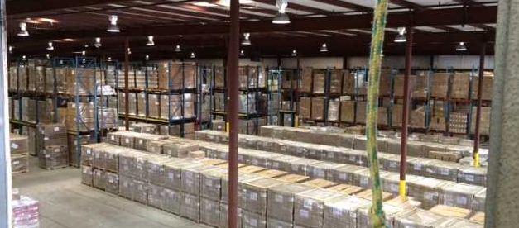
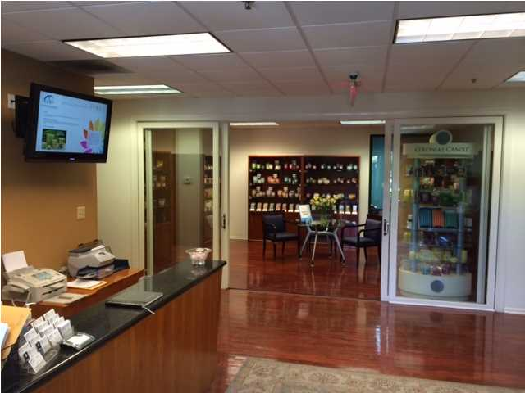
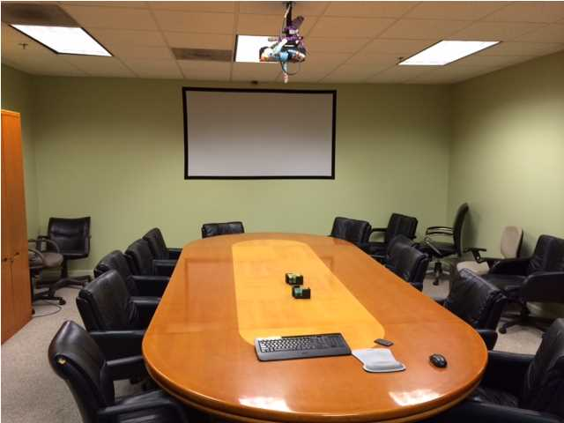
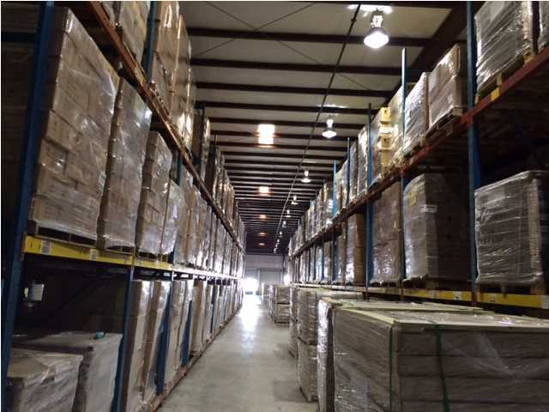
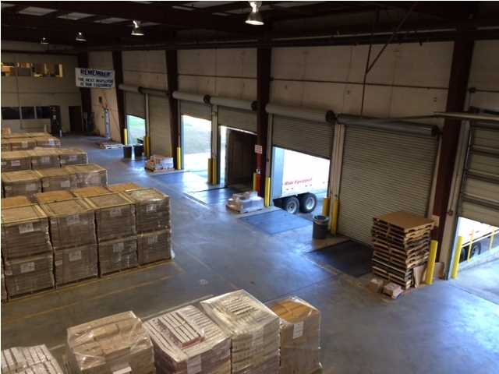


Great Corporate Headquarters Opportunity
Approximately 75,760 to 109,260 square feet for sublease and available immediately comprised of 18,520 sqft of office on two floors and 90,740 of warehouse. Building is in excellent condition, located in Berkeley County and is zoned for Industrial Use. Triple Net Lease with $1.10 per square foot pass through expenses. Less than half a mile from 526 and within 5 miles from I-26. See pictures and included media for more information. Site is just under 7 acres. Facility has 12 dock doors and 2 drive in doors. Rack systems are currently in place and may remain depending on terms. Wet fire system with 25' center and 21' eaves with 50' column spacing. Office space available from 1,520 square feet in the warehouse. Warehouse space available from 74,240+.
Warehouse is priced at $4.25/sf and the entire facility is priced at $5.75/sf.
Acres: 6.700
Address: 1031 LEGRAND BLVD
Area: BER-Wando/Cainhoy Area
Building Square Feet: 109,260
Category: details
City: CHARLESTON
County: Berkeley
Listing ID: 1416706
Lease Rate: $4.25/sf - $5.75/sf
Max Contiguous SqFt: 109,260
Minimum Div. SqFt: 75,760
Office SqFt: 18,520
Property Name: MVP

