Slide 1

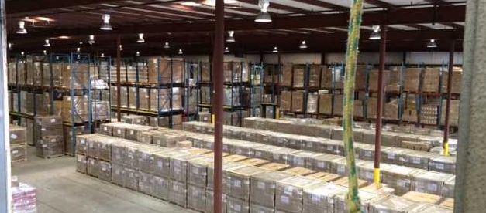
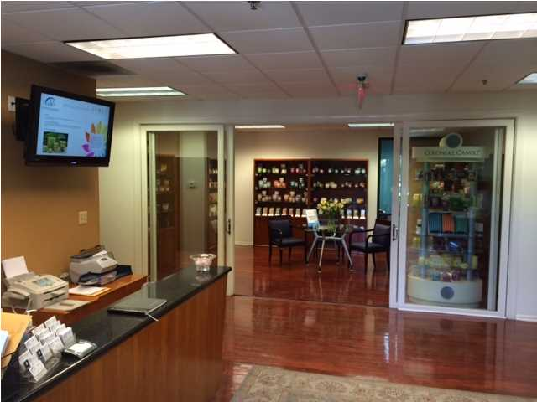
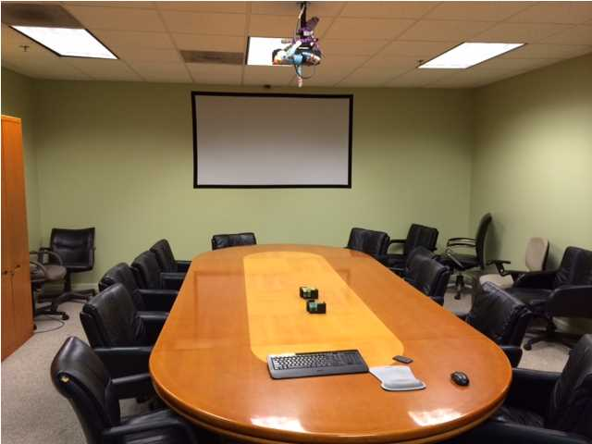
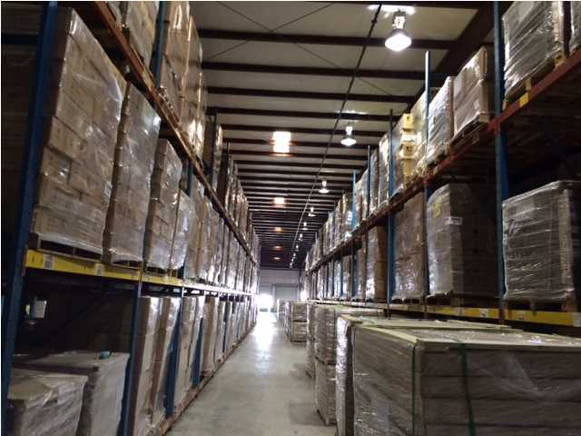
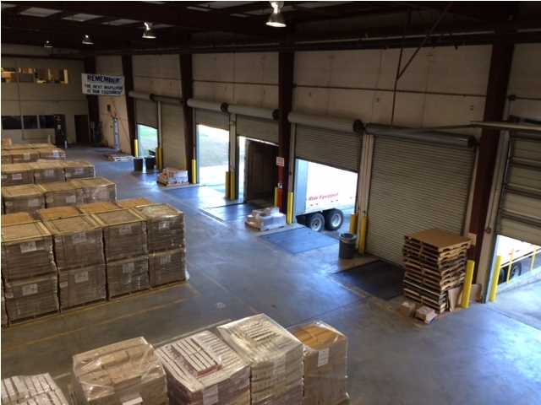


APPROXIMATELY 75,760+ SQUARE FEET FOR SUBLEASE AND AVAILABLE IMMEDIATELY
Building is in excellent condition, located in Berkeley County and is zoned for Industrial Use. Triple Net Lease with $1.10 per square foot pass through expenses. Less than half a mile from 526 and within 5 miles from I-26. See pictures and included media for more information. Current Tenant prefers to sublease 75,760 square feet. Site is just under 7 acres. Facility has 12 dock doors and 2 drive in doors. Rack systems are currently in place and may remain depending on terms. Wet fire system with 25' center and 21' eaves with 50' column spacing. Office space available from 1,520+ square feet. Warehouse space available from 74,240+.
Acres: 6.700
Address: 1031 LEGRAND BLVD
Area: BER-Wando/Cainhoy Area
Building Square Feet: 101760
Category: details
City: CHARLESTON
County: Berkeley
Listing ID: 1416706
Listing Price: $4
Max Contiguous SqFt: 101760
Minimum Div. SqFt: 75760
Office SqFt: 1520
Property Name: MVP

