Slide 1
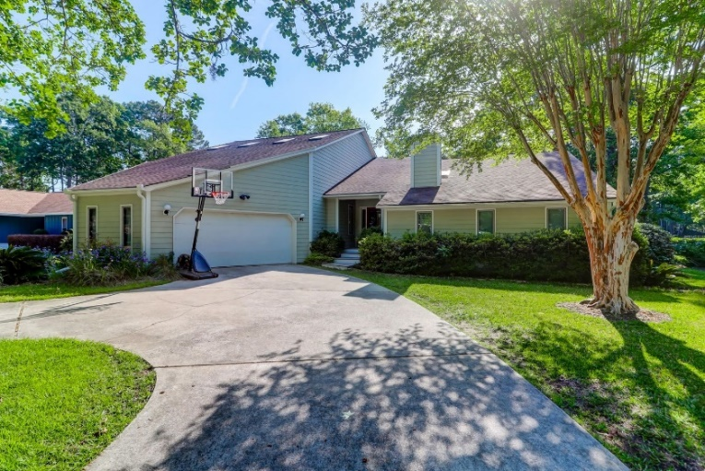
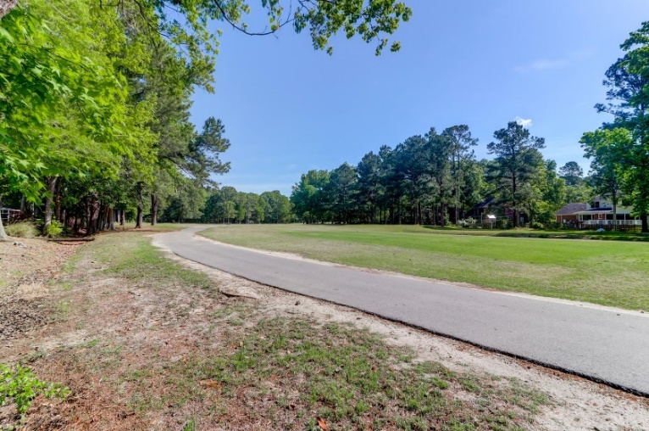
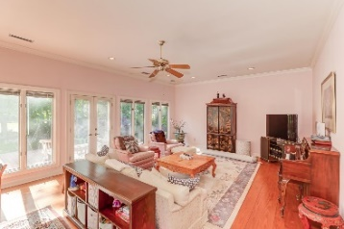
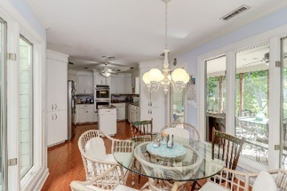
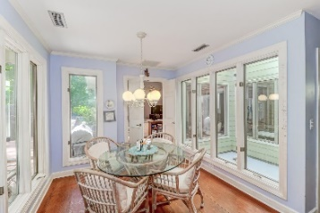
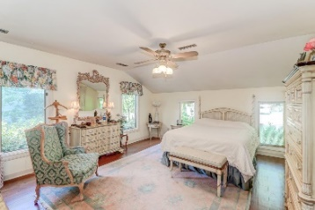
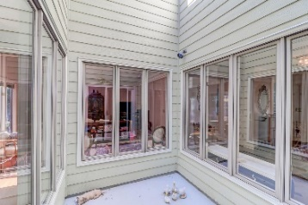
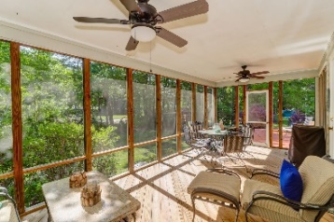
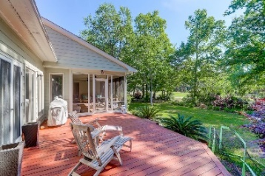
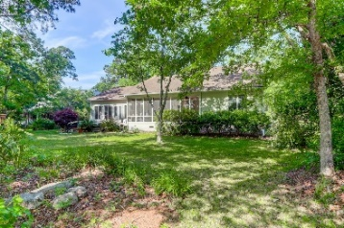


1031 Royalist Road Snee Farm :: Mount Pleasant, SC 29464 MLS# 21011955 :: $980,000
Golf Course Home In Desirable Snee Farm
Fabulous Snee Farm home located on the golf course in the heart of Mt Pleasant. This spacious home is over 4000 sq ft and perfect for entertaining friends and family. The first floor features a beautiful foyer with a slate floor and an atrium with skylights which is perfect for plants, a formal living room with hard wood floors and a fireplace, a separate formal dining room, a huge 17'x26' great room with lots of windows, sunlight and access to a large deck. The owner's suite features a private bath, ceiling fan and walk-in closet. The kitchen has an island, granite counter tops ,double oven, a smooth cook top and a nice eating area. The kitchen area opens onto a very large screened porch. There are 2 additional bedrooms on this first floor level and one is presently used as an office.
There is also 3 full baths, a laundry room and a door off the hallway that leads to the 3-car attached garage with a workshop area and plenty of room for a golf cart. You could easily live very comfortably on the first floor level. Upstairs is 2 additional bedrooms, one bedroom could be a second owners suite. This large bedroom has an adjoining room which could be a sitting room or an office. There is also a Jack and Jill bathroom and a very large storage room. This spacious home was built by the owner who was a noted engineer and has been in the same family since 1986.
Carolina One Real Estate 1503 Palm Blvd Isle of Palms, SC 29451
Bill Donovan Office - 843-886-8110
Mobile – 843-991-0146
donovans@carolinaone.com
Carolina One Real Estate
1503 Palm Blvd
Isle of Palms, SC 29451-2280
www.billdonovan.com

