Slide 1
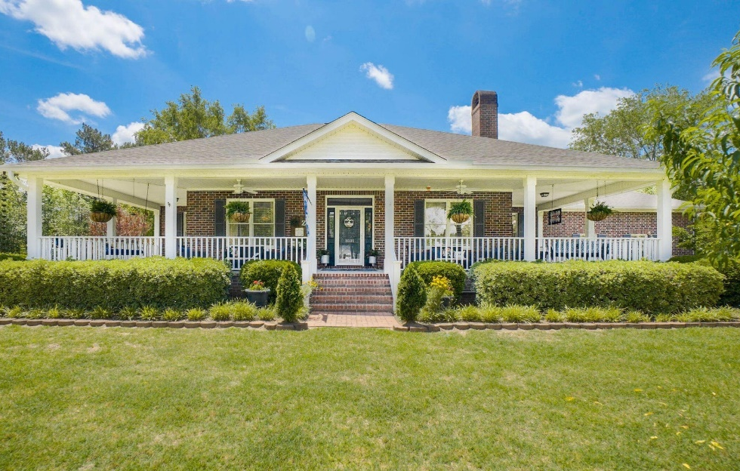
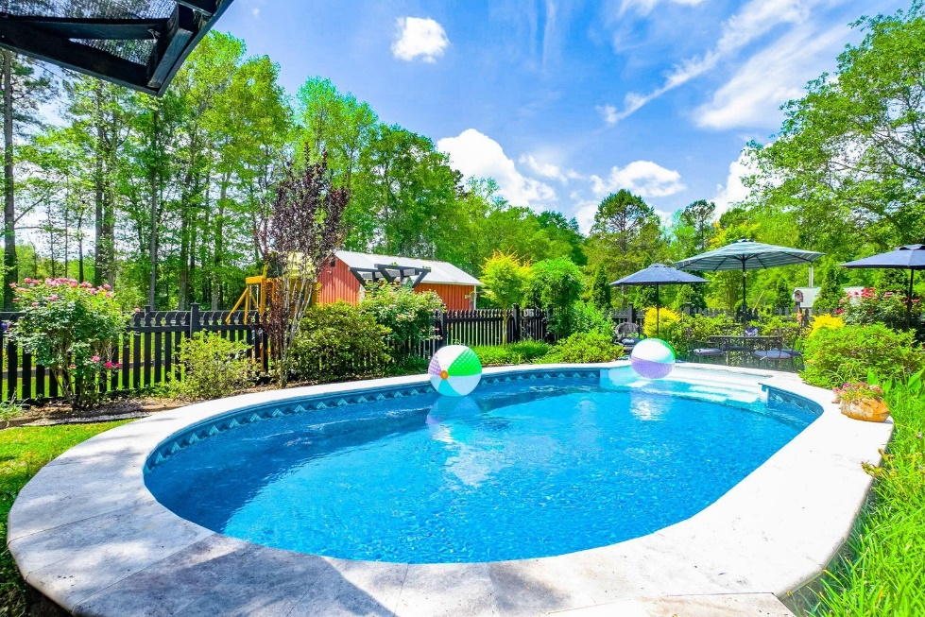







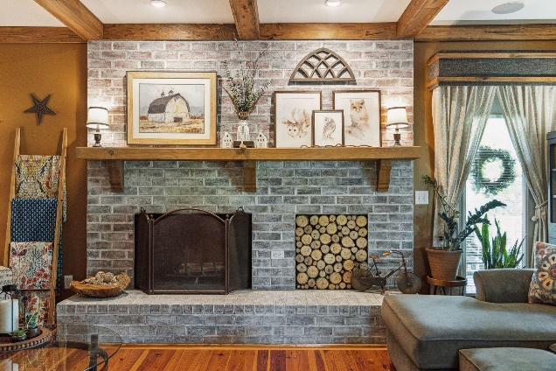
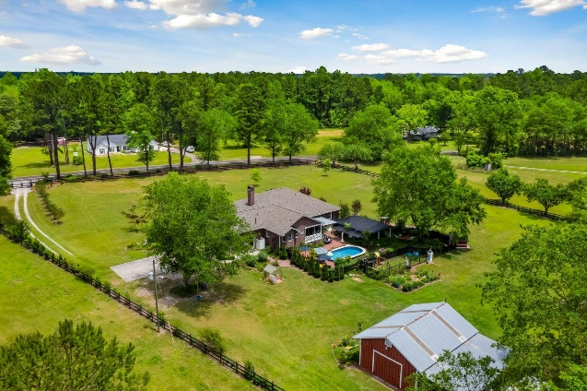
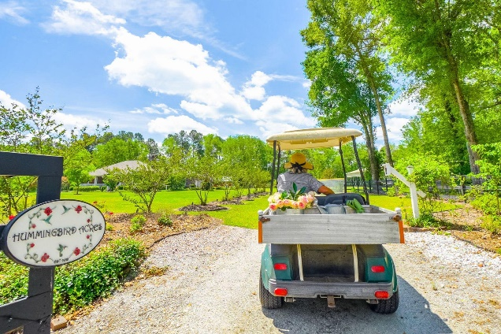
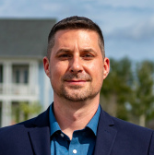
#23011388
Reduced $25k
Nearly 3 Acres with a Pool!
1031 Spring Hill Church Road
Ridgeville, SC 29472
Open House
Sat 10-12 & Sun 10-12
3 BED
2 BATH
2,226 SF
$775,000
Private gated oasis just listed 7 minutes from the Volvo campus in Berkeley County! This brick custom home is absolutely stunning and entirely move-in ready with 3 bedrooms, 2 bathrooms, separate dining room / living room / office space, family room with gorgeous brick fireplace and surround, separate eating area, gourmet kitchen with granite counter tops, double ovens, gas cooking, new stainless steel appliances, owner's retreat with custom details throughout, double walk-in closets, renovated owner's bathroom with a huge 6' tiled walk-in shower with double shower heads, bench, separate soaking tub, double granite sinks, beadboard, crown moulding and more! This is a split-bedroom layout creating privacy for everyone! The secondary bathroom has also been renovated with granite double sinks, tile flooring with a beautiful custom inlay and more! The laundry room has also been renovated with new tile flooring and washtub, in addition to a storage closet! There is another washtub in the side-load automatic garage as well! This 2.63 acre homesite is a dream and includes a saltwater pool, a cascading pond with pergola and brand-new shade cloths, fire pit, separate enclosed playground, pistol range, greenhouse, enormous barn with plumbing, water and electricity. There's also a lean-to for your RV with 30 and 50 amp hookups and concrete pad! The homesite is fenced, and there's an automatic solar gate at the entrance. The owners have also planted many fruit bearing trees and bushes throughout the property. They also installed a whole house generator as well as a secondary propane water heater, 250 and 300 gallon buried propane tanks, alarm system with closed circuit TV cameras, new roof (2022), new HVAC (2019), exterior propane grill hookup, gutters with downspouts and SO MUCH MORE! You'll absolutely love Hummingbird Acres so schedule your appointment today!
Video Tour: https://youtu.be/j3OC30jHCgs
Meg H. Kandik
843-814-5137
Meg@HolyCityRE.com
www.holycityre.com
Brand Name Real Estate
4 Carriage Ln
Charleston 29407
Matt Kimes
843-860-1669 | mattkimeshomes@gmail.com
www.mattkimeshomes.com

