Slide 1
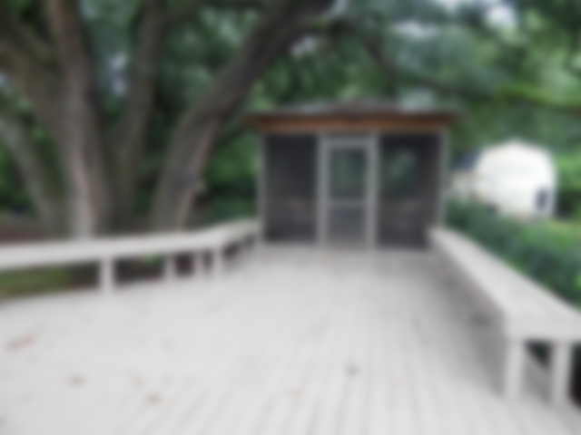
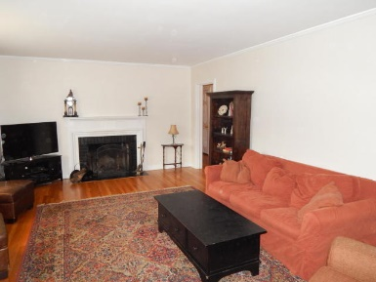
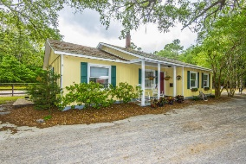
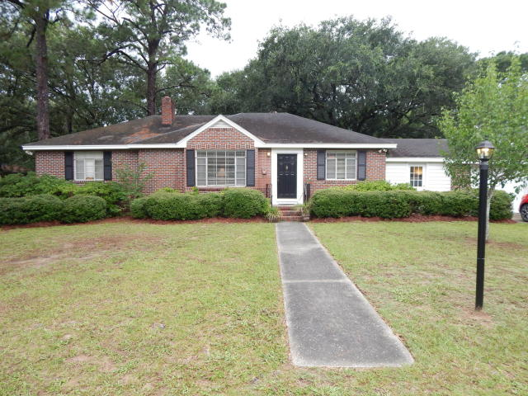
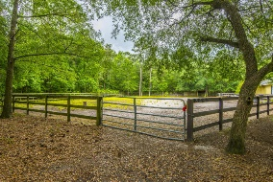
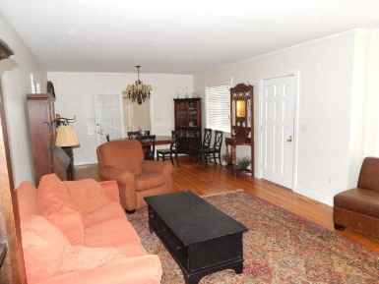
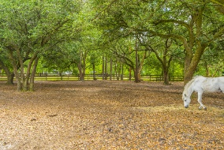
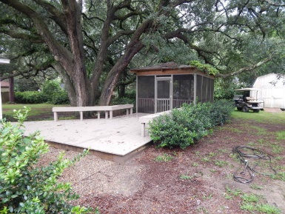
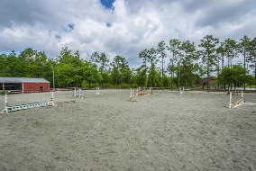
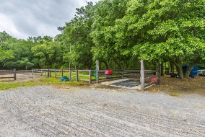
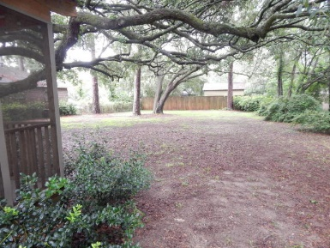
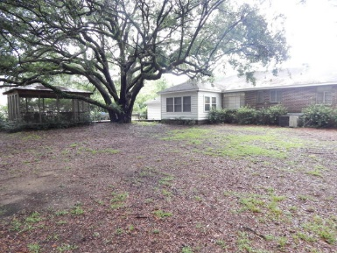
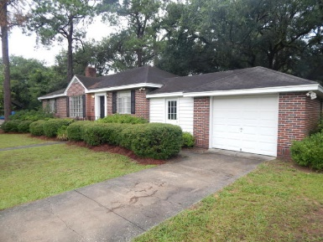

1032 Cliffwood Drive The Groves ~ Mount Pleasant, SC 29464 MLS# 17020159 ~ $527,000
3 Bedroom Brick Beauty
Over 1/2 Acre Lot!
Beautiful one story brick ranch style home in one of the most popular subdivisions in Mt. Pleasant. Home has an attached one car garage and a new deck and an enclosed separate screen porch with seating on both for entertaining. The home has oak flooring and tile in the de. The very large family room has a fireplace, as well. The yard is over a half acre and features gorgeous live oaks. The back yard is fenced for pets and children. There is also a shed for lawn equipment and tools, etc., with a drive-in ramp. The Groves is a very well established neighborhood and is centrally located in Mount Pleasant, with easy access to shopping and schools.
Carolina One Real Estate
2713 Highway 17 North
Mt. Pleasant, SC 29466
Terry Hamlin
(843) 830-3946
terry@thamlinproperties.com

