Slide 1
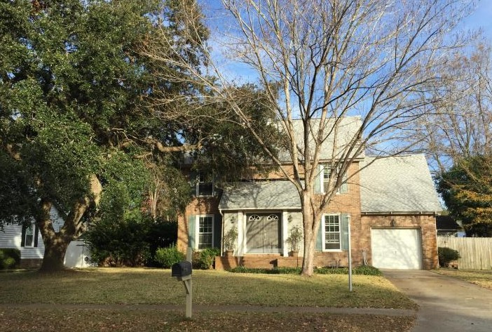
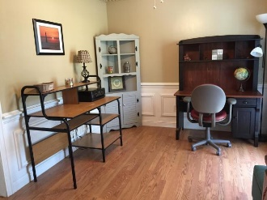
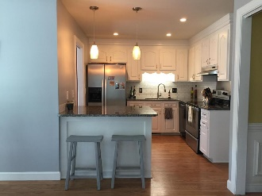
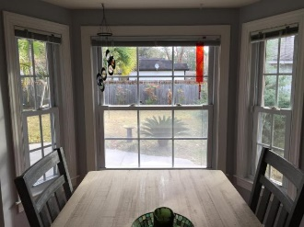
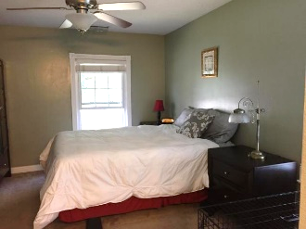
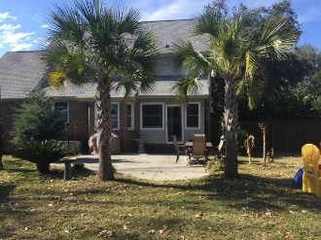



Great new listing in sought after James Island neighborhood
1032 Grand Concourse Street
Harbor Woods · Charleston MLS# 17001714 · $349,900
Marsha Allande
(843) 817-3370
scoceanlover@gmail.com
Beautiful well kept 2 story 3 bedroom brick and hardiplank home located in well sought after Harbor Woods subdivision. Huge old oak tree compliments the front yard. The spacious and inviting back yard is complete with 6’ privacy fence, a detached 24x28 garage to keep your boat, use as a workshop or just great man cave and a well, perfect for lowering your water bill. Ceiling fans throughout the home even on the back porch. The finished room over the garage provides extra space for a kids playroom or even for a fourth bedroom. Total remodel of the eating area along with a brand new island, new lighting fixtures, granite counter tops, granite sink and subway tiles in the kitchen.
AgentOwned Charleston Group
902 Savannah Hwy
Charleston, SC 29407
Real Estate ● Mortgage Insurance ● Business Brokerage

