Slide 1


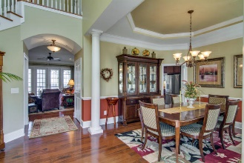
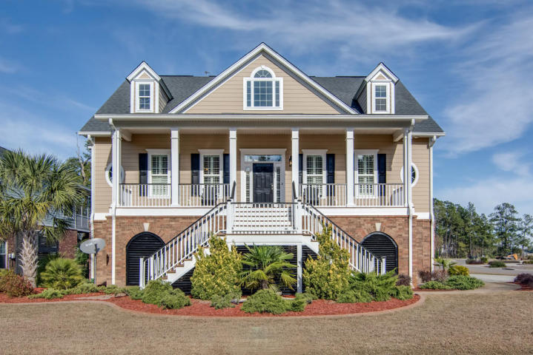

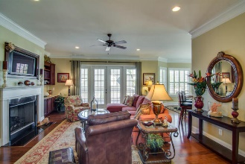
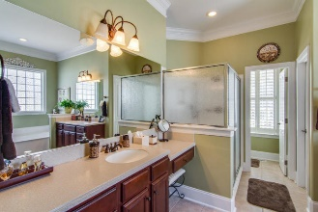
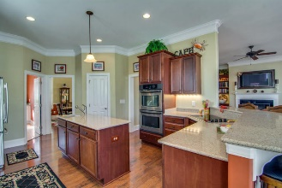
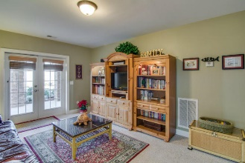
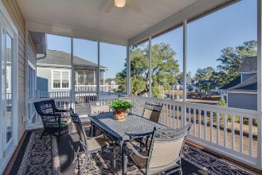
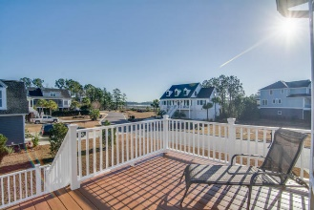
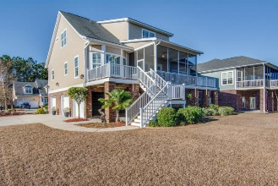
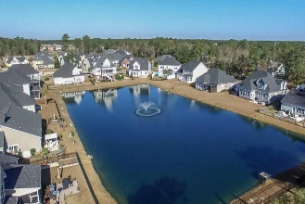
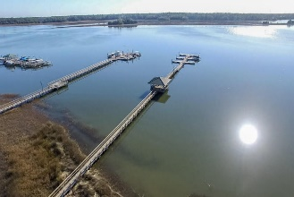

Beautiful Home in Waterfront Neighborhood
1033 Jervey Point Road River Reach Pointe ~ Charleston
MLS# 16031361 ~ $739,900
The neighborhood is directly on the Wando River with beautiful views, cool breezes and no through traffic. The locked community dock goes to deep water on the Wando. It is close enough to Mt. Pleasant to get to things but far enough away to avoid the traffic. The house is IMMACULATE - it looks like the house has never been lived in. It is a large house with an elevator to all three stories. There is a mother-in-law suite on the ground floor with a full bath and separate entrance. It can be used as another family room with a bed room. There is designer quality trim and appointments in all of the rooms -example, plantation shutters throughout the house. Three LARGE car garage. New outside paint Dec 2016. New community pool is in advanced planning now, land purchase agreements done.
Jim Heslep (843) 343-7188
jim.heslep@goldenbearrealty.com
Golden Bear Realty | 654 Coleman Blvd, Suite 100 | Mt Pleasant , SC 29464
Office (855) 352-9088 | Fax (561) 721-3311

