Slide 1
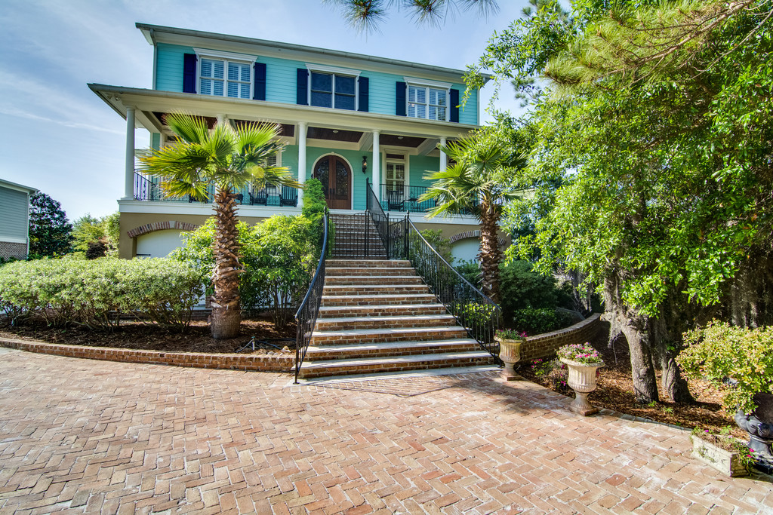
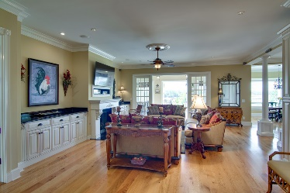
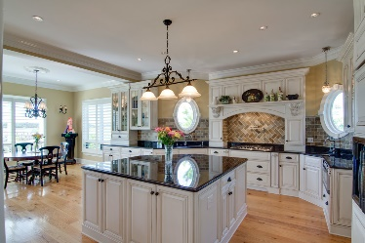
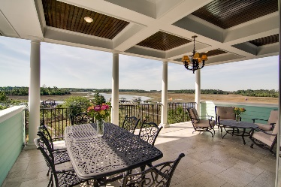
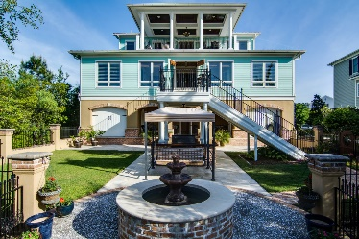
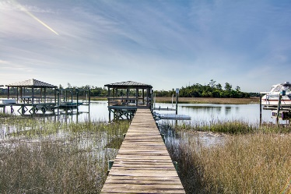
1033 Rivershore Road
Beresford Creek Landing ~ Charleston, SC 29492 ~ MLS# 16013148 ~ $1,490,000
Beautiful Deepwater
Elevated Home
Carolina Country Club, 367 Twin Oaks Drive, Spartanburg, SC
Deep water access elevated home w/ bright open floor plan, 5 bedroom! First floor master with lovely marble fireplace, built-ins & sitting room, with large expansive backyard enclosed w/ iron fence perched on stucco and century old Charleston brick, situated on largest deep waterway access lot in the community backing up to Nowells Creek. This lovely home planked with travertine covered porches & private dock & floaters providing scenic water and & Ravenel Bridge views, make for a true aficionado’s paradise. Built for entertainment, from circle brick driveway, your greeted w/ picturesque entrance way w/ wrought iron custom staircase awaits a perfect flowing traditional home for entertaining w/ fireplace, w/ extensive detail molding and trim w/ 10' ceilings / 8' doors both upstairs and down, recessed lighting. Ceiling speakers, central vacuum including connections to 3 car garage & porch, workshop. Man cave opens to backyard & covered porch leading to private covered dock and lift.
Immense kitchen w/ adjoining butler's pantry both equipped with abundant custom storage & built-ins, open to living room and enclosed sunroom, Upstairs: 4 large bedrooms, spacious office/entertain/bonus room w/ sweeping water & marsh views and a mega covered porch to entertain, relax converse. Inviting oversized groomed backyard for continued entertaining w/ built in grilling area, charming fountain, lounging covered porch & marble/travertine patio, separate fire pit area, covered dock equipped w/ 10k lb lift, lighting & power. Elevator shaft to all 3 levels, galvinzed metal roof, some steel beam construction, spray foam insulation, 3 Carrier system, sprinkler lawn system, 14K house generator, 2 tankless water heaters separate water meter for irrigation.
Neighborhood amenities: Club house, pool &, grill area with FP, playpark, boat storage, community dock, tennis court, Enjoy being close to everything.
Stephen Toop
(910) 791-2829
unitedbrokers@eastnc.twcbc.com
United Brokers LTD

