Slide 1
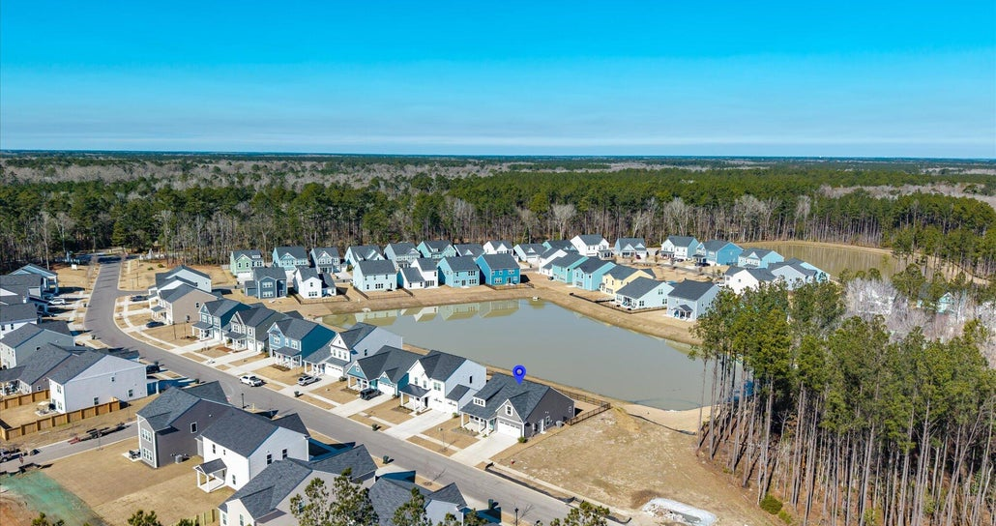
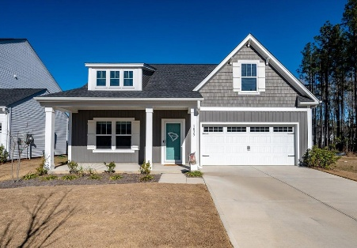
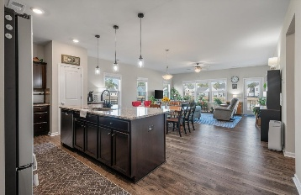
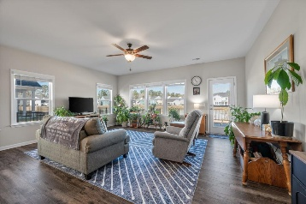
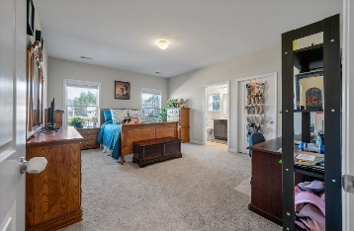
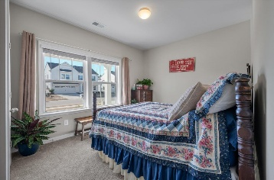
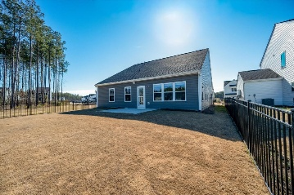


Single Story Under $390
Pond Lot w/ Fenced Yard & 2 Car Garage DD2 Schools
3 Bedrooms
2 Baths
1,572 sqft
Built New in 2025
AI Generated
1033 Marsh Harrier
Homecoming | Ravenel, SC 29470 | MLS# 26002414 | $389,900
Built brand-new in 2025, this charming single-story home is truly move-in ready and designed for easy, comfortable living. Offering 3 bedrooms and 2 full bathrooms, the home sits on a premium pond lot with no house directly behind, and added privacy on the right side and wooded views. This creates an open and private feeling. The interior is finished and ready from day one, featuring two-tone paint and blinds throughout. The spacious primary suite including bathroom, closet, and hallway are designed with extra-wide 3-foot doorways, providing excellent accessibility and flexibility for long-term living. This pet-free home has been well cared for and requires no additional upgrades. Existing highlights already in place include a tankless hot water heater, whole-house water filtration system, gutters, and storm doors on both the front and back doors, items that are often additional charges onto the base price you would need to pay extra for in new construction, but included and done on this house! The fenced backyard with patio offers a private outdoor retreat, while the 2-car garage is finished with an epoxy floor, fully insulated walls, and fresh paint. Ongoing interior and exterior pest control service is already established, and multiple builder warranties remain active. Notable upgrades already completed include a fenced yard at a cost of $4,600, a whole-house water filtration system at $3,000, and an epoxy garage floor at $2,500 saving the buyer time, money, and the hassle of post-closing projects. This move in ready home also makes an excellent 'lock it and leave it' house for part time occupancy, or full time living with a flexible travel lifestyle. Convenient to everything downtown Summerville offers and Dorchester District 2 Schools. No flood insurance currently required. Clean and easy to show, this home checks a lot of boxes and sits on an incredible lot! Neighborhood amenities include pool with neighborhood trail access without getting on the main road, pickleball courts, play ground, fire pit, and corn hole.
Jerod Coulter, ABR, REALTOR
843-513-3741
jerodcoulter@gmail.com
The Boulevard Company, LLC | 35 Broad Street | Charleston, SC 29401

