Slide 1
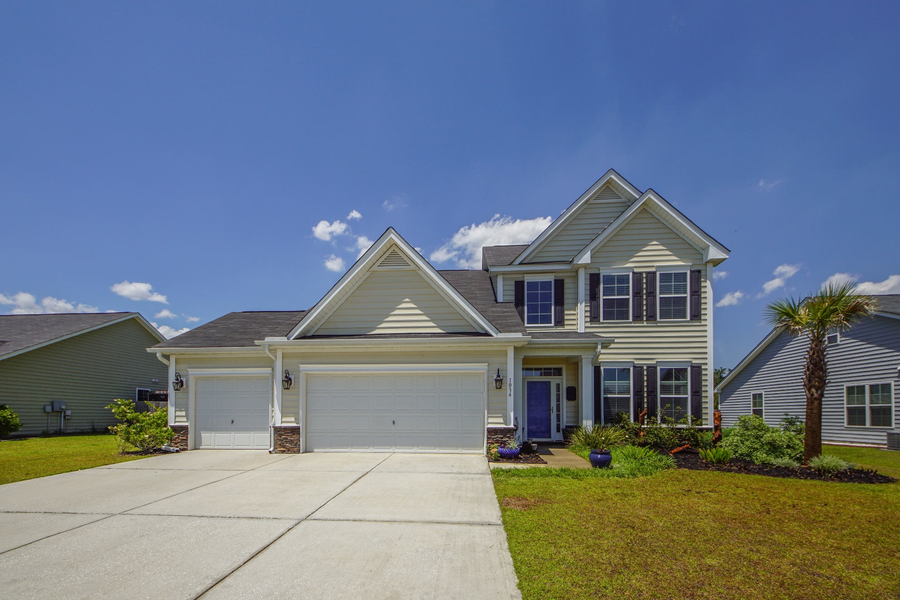
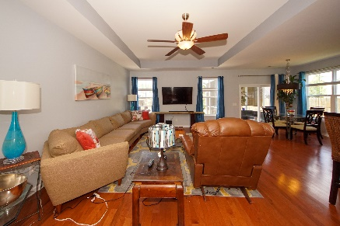
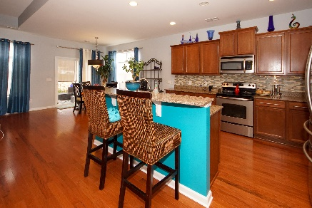
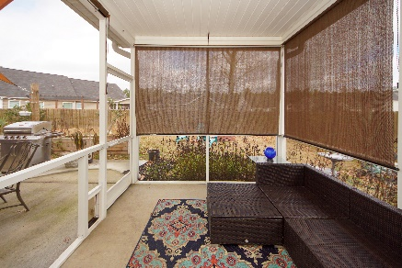


1034 Bridlewood Farms Parkway Bridlewood Farms :: Ridgeville, SC 29472 MLS# 20000333 :: $292,500 5 Bed / 2½ Bath
Must See…Must Own!
Reduced!
Spectacular 5 bedroom home with a 3 car garage!
New owner will take advantage of the upgrades seller selected with new construction! Master bedroom down stairs, wood flooring, granite counter tops, open concept, screen porch and more!
Upstairs are 3 bedrooms with a 4 bedroom/bonus perfect for an extra living space or pool room utilized by this seller.
Space, upgrades situated on an over sized lot make this home a must see and must own!
Connie White, Broker
843-532-3356
connie@chrepros.com · conniewhiterealestate.com
Charleston Homes · 597 Old Mt. Holly Road · Suite 301 · Goose Creek, SC 29445

