Slide 1
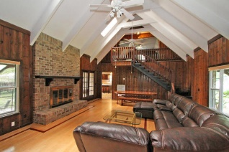
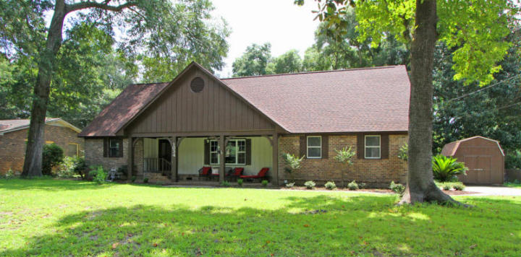
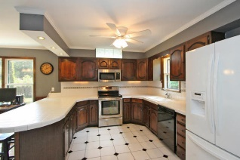
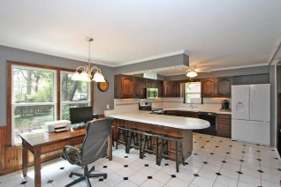
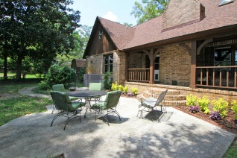
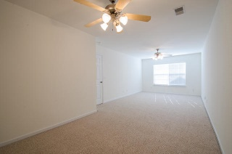
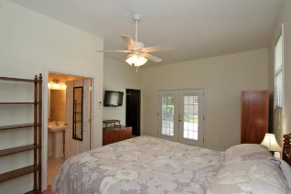
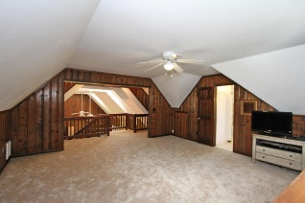
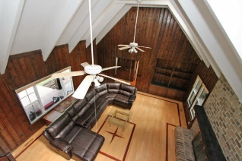
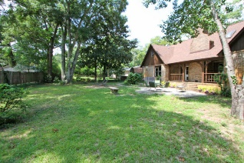
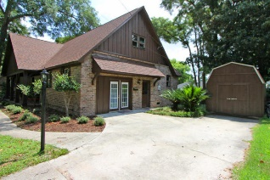


1034 Chambers Lane
Cooper Estates :: Mount Pleasant :: MLS# 15021577 :: $525,000
Cooper Estates Home with Mother In-Law Suite
Cooper Estates 4 Bedroom 3 Full Bath Home with Character. If you’re looking to get away from the classic cookie cutter homes, come see this Lovely Home with a Very Versatile, Open Floor Plan. Located on a quiet cul-de-sac street and situated on a .33 Acre lot, this Beautiful Move-In Ready home offers Hardwood Floors throughout the Foyer and Downstairs Living Room. Soaring Two Story Cathedral Ceiling with Knotty Pine Surround Encompass the Large Living Room with Gleaming Hardwood Floors, a Wall of Windows, and an elegant solid brick Fireplace as the center piece. Recent notable Improvements Include New Roof in 2013, New HVAC in December of 2011, and All New Windows in 2010. On the Left side of the house are two bedrooms, both of generous size and New Paint, amble closet space, and the first of three full baths in the home. This bath has new flooring, double sinks, and Fresh Paint. An enormous Kitchen with tile flooring, Stainless Steel Range and Microwave, Large Cabinetry, Separate Bar Seating as well as an Eat-In Area, and views of the Backyard. Off the Kitchen is another Bedroom with Full Bath and direct outside access through a private door, making this a very flexible room option for a Private Mother-In Law Suite, Home Office with Private Entrance, or even another Master Bedroom. The 4th Bedroom is the only room upstairs and is extremely large. This room could also serve as a Master Bedroom giving the home dual masters up and down, or it's perfect for a playroom, teenager retreat, home office, etc. The garage has been enclosed (2011), but of course can be turned back into a garage if desired, or keep as is for the current flexible floor plan that is rare in this location. Relax on the back porch overlooking a fantastic fenced in backyard with mature trees, landscaping, and patio. The secluded backyard has room for a pool and the porch is easy to enclose or screen in if needed. A detached Storage Shed Conveys with the Home for extra storage. Fresh Paint on the Exterior and much of the Interior. Very Clean and Well Kept. 1034 Chambers is on a quiet cul-de-sac with no busy traffic to worry about, and in 2 right hand turns you can be on Coleman Boulevard looking at Shem Creek. Private Community Boat Landing into Shem Creek for Residents Only.
Jerod Coulter
Office - 843-284-1800
Cell - 843-513-3741
Jerod@Realtor.com
www.HomesOfMountPleasant.com
Carolina One Real Estate
2713 Highway 17 North
Mt. Pleasant, SC 29466

