Slide 1
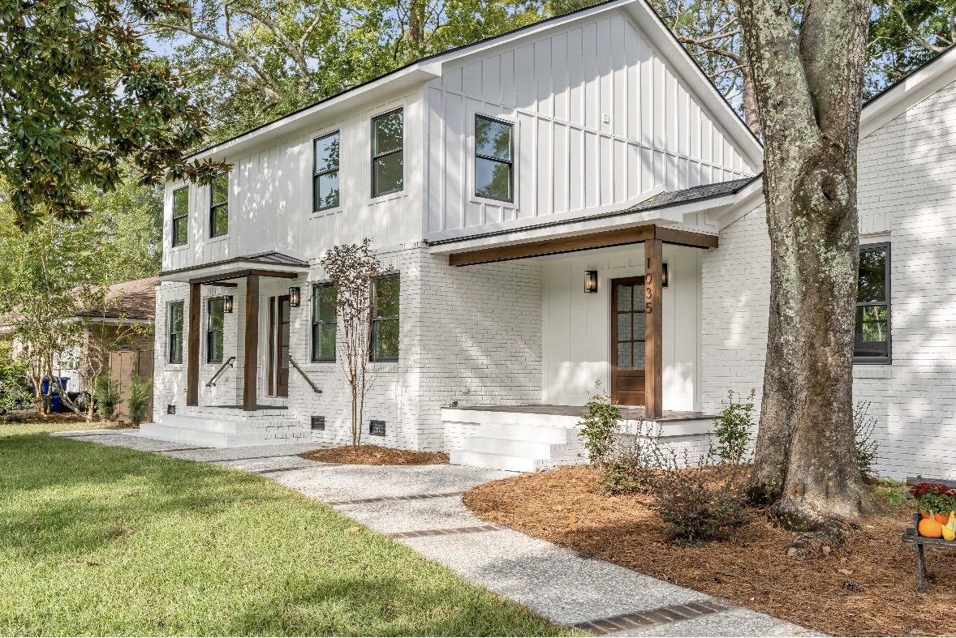
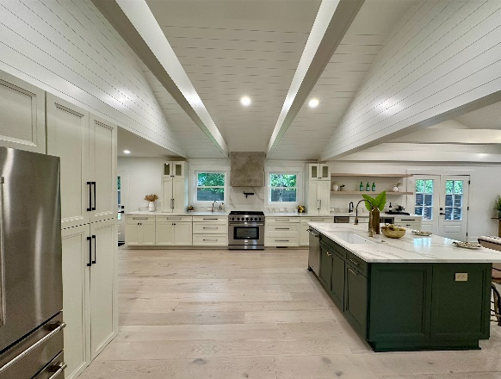
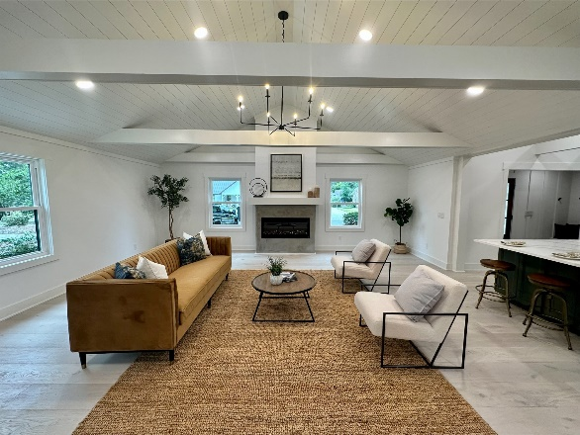
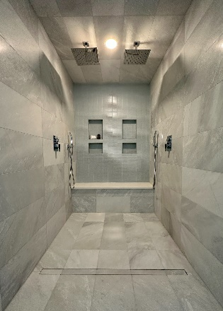
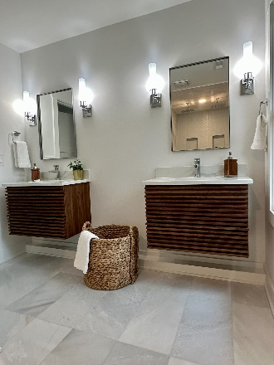


Gorgeous Renovated Home, Close To Everything
1035 Chambers Lane
Cooper Estates | Mt Pleasant, SC 29464 | Offering at $2,100,000
No expense spared in this massive renovation; 5 bedrooms and 4 baths, over 3000 sq ft, new everything, dual master suites, extremely functional open floorplan, on a huge lot just steps to Shem Creek.
Open House Saturday 12-2 but can show anytime.
Justin Natale
843-437-9739 | jnatale1982@gmail.com
www.theblvdcompany.com
The Boulevard Company, LLC | 806 Johnnie Dodds Blvd Ste 100 | Mt Pleasant, SC 29464
Going in the MLS tomorrow. Reach out to agent for showings if it's not in showing time yet

