Slide 1
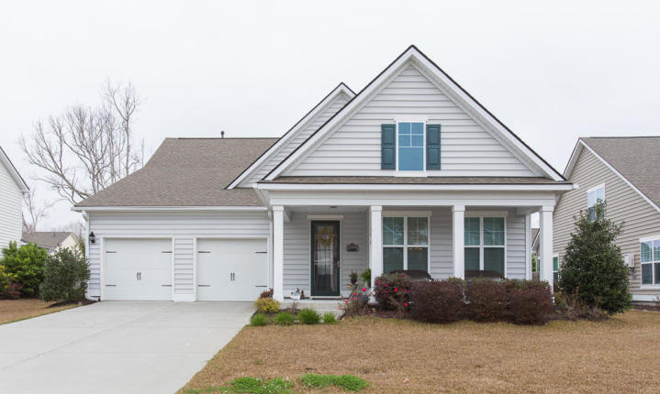
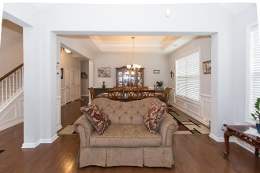
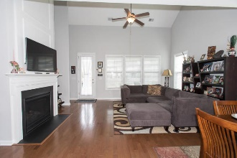
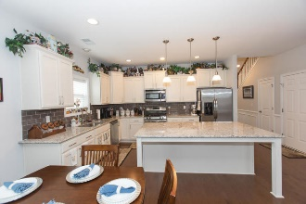
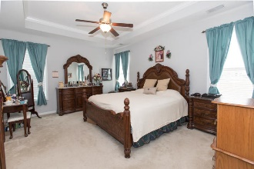
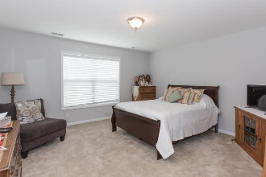
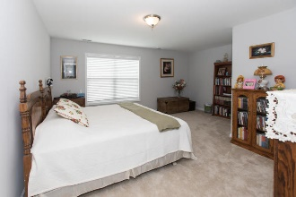
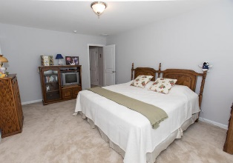
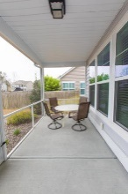
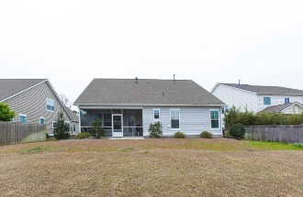


1038 Harbortowne Road Harbor Woods Charleston, SC 29412 MLS# 19005450 $550,000
Welcome to the Desired neighborhood of Harbor Woods. Open floor plan with Master down and another bedroom or office on first floor. Downstairs, at the front of the home is a beautiful formal living with vaulted ceiling. adjacent to the living room is the formal dining room with tray ceiling. The kitchen is equipped with stainless steel GE appliances, a pantry, granite countertops, and a Huge eat in island overlooking the family room with gas fireplace. Off the family room is a screen porch overlooking the back yard. On the second floor you will find two large bedrooms and a bath. Also upstairs are two massive, easy access, unfinished storage areas. Very convenient location, about 10 minutes to downtown Charleston and 10 minutes to Folly Beach. Thank you for showing.
Open House
Saturday & Sunday 2-4 pm
Cathy Rosenblum
843-817-7869
crosenblum@comcast.net

