Slide 1
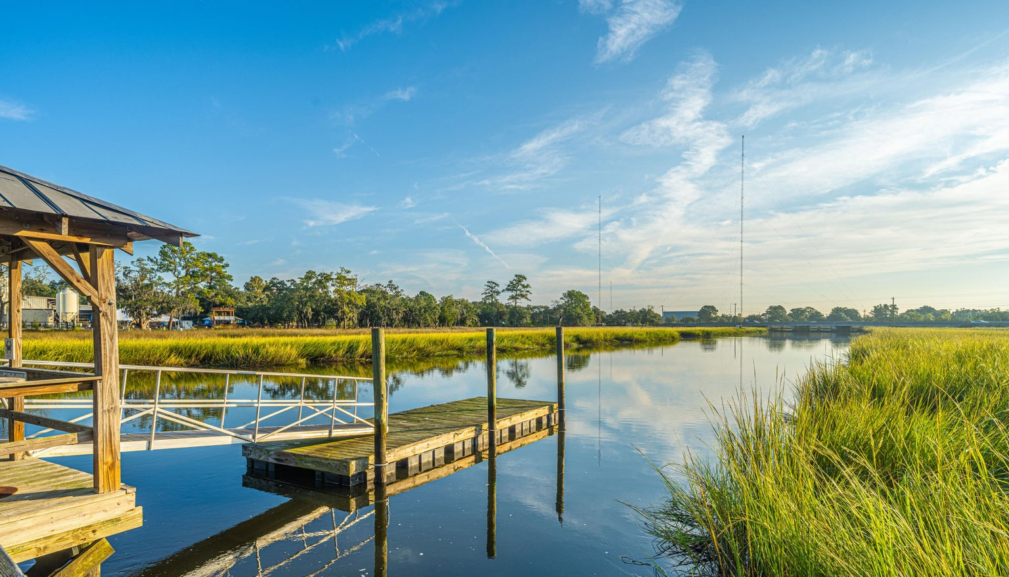
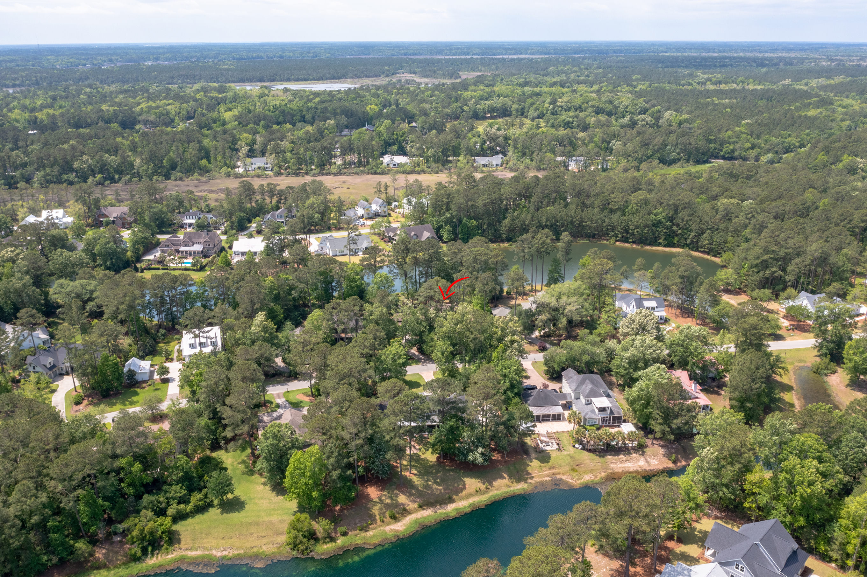
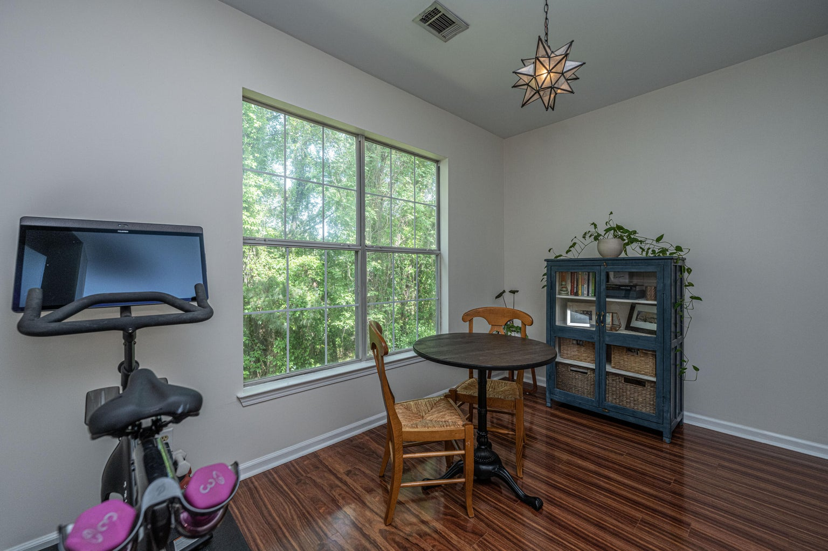
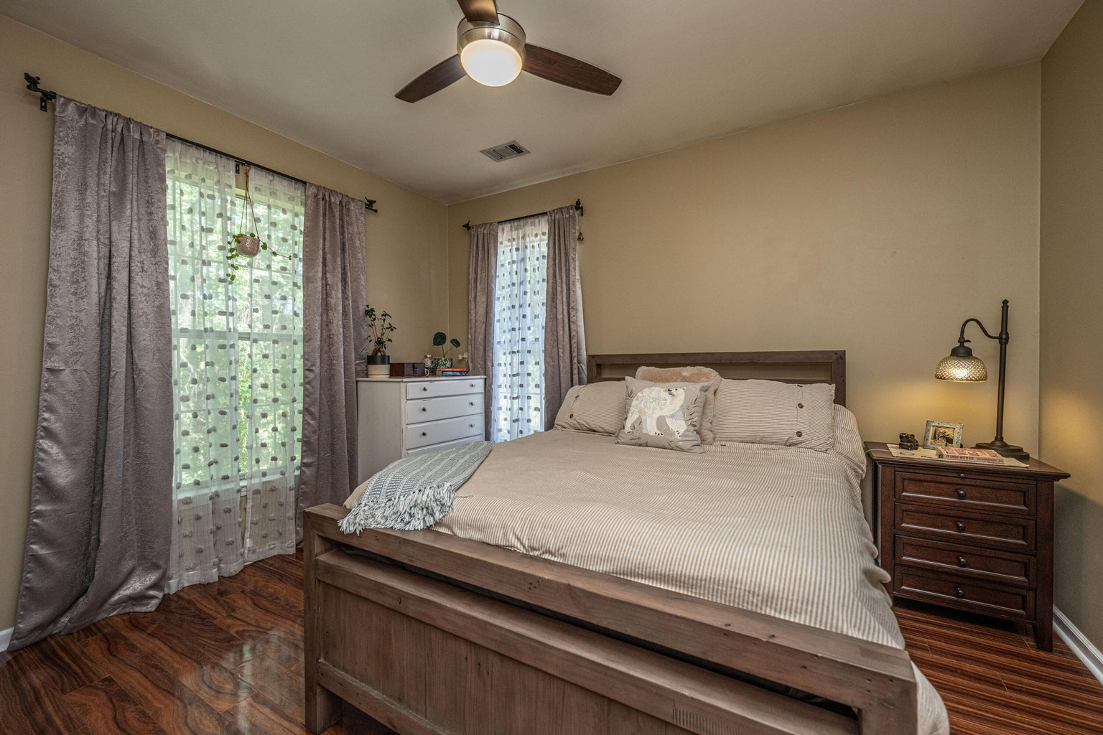



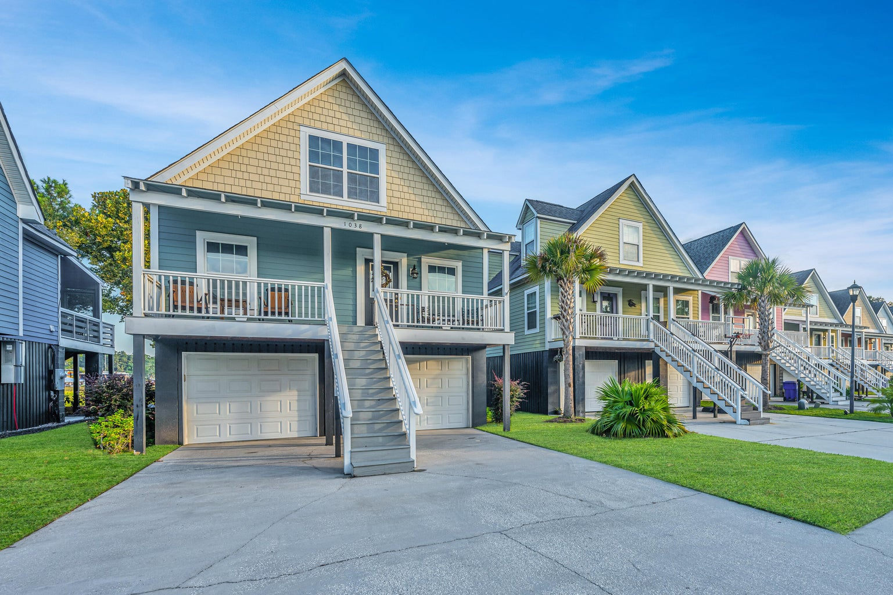
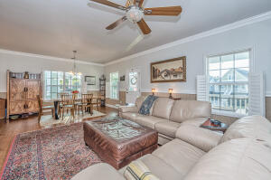
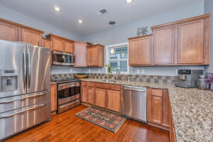
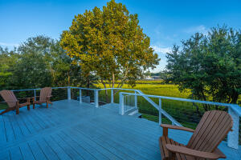
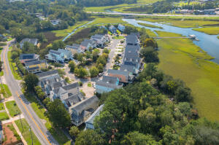
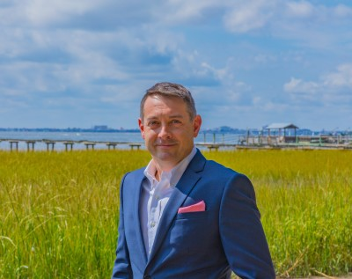

Agent Open House Thursday
1038 Hunley Waters Circle Hunley Waters | North Charleston MLS# 23021795 | $675,000
11am-2pm ~ Lunch will be provided
One of the few waterfront properties in the exclusive gated community of Hunley Waters, this house has sweeping views of the Noisette Creek in the heart of Park Circle! The beautiful 3 bedroom home has gleaming hardwood floors and a spacious open floor plan perfect for entertaining! The kitchen has granite countertops, stainless steel appliances and bartop for casual dining. The main level primary bedroom has a gorgeous en suite with subway tile surround shower and semi frameless glass door. Bathroom also features dual vanities and linen closet for additional storage. Primary suite enjoys access to the newly rebuilt deck with serene water and marsh views. Heading upstairs you'll find 2 equally oversized bedrooms that share a recently updated bathroom featuring marble countertops and tile surround shower room with soaking tub. The living space of the home is extended with the covered patio under the deck which has plenty of space for all of your outdoor furniture. Super low electric bills with spray foam insulation and solar panels that are paid off! The garage has parking for up to three vehicles and storage for all your toys. Lawn care is included with HOA dues so get out and enjoy the community. Park Circle was voted Best Neighborhood by the Charleston City Paper FOUR YEARS IN A ROW! All new $20 million inclusive park just over 1 mile away that is set to open in November, and a new, $27 million athletic complex coming to Danny Jones Park that includes baseball fields, basketball & pickleball courts, plus temperature controlled pools. The city's most popular brewery, Holy City is just across the creek, and the newly constructed Noisette bridge was just named top 10 in the world by Architectural Digest. Schedule your showing today before this amazing opportunity is gone! A $2,500 Lender Credit is available and will be applied towards the buyer's closing costs and pre-paids if the buyer chooses to use the seller's preferred lender. This credit is in addition to any negotiated seller concessions.
4
3
1,844
Sean Welsh 843-364-6217 | sean.welsh@carolinaone.com
www.seanwelshrealtor.com
Carolina One Real Estate | 195 W Coleman Blvd | Mt Pleasant, SC 29464-3495

