Slide 1
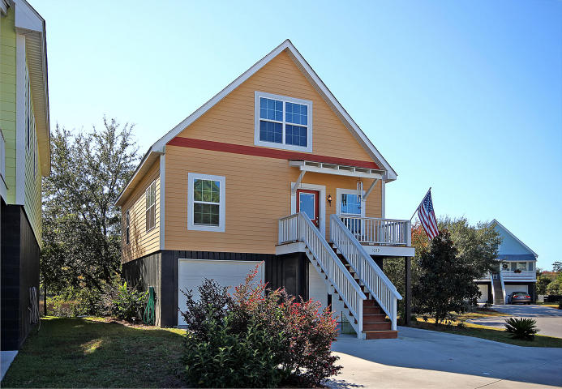
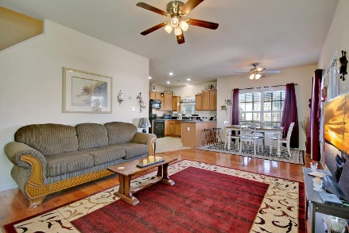
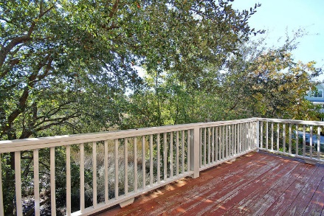
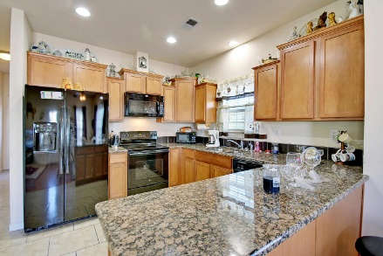
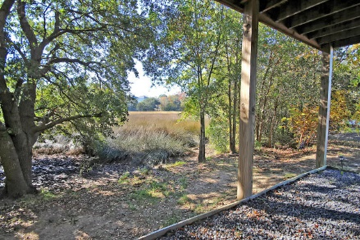
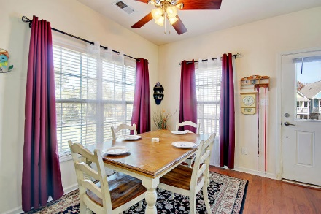
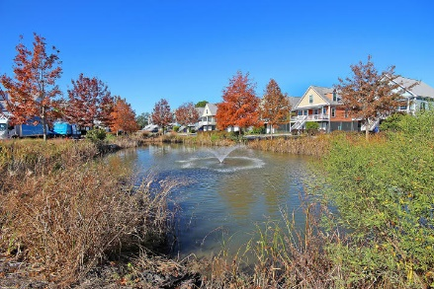
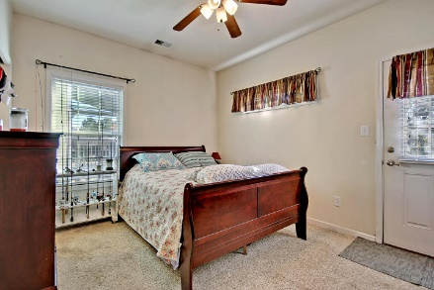
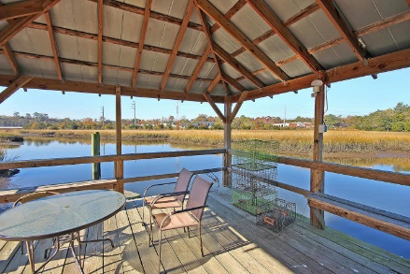
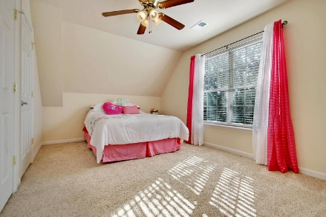
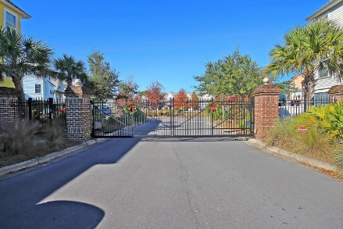

Price Reduced!
1039 Hunley Waters Circle
Hunley Waters ~ North Charleston ~ MLS# 17031874 ~ $319,000
Lovely home in the highly desirable Park Circle area! This newly built, 3 bedroom, 2.5 bathroom home boasts an open floor plan with an updated kitchen. Beautiful marsh views will surround you in every direction. Enjoy a cup of coffee on the large back patio accessible from the main living area and also the master bedroom. The gated community has much to offer! You will be just steps from the gorgeous Noisette Creek side dock where you can drop your kayak for an evening paddle or throw a crab trap in to catch dinner. Here your only 1/16 mile from the Cooper River! HOA includes grass maintenance so you can leave your lawn mower behind! The neighborhood is only minutes from all that Park Circle has to offer...great entertainment, dining, festivals, and also very close to Riverfront Park!
Additional features include:
Gated community near Park Circle
Spacious open floor plan
Two car garage big enough to store a boat
New refrigerator and oven
Levelor blinds throughout the whole house
Ceiling fans and LED lights throughout the house
Garbage and sewage included
Community dock with kayak storage, covered picnic tables, and built in grill. Great for entertaining!
Newly constructed - built in 2012
Gorgeous marsh views from front and back patio
Book your showing soon!
Katie Wishneff kwishneff@mattoneillteam.com 843-870-8784

