Slide 1
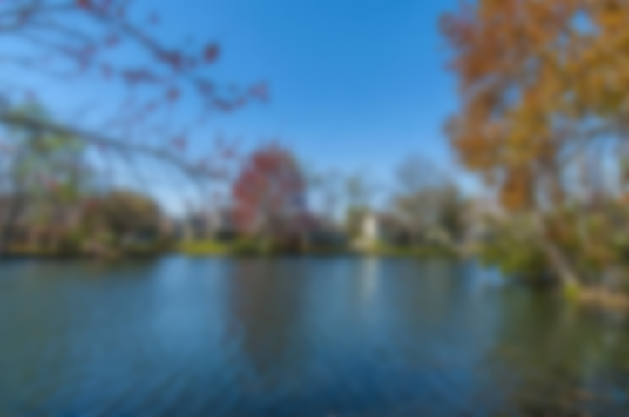
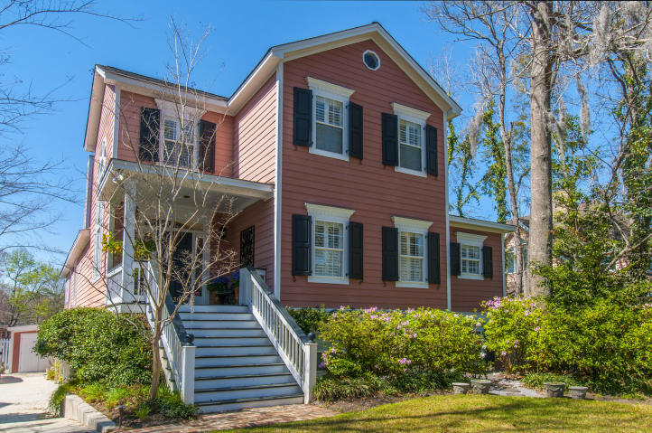
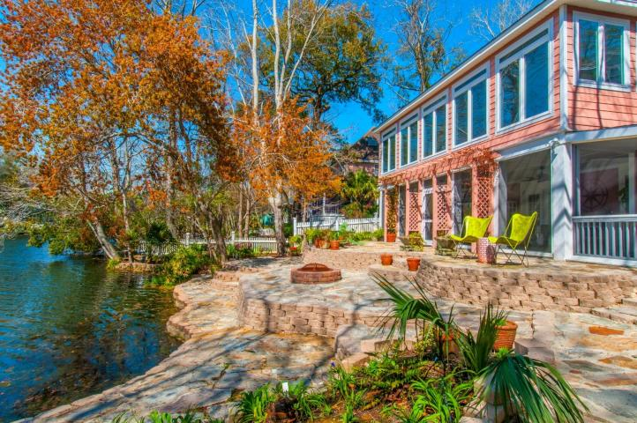
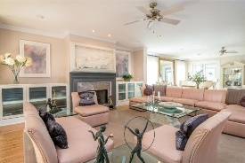
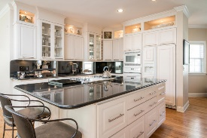
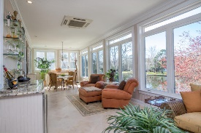
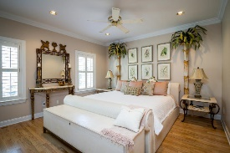
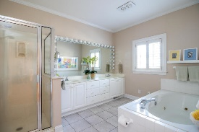
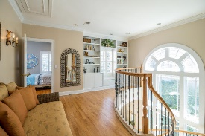
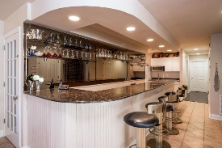
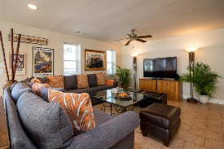
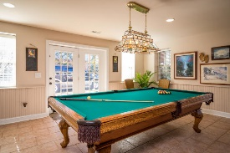

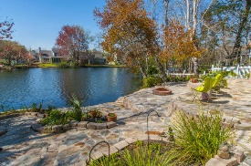
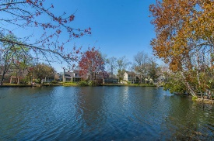

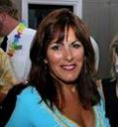
Broker Open House Thursday, 4/27 from 11:30 - 1:30 Catered by Zoe's Kitchen
1039 Wharf Indigo Place
Wharf Indigo @ Creekside Park · Mount Pleasant, SC 29464 MLS# 17005993 · $1,295,000
THE BEST LOCATION IN MOUNT PLEASANT!!!
If a casual but elegant home in the heart of Mt. Pleasant is what you’re seeking, you need to take a look at this one! Don't let the modest exterior fool you – it features over 5000 square feet of well-appointed living space. It is situated on private, stocked Lake Cooper, with phenomenal views! This home is huge and made for entertaining and has a mother in law suite on the ground floor.
Kathy Jordan
(843) 442-0782
kathycharleston@gmail.com
The Boulevard Company, LLC | 35 Broad Street | Charleston, SC 29401

