Slide 1
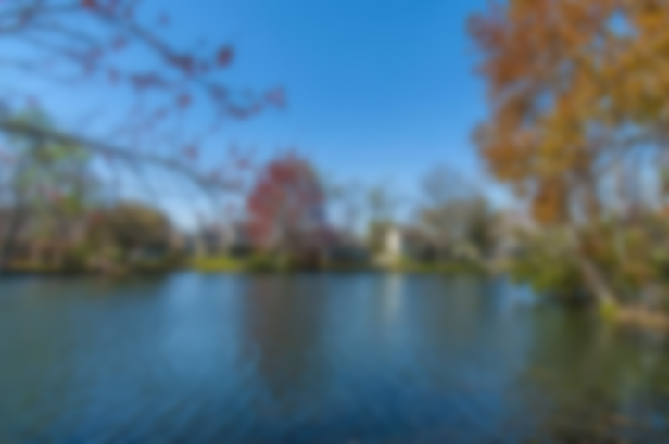
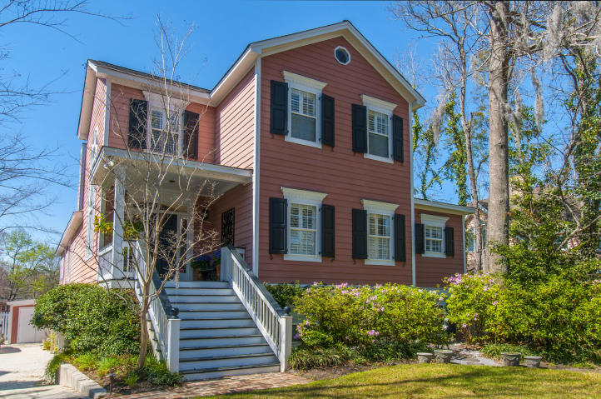
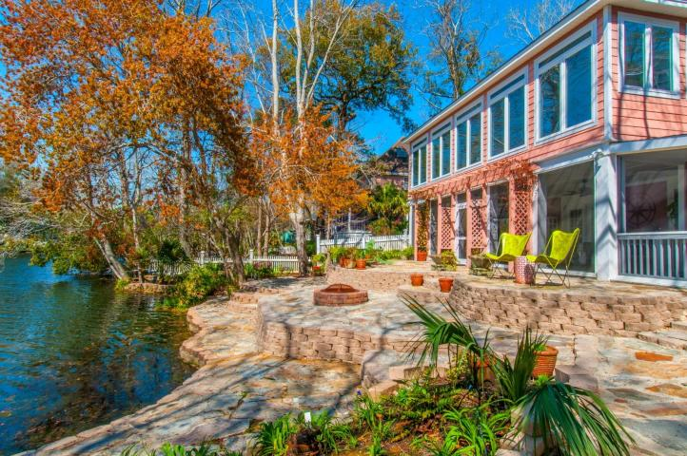
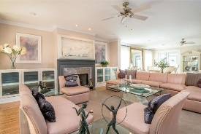
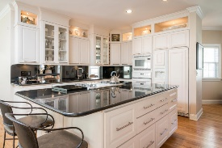
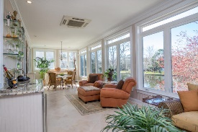
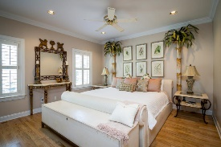
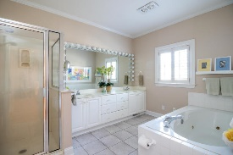
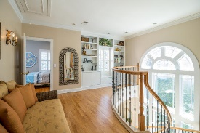
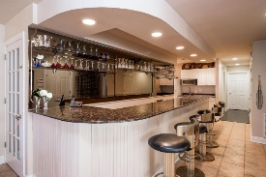
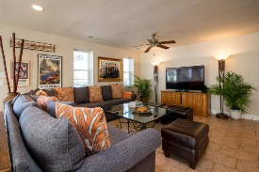
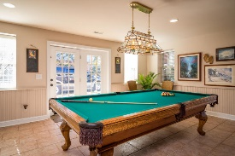

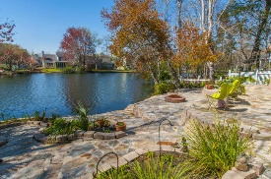
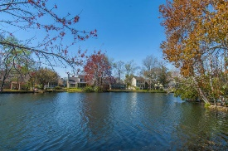

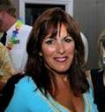
Open House Sunday Oct. 7th from 1-4 pm!
We will be serving wine, cheese & refreshments!
1039 Wharf Indigo Place
Wharf Indigo @ Creekside Park · Mount Pleasant, SC 29464
MLS 18021907 ~ $994,963
THE BEST LOCATION IN MOUNT PLEASANT!!!
If a casual but elegant home in the heart of Mt. Pleasant is what you're seeking, you need to take a look at this one! Don't let the modest exterior fool you – it features over 5000 square feet of well-appointed living space. It is situated on private, stocked Lake Cooper, with phenomenal views! The main floor features a breathtaking 2 story foyer with a custom curved open stair-case. The kitchen has granite counters, an island and 2 dishwashers, and opens onto a spacious formal living room with fireplace, a private dining room, a separate library, and a master suite with private laundry. A stunning glassed sun porch completes the main floor with a wet bar, granite, mini fridge and ice maker, overlooking the lake.
Questions? Call us!
Gina Brammer - 843-437-7828
Annette Klohn – 843-442-7011
Phillip Woody – 843-412-3057
The Boulevard Company, LLC | 35 Broad Street | Charleston, SC 29401

