Slide 1
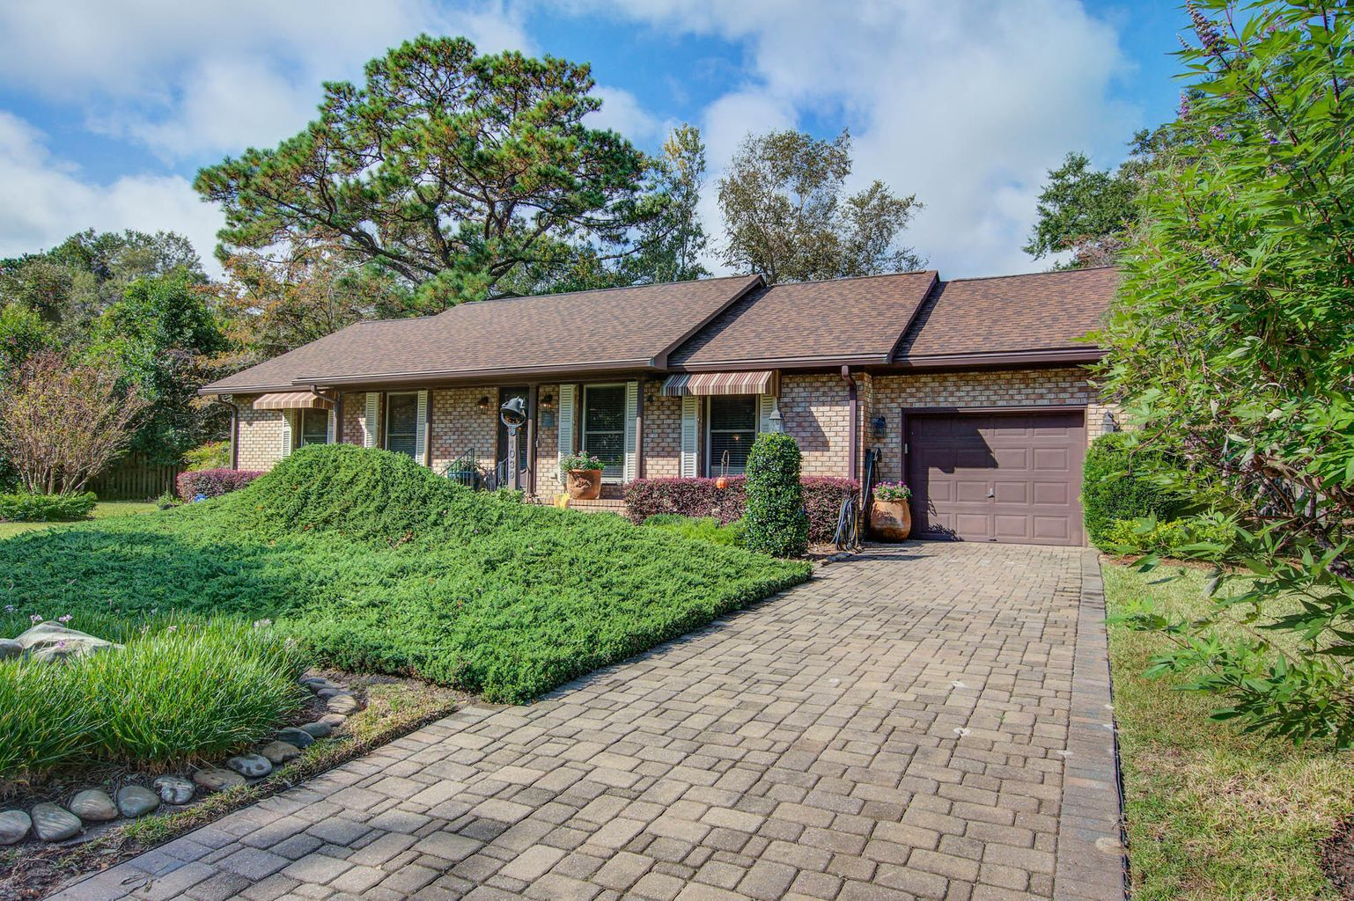
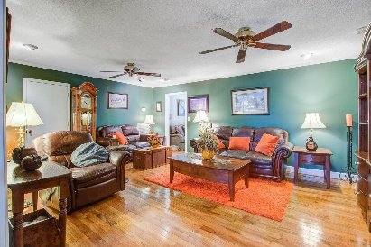
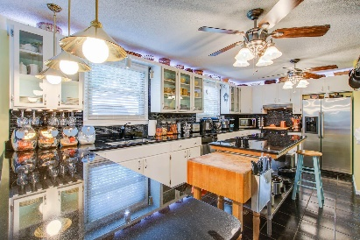
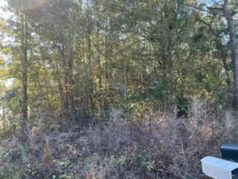
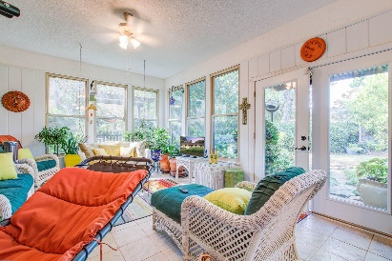
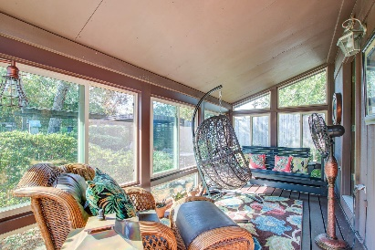
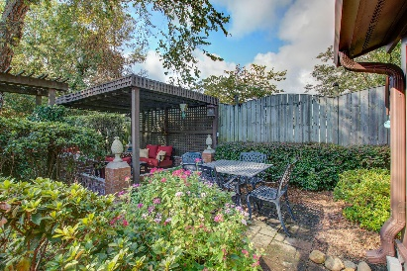
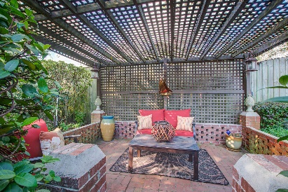


Open House Sunday, February 19th 1-4
Great Price
On James Island
1039 Grand Concourse Street
Harbor Woods · Charleston, SC 29412
MLS# 22028251 · $674,900
Michael Dew
O 843-769-5100
M 843-870-7000
michaeledew@gmail.com
www.michaeldewrealestate.com
Absolutely immaculate 3 bed 2 bath home in desirable Harbor Woods neighborhood. Paver drive and walkway. Hardwood floors throughout main living areas. Formal living room and family room. Chef's kitchen with tons of light. Commercial Wolfe gas range and refrigerator. Large island for prep space. Granite counter tops and glass backsplash. Additional electric stove and refrigerator. Breakfast bar with pendant lighting, all open to dining area. Large pantry, laundry room and frog. Master bedroom ensuite with tiled walk in shower. 2 additional bedrooms and hall bath with claw foot tub. Step down to the sunroom overlooking the beautiful manicured back yard. Stone pathway to the 325 sq. ft. studio space with its own sun porch, electricity, sink and window unit. Great flex space for craft room, workout area, etc. So many improvements have been made including: Hurricane shutters; lawn irrigation system; Muhler windows installed; Roof replaced 2019; Crawl space incapsulated 2022; Gutter guards installed; Whole house generator installed 2019. Convenient to schools, shopping, down town and Folly Beach. An absolute must see!
AgentOwned Charleston Group
902 Savannah Hwy
Charleston, SC 29407
Real Estate ● Mortgage
Insurance ● Business Brokerage

