Slide 1
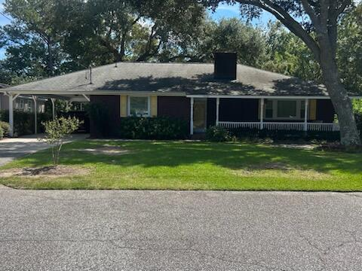
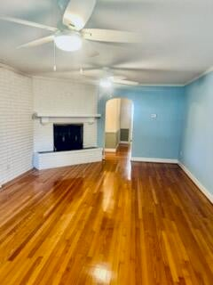
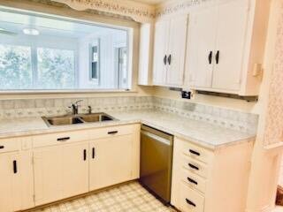
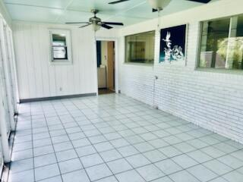
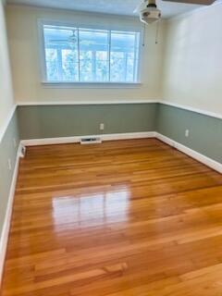
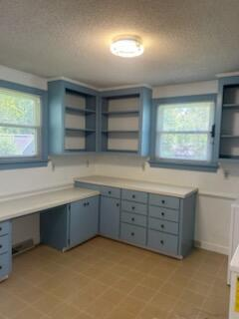
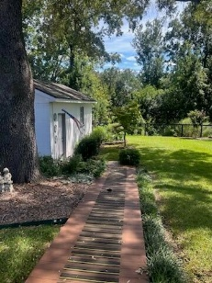
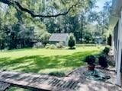
Open House Saturday & Sunday 1:00-5:00 Stop by or send your clients!
1039 Riverview Drive
Berkeley Hills
Hanahan, SC 29410
MLS# 25025161 | $429,900
SELLER IS OFFERING 3% BUYER AGENT COMMISSION!
Beautiful one story, two bedroom, one and a half bath ranch home located in the quiet Berkeley Hills subdivision of Hanahan. This well maintained home boasts gleaming hardwood floors, foyer, formal living room, kitchen with attached dining area, family room, bedrooms have two closets each, large laundry room, screened in porch with removable panels, covered deck and workshop! The porch overlooks a beautifully landscaped backyard and pond! Home is being sold as is. All listing information is deemed to be accurate however, seller and sellers agent are not liable, and are held harmless for any information in discovery that is inaccurate. Buyer and buyers agent are solely responsible to check and verify all information in order to make a buying decision.
Karen Fulghum
Miler Properties
843-697-7712
kfulghum@milerproperties.com
www.milerproperties.com

