Slide 1
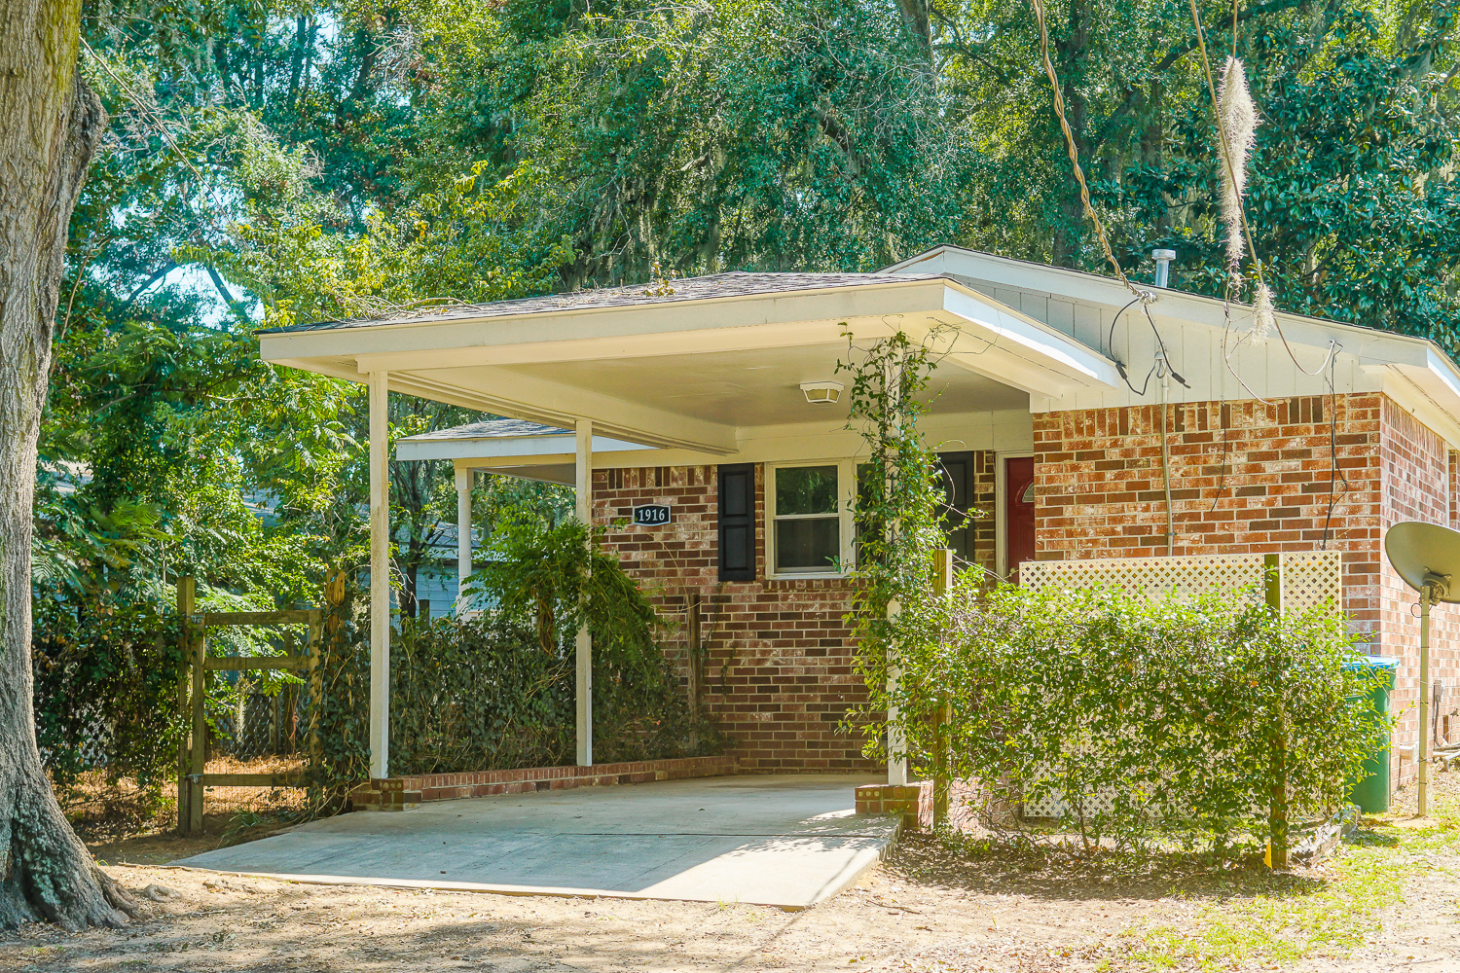
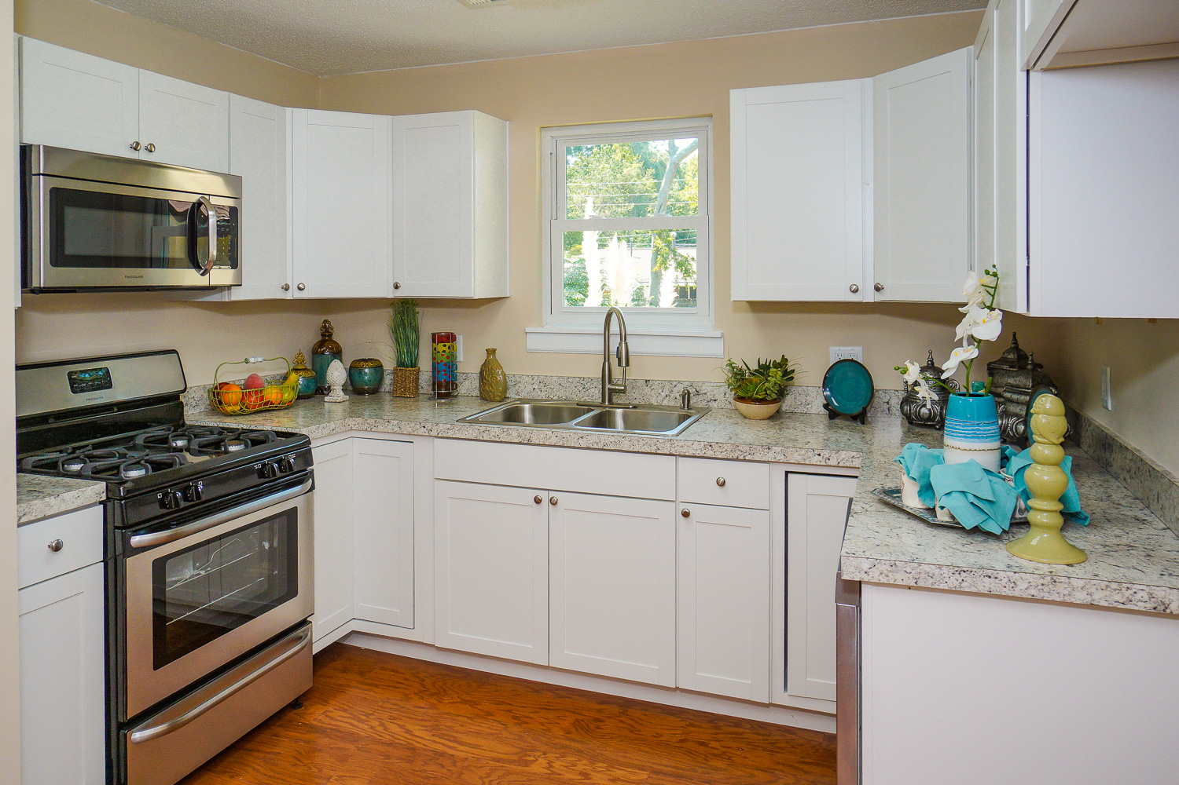
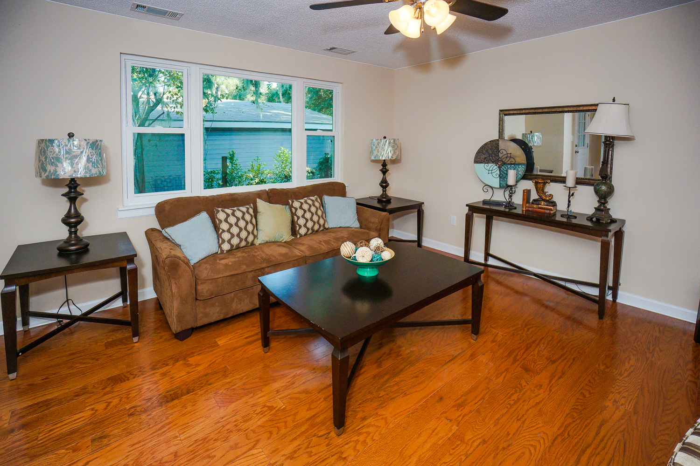
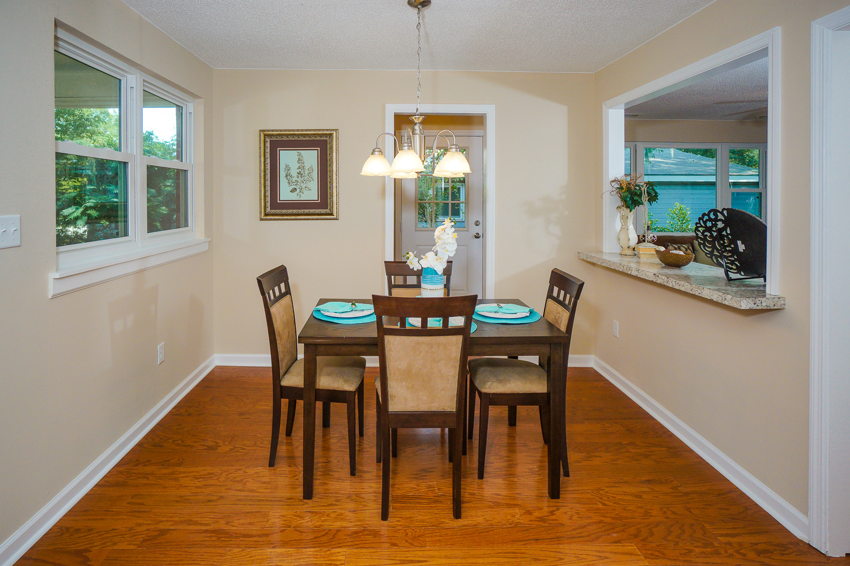
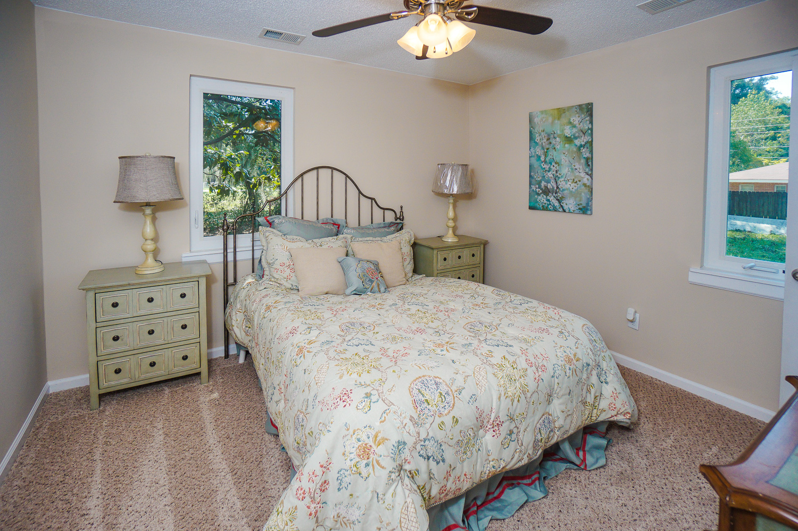
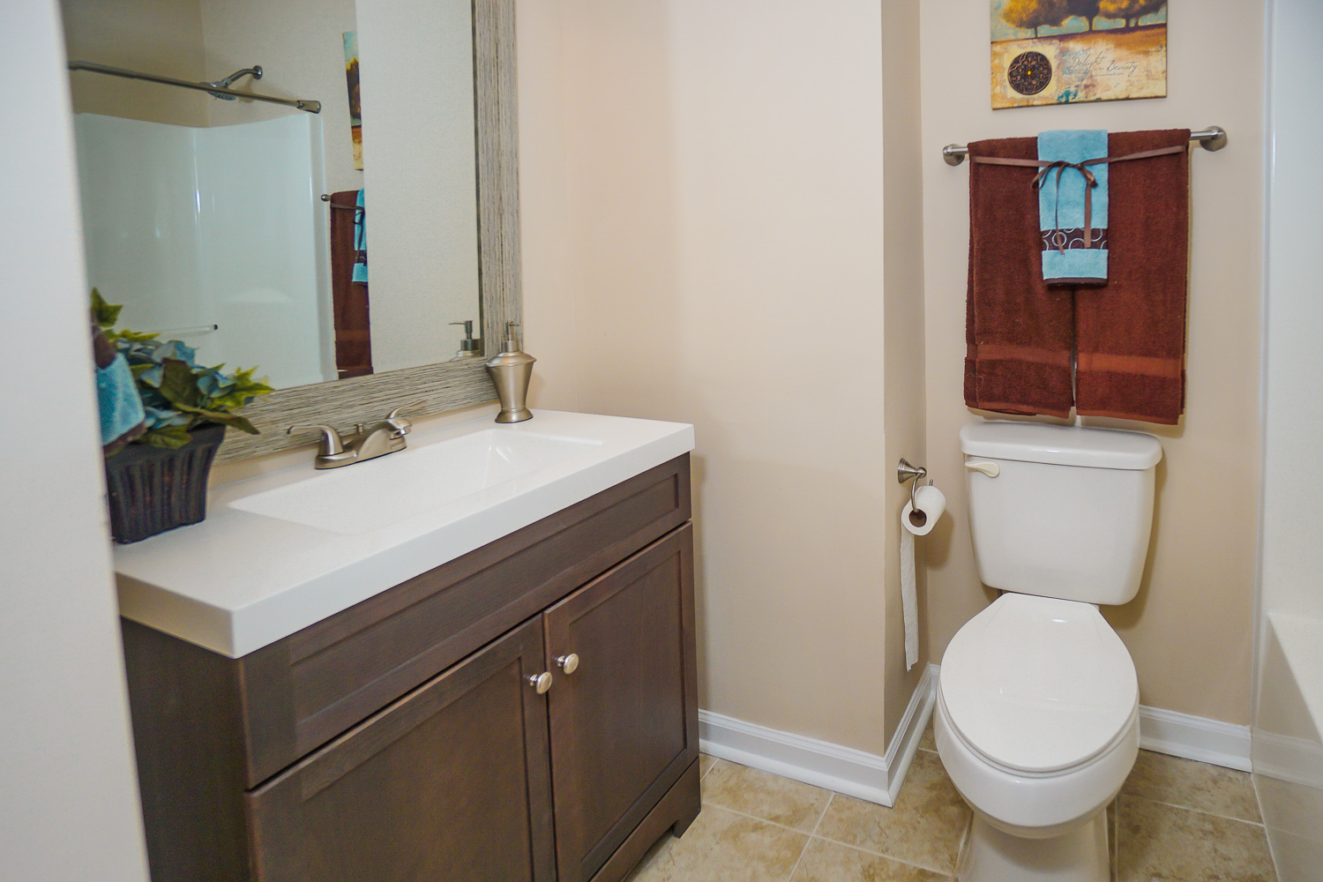
103 Cameron Ct~ Goose Creek
$254,900
This beautiful, Charleston single-style home in Liberty Hall has just had a FULL Renovation! Huge Loft on 2nd floor could be a 5th bedroom, media room, giant playroom, craft room or divided for multiple uses! New HVAC The entire interior has just been professionally painted! Wood flooring in the foyer, New Tile flooring in Laundry/Upstairs Baths; and New Frieze carpet/pad! The double side porches and fresh landscaping welcome you to this cul-de-sac home! Great open floor plan with a formal dining room that connects right to large kitchen and oversized family room at the back of the home with fireplace. Premium upgraded 42” cabinets, ample countertops, large pantry, New sink/faucet and New premium stainless steel appliances Renovated bathrooms: marble vanity tops, New commodes, New tile flooring, New fixtures, tub/showers and New framed mirrors. 1st Floor Master bedroom suite has double sinks, garden tub/separate shower and large walk in closet. 3 spacious bedrooms upstairs. Laundry room closet, right off of the kitchen makes for easy convenient laundry days! Garage has just painted walls, ceilings and even an epoxy painted floor! Out back, enjoy the patio, oversized yard, partial fencing, and palm trees.
Bedrooms:
Bathrooms:
Sq Ft:
Fence:
Lot Size:
3
1.5
1073
YES
0.17 Acres
Year Built:
New Roof:
New Central Air:
New Heat:
Type of Floors:
1978
2016
2016
2016
Wood, Ceramic Tile, Carpet
Greg Cook
Anchor One Realty, LLC
843-343-3030
gcook@AnchorPropertiesofSC.com

