Slide 1
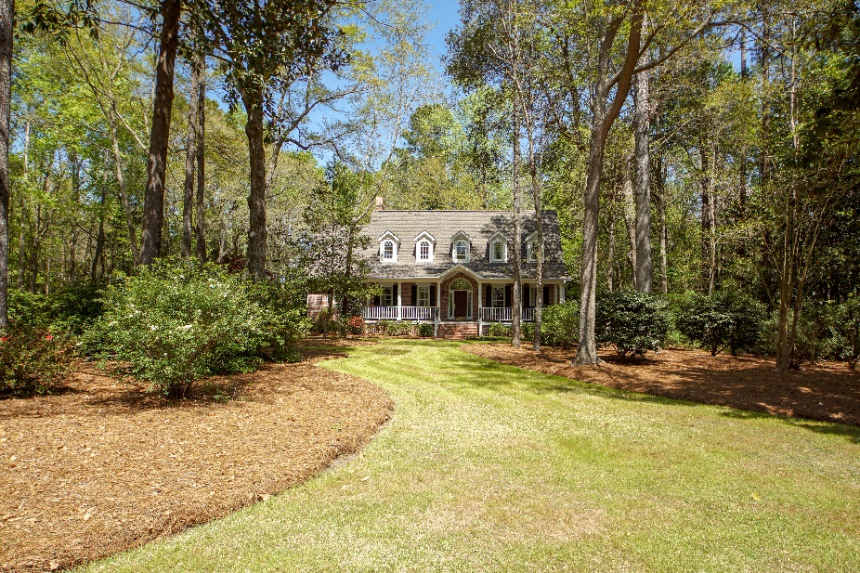
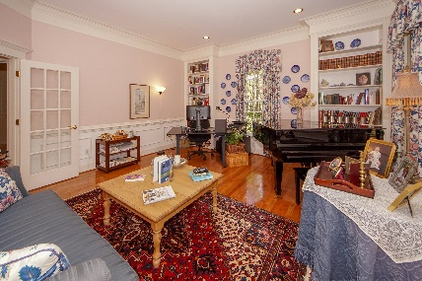
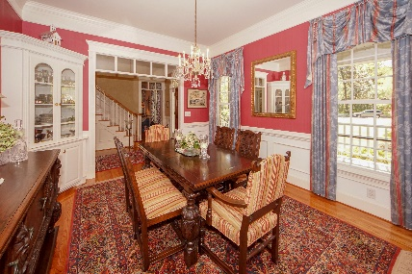
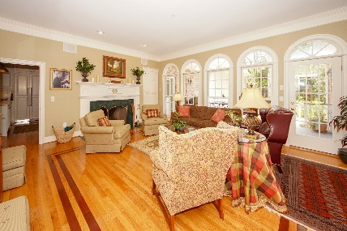
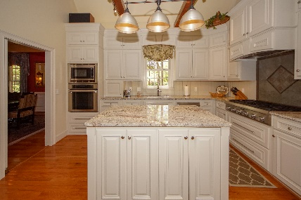
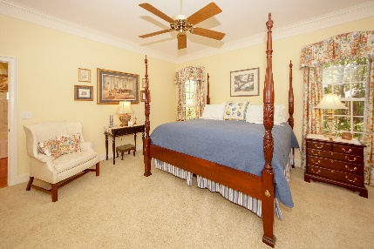
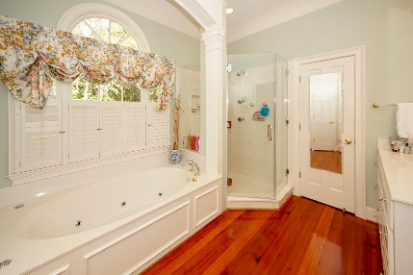
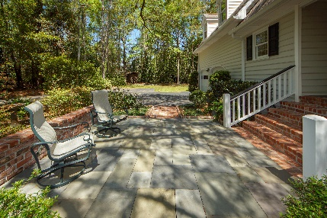
Open House Tues 8/6 from 11-1 free snacks, sandwiches and drinks + $100 drawing
103 Drayton Drive
Gadsden Manor | Summerville, SC 29483
MLS# 19011911 | $795,000
4 Bedroom | 3 Full Baths | 2 Half Baths | 4,103 SqFt
103 Drayton Drive...where quality, elegance and Southern charm graciously meet. This CUSTOM BUILT HOME by one of Summerville's premier builders on almost 1.5 ACRES of in-town paradise is replete with INCREDIBLE UPGRADES and special features. As they say...seeing is believing. A long and inviting front porch welcomes you into a spacious foyer with VAULTED CEILING and HARDWOOD OAK FLOORS throughout the downstairs. ELEGANCE is the word to describe the living room and formal dining room both adorned with chair rail and ,wood trimming and custom curtains. The GOURMET KITCHEN features granite counters, custom cabinets, serving island, gas stove, integrated French door refrigerator, pantry, and breakfast area with GAS LOG FIREPLACE. A fantastic family room accented with five full length palladium windows, fire place built-in book shelves and wet bar make this room an entertainment treasure that flows into the back deck with views into a large private backyard. The downstairs master bedroom suite features dual walk-in closets, dual vanities, jetted tub, custom shower with multiple body sprays, private water closet, and hard wood floors. All the upstairs bedrooms are generously sized and offer plenty of closet space. Upstairs also features a huge entertainment room and an open air loft over the kitchen that is ideal for office space. There are too many upgrades to list. The large and private yard provides a sense of seclusion and peace, while being conveniently located in downtown Summerville. Many mature camellias and azaleas adorn the front yard, and a live oak shades the side patio and entrance. This incredible home offers the best of Summerville in the town's premier neighborhood. Welcome home!
Dicky Miler
Miler Properties
Office: 843-821-1111
Cell: 843-270-9532
rlmiler@milerproperties.com
www.milerproperties.com

