Slide 1
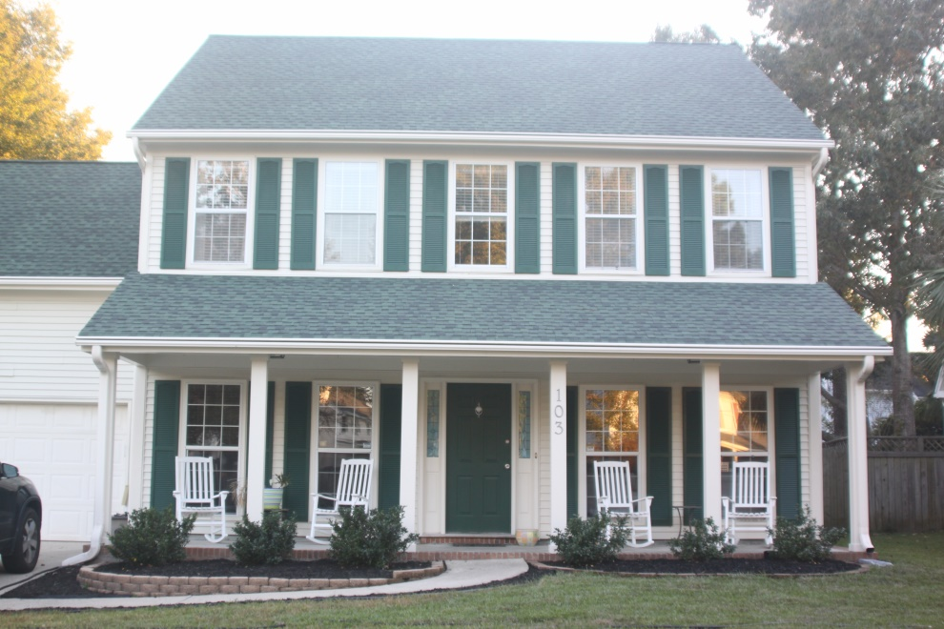
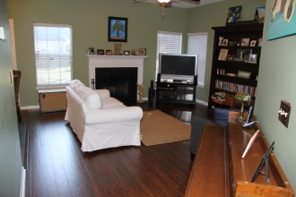
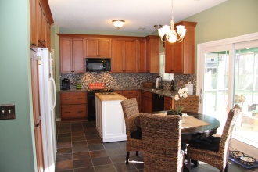
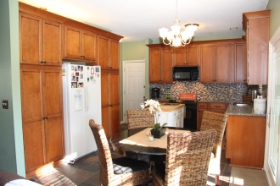
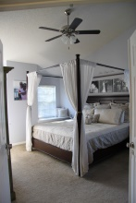
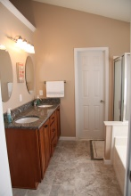
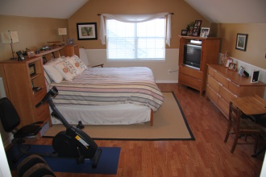

Exquisite Home in Crowfield Plantation
103 Durrell Ct ~ Goose Creek ~ MLS# 14028313 ~ $235,000
UPGRADES GALORE - Over $40k worth! This MUST SEE, two-story, open floor plan home located on a quaint cul-de-sac in the highly desirable Crowfield Plantation. Home features a BEAUTIFULLY REMODELED Eat-In Kitchen with 42-inch maple cabinets, built-in pantries, GRANITE countertops, tile BACKSPLASH, and natural slate flooring. Wood laminate flooring has been newly installed in the Living Room, Family Room, and Dining Room areas. Upstairs has four SPACIOUS bedrooms. LARGE master suite has vaulted ceiling, walk-in closet, and window seats with storage. Master Bath has been UPGRADED with MARBLE TILE flooring, tall maple cabinets, DUAL sinks, and GRANITE countertops. Upstairs Hall Bath has the same beautiful upgraded finishes as the master bath. Home has large FENCED BACKYARD with storage shed.
The HUGE Bonus Room over the garage is the 4th bedroom (with no closet)... It does have 2 large STORAGE closets. You can enjoy relaxing on the screened in porch located directly off of the kitchen. This home has full coverage leaf guard gutters, has a transferable termite bond through Terminix and the Seller will include a one year AHS home warranty with an acceptable offer.
Enjoy all of the amenities Crowfield has to offer: Fishing lakes, parks, sidewalks, tennis courts, club house, RV/Boat Storage, miles of bike/walking trails and a golf course all within the community. The bike/walking trails also connect to the bike/walking trail that takes you to Charleston County's Wannamaker Park. The home is super convenient to schools and shopping. The low annual HOA fee covers the maintenance of the neighborhood landscaping, walking/biking trails, lakes, and play parks. An optional pool membership is available for a low annual fee and gives you access to three (3) different pools and the tennis courts. The optional RV storage also has a low annual fee. The neighborhood club house can be rented for low fee.
Information is deemed reliable but not guaranteed. Buyer should verify all items of importance to Buyer's own satisfaction.
Schedule a showing today! This beautiful home will go quickly!

