Slide 1
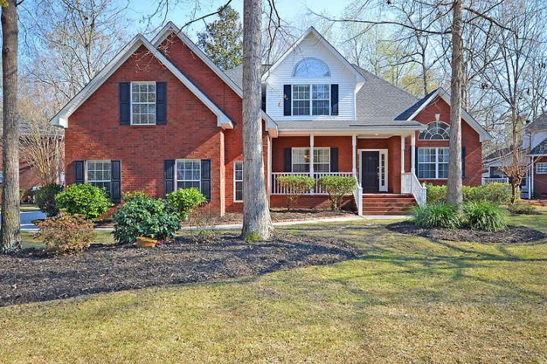
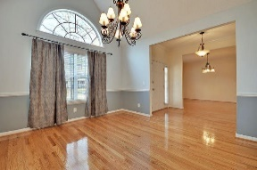
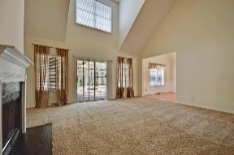
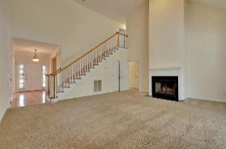
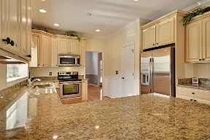
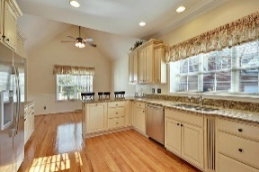
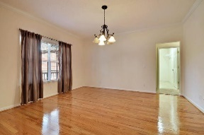
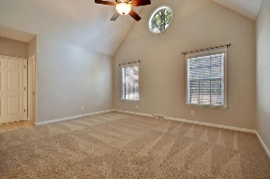
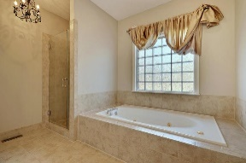
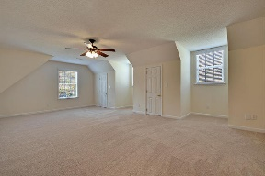
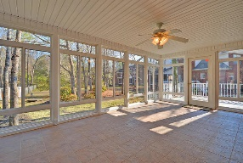
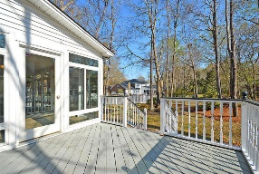
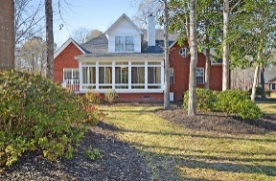


Ashborough East Beauty - Master Down!
103 Elery Terrace
Ashborough East
Summerville, SC 29485
MLS# 17007507
$379,000
4 Bedrooms | 2½ Baths | 3,400 sf
Great home in established neighborhood close to it all! Updated home in the sought after neighborhood of Ashborough East. All major updating has been done on this home, newer roof and HVAC, freshly painted, new carpeting, encapsulated crawl space with dehumidification. This home is move in ready! Located on a cul-de-sac, this home is situated on a third of an acre. Walk in and immediately notice the gorgeous wood floors throughout the formal living, dining room and kitchen! The kitchen is a cooks delight with stainless steel appliances, granite countertops, pantry, tons of cabinet space, breakfast bar and large eat in kitchen area. The family room has vaulted ceilings, wood burning fireplace and access to the gorgeous sunroom! The sunroom has its own heating & air unit and tiled flooring!
The first floor master has a vaulted ceiling, TWO walk in closets, linen closet and master bath with dual vanities and separate shower and jetted tub. The first floor also has a laundry room with its own utility sink and cabinetry. Upstairs, head to the first bedroom which is huge! Two large closets in this room, as well as walk in attic space. There is a full bath in the hall, another good size bedroom, then head down a small staircase to a bonus room that can be the 4th bedroom! This room is huge and offers tons of storage as well as closet space. This home has two staircases accessing upstairs! This home is a must see and centrally located! Ashborough East is close to it all, has a community pool and clubhouse with great events!
Larry & Kathy Mazalatis
Larry Cell 843-693-0529
Kathy Cell 843-693-0159
Office 843-871-9133
AGENTOWNED PREMIERE GROUP | 1800 TROLLEY RD | SUMMERVILLE, SC 29485

