Slide 1
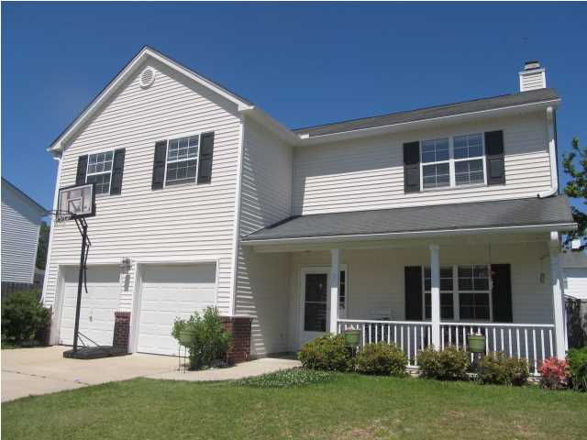
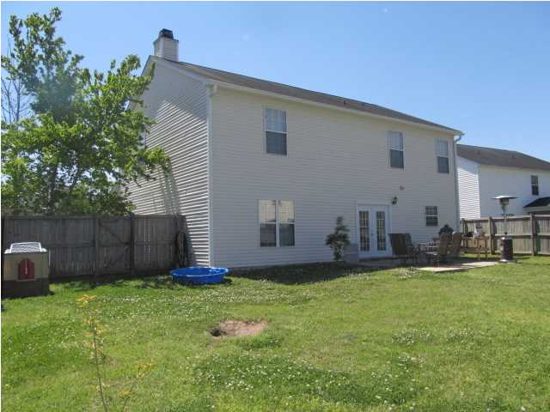
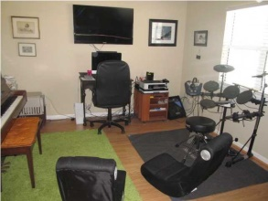
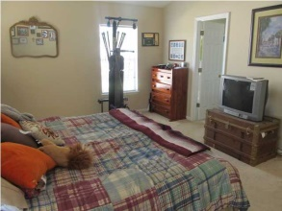
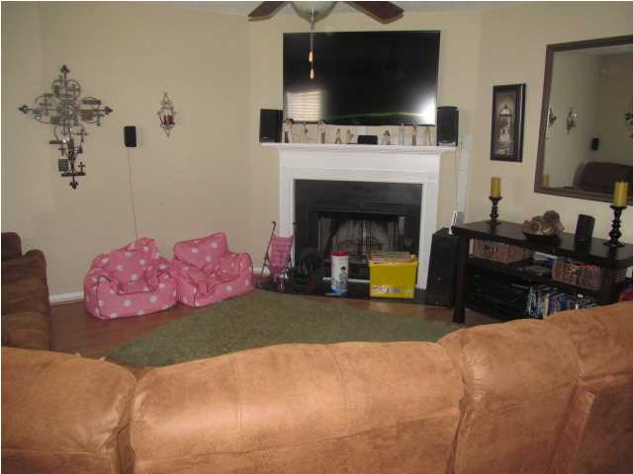
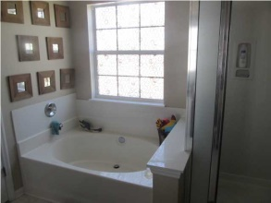
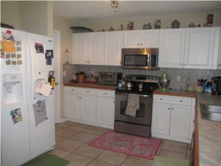
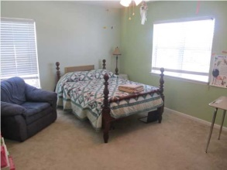
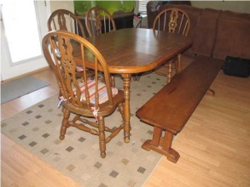
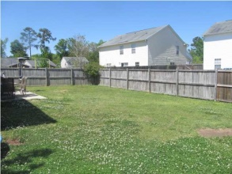
Just Reduced!
103 Lakewood Dr
Bridges of Summerville
Summerville, SC
MLS# 1421806
$191,000
Beautiful 4 bedroom, 2.5 bath home located on a quiet cul-de-sac! All bedrooms are oversized and are located on the 2nd floor. Master bedroom is huge with walk-in closet. Master bath has separate tub and shower. Each bedroom has large closets, along with a cathedral ceiling in the master. Enjoy time in family room that boasts a wonderful fireplace. The extra room downstairs would make a great office or study. The large kitchen is a chef's dream and has gorgeous cabinets with brush nickel hardware. The track lighting is the perfect fit to work in the kitchen. You have to see the countertops that are ceramic tile with wood trim. The kitchen and dining room are open and flows into the family room which makes the perfect set up for entertaining or keeping close to the family. Use the French doors to go outside onto the patio in the backyard. This large backyard is completely fenced in with a gate on each side of the home. Brand new entire air conditioning system with 10 year warranty just installed!! There is a pond and a community park on the other side of the cul-de-sac. The community has so much to offer such as common areas that are beautifully landscaped, ponds with fish and other wildlife, a community watch, and an amenity center with a kids' play park and swimming pool! Sellers are offering a one year home warranty.
David Hickman | 843.505.0456 | davidisyouragent@gmail.com | www.omnicarolinarealestate.com
Omni Carolina Real Estate | 126 Eston Dr | Goose Creek, SC 29445

