Slide 1
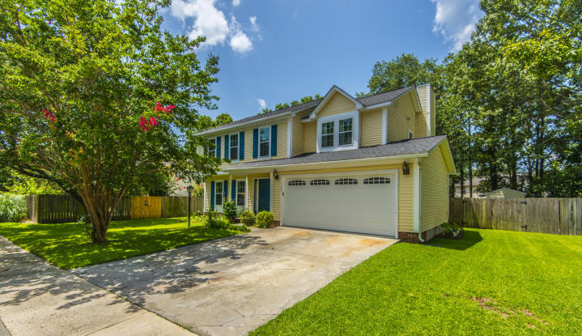
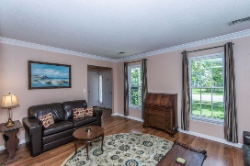
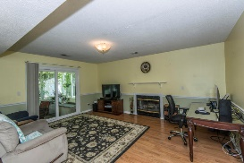
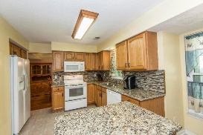
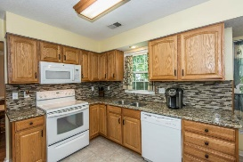
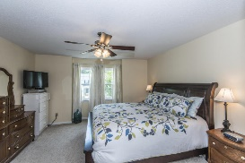
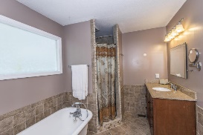
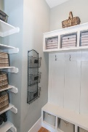
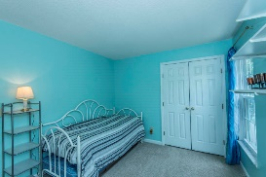
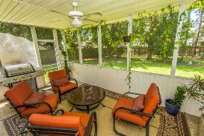
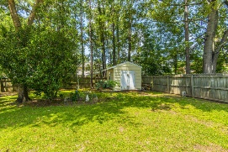
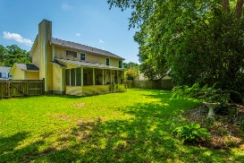


103 Long Bay Court Goose Creek ~ MLS# 17019441
Just listed!
Updated and renovated steal in Crowfield!
$70,000+
Price Reduction
Don't wait...this is the home you have been looking for!
One of the best priced homes in the sought after neighborhood of Crowfield Plantation. This home has it all- from the covered front porch to the 2 car garage to many renovations inside. This home offers many options with a living room/office space, formal dining room, kitchen with island open to the family room, screened porch and four bedrooms upstairs. Outside there is a large private fenced yard with storage shed. Updates and upgrades include: -Laminate wood floors throughout downstairs except for the kitchen. -Wood treads up the stairs and laminate wood in the hallways. -Roof only 4 years old -Windows all replaced Oct.2016 with new Energy Star windows -Granite countertops in the kitchen with custom backsplash.
Remodeled master bath with claw foot tub, tile shower and granite vanities.
Custom closet master bedroom.
Carpet only 3 years old.
Termite bond with Terminex
Yard irrigation
Crowfield Plantation offers many amenities including miles of walking and biking trails, pools, play grounds, tennis courts, a public golf course and nearby Lake Crowfield.
Close to shopping, schools, and restaurants as well as county parks!
Available for a quick closing so plan your showing today!
Melodie Smith (843) 408-5067 M
melodie.smith@carolinaone.com www.melodiesmithrealestate.com

