Slide 1
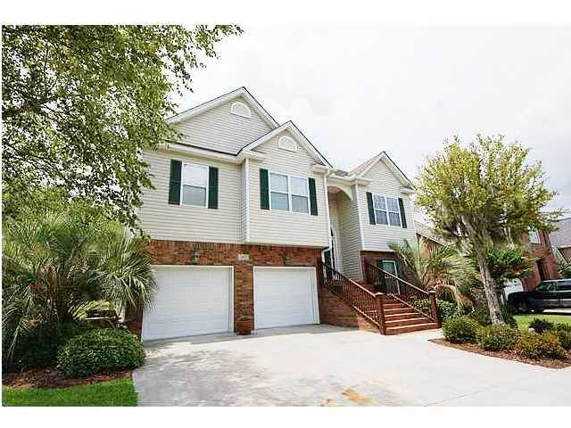
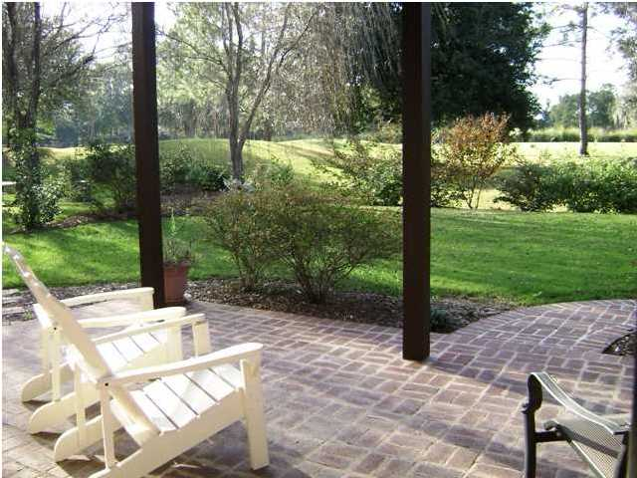
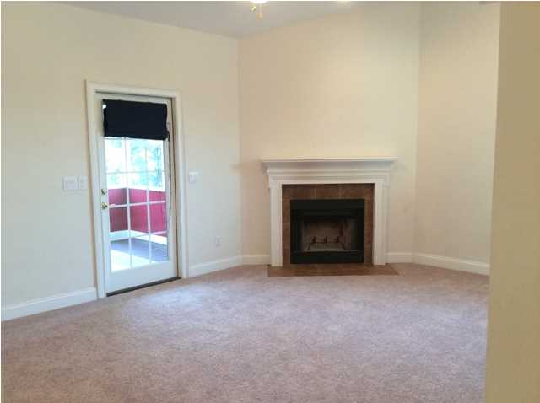
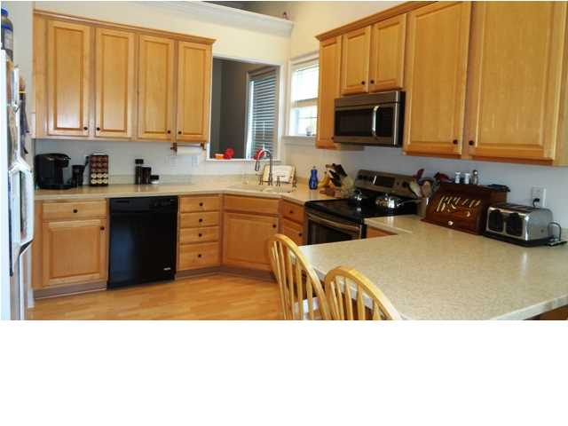
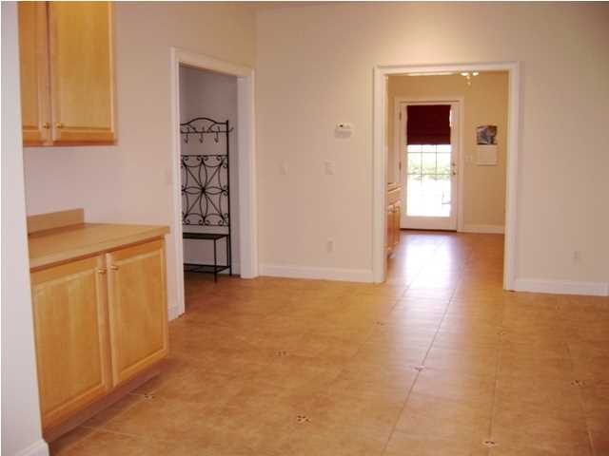
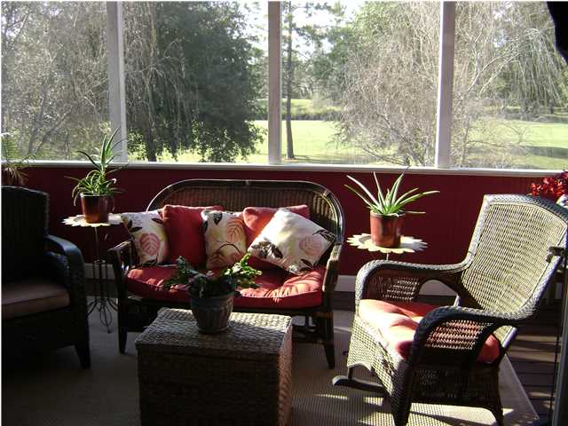



Golf Course Living
103 N Gateshead Crossing ~ Goose Creek
Crowfield Plantation ~ MLS# 1411611 ~ $289,900
An Awesome floor plan located on the golf course of The Hamlets at Crowfield Plantation. This split level home offers upgrades and extras featuring a MBR with a Trey Ceiling, Walk-in closet, Dual Sinks and a Garden Tub. A beautiful Master Suite downstairs that could be used as a Mother-in-Law Suite featuring a corner Gas Fireplace, two Walk-in Closets, and a Spa Like Master Bath with Dual Sinks. And don't forget to view the Bonus Room Downstairs and the Study that incorporates a sink, a place for a small refrigerator, and shelving with two built-in computer areas. More extras include the Surround Sound System with individual volume controls in all the main living areas and Cable Access in every room. Take in the Spacious Kitchen with Hardwood Flooring and Corian Countertops, a Stainless Smooth Top Range, A Built-in Stainless Microwave and Instant-On Hot Water. The Family Room with a Corner Wood-Burning Fireplace accesses the Large Screened Porch overlooking the 18th hole, not to forget about the Large Covered Patio, the Invisible Yard Fence for your pet and the Over-sized Two Car Garage. So, you need to see this for yourself.TONS OF EXTRAS. Enjoy all the amenities that Crowfield Plantation offers ..Swimming Pool, Tennis, Play Parks, Jogging/Biking Trails and a Golf Membership. We invite you to view this lovely home and stay for a while! Fresh Paint and New Carpet.
JACKIE LAWSON
Sales Associate - Realtor
JLawsonHomes@gmail.com
C (843)568.1250
F (843)725.7118

