Slide 1
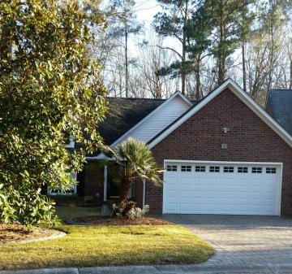
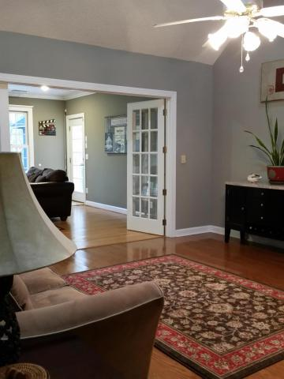
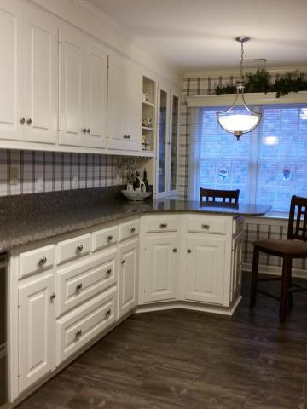
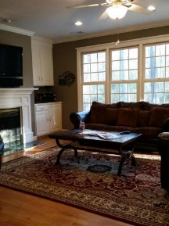
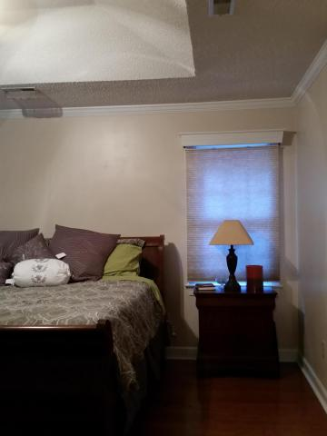
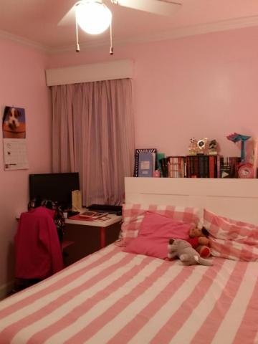
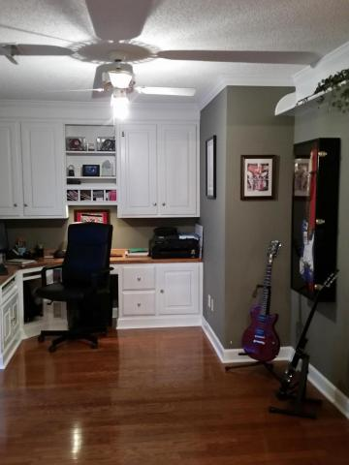
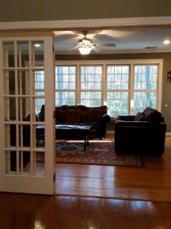
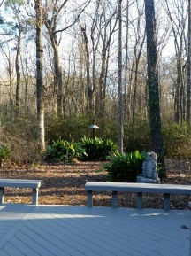
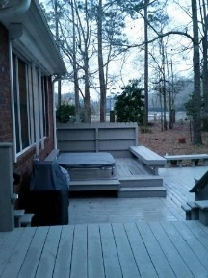


Brokers' Open House, 3/14 from 1-3
Free Bottle of Wine to First 10 Agents!
103 Olympic Club Drive
Pine Forest Country Club ~ Summerville ~ MLS# 16005352 ~ $260,000
Beautiful party house for grown ups! Head out early for a round of golf or swim at the Club. At the end of the day, grill out on your own multilevel back deck; then soak in the hot tub, or head to the screened, heated gazebo to dine there. Inside your home you will find an office with built-ins that can double as the guest room, room to hold dinners and parties in your spaciously elegant family and dining rooms. If you like to entertain (even yourself), you must see this house. Separate laundry room, great cook's kitchen, and much more. Oh, and luxury of luxuries: bathroom floors are heated! Seller offering $5000 for closing costs with acceptable offer. Office can be turned into 3rd bedroom easily with addition of a door.
Susan Woodworth Kraber
Mobile - (843) 779-9655
susankraber1@gmail.com
ERA Wilder Realty, 125-F Wappoo Creek Dr, Charleston, SC 29412

