Slide 1
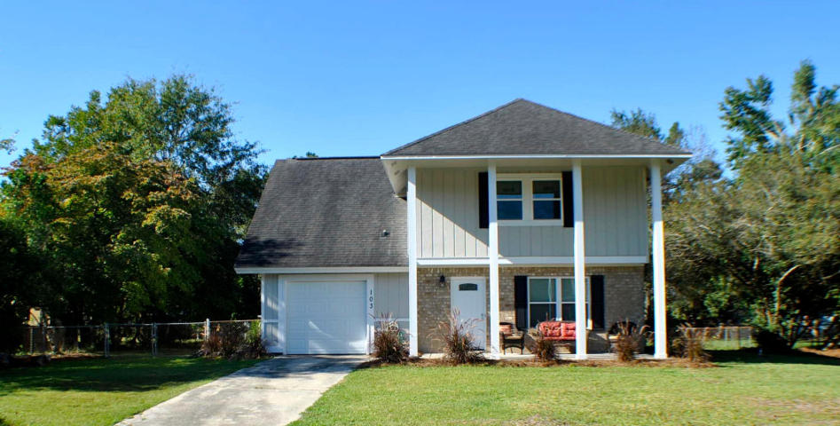
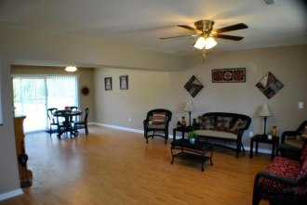
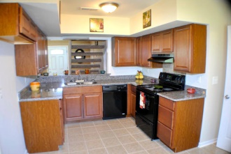
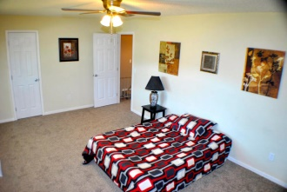
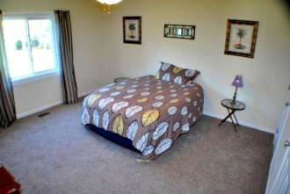
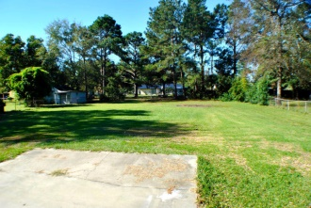
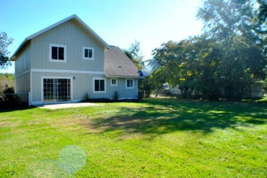

Great Opportunity!
103 Pine Straw Lane
Conifer Hall ~ Moncks Corner ~ MLS# 14027354 ~ $145,900
$1000 agent bonus with BIC approval on ratified contract
by 1-31-15 and closed by 2-28-15.
Wonderful, renovated, large yard, granite are just a few of the adjectives we can use on this one! Located in Conifer Hall this home features an open floor plan and spacious rooms. Owner has installed new cabinets, windows, doors, flooring, vanities, fixtures, and appliances to say the least. All of this in a home situated on a half acre lot. Nicely located just between Hwy 52 and Hwy 17, commuting is made easy in either direction. With features like a huge family and dining area along with an eat-in kitchen, there is lots of space for entertaining. All bedrooms are large enough to accommodate king size beds, so no issues there.
Corwyn J. Melette, BIC
Accredited Buyer Representative
843-619-0071
corwyn@corwynmelette.com
Corwyn J Melette & Associates
PO Box 2175
Goose Creek, SC 29445 www.corwynmelette.com

