Slide 1
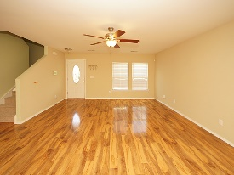
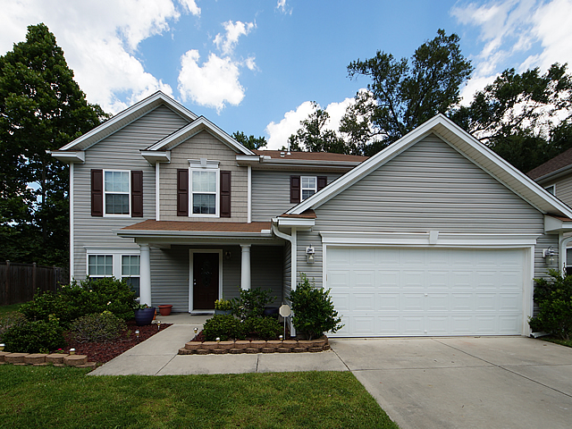
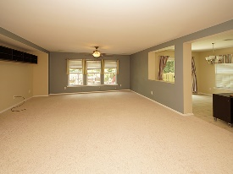
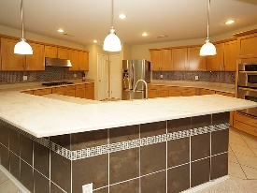
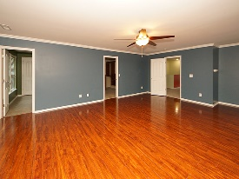
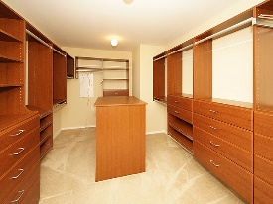
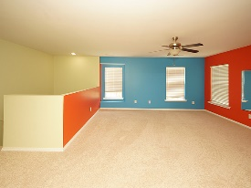
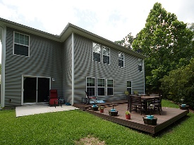

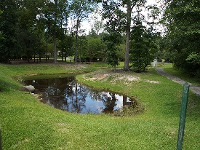

Great New Price!
103 Salt Meadow Lane
Blackberry Creek
Summerville, SC 29483
Open House Canceled!
Under Contract In 3 Days!
MLS# 17019421
$275,000
4 Bed / 3 Bath
Are you looking for a beautiful home with a gourmet kitchen and large open spaces that has all the custom features? Then welcome home to 103 Salt Meadow Lane! This home boasts of custom paint, new carpet, hard wood flooring, gas cook-top and stainless appliances, large granite island/bar, can lights, custom designed wood shelving in closet, huge master bedroom and bath. Seller had entire house wired for Ethernet! Back yard is private, professionally landscaped with composite deck, privacy fence and pond....Pictures are worth a thousand words!
Connie White, Broker
843-532-3356 · conniesyouragent@gmail.com
Charleston Homes · 597 Old Mt. Holly Road · Suite 301 · Goose Creek, SC 29445

