Slide 1
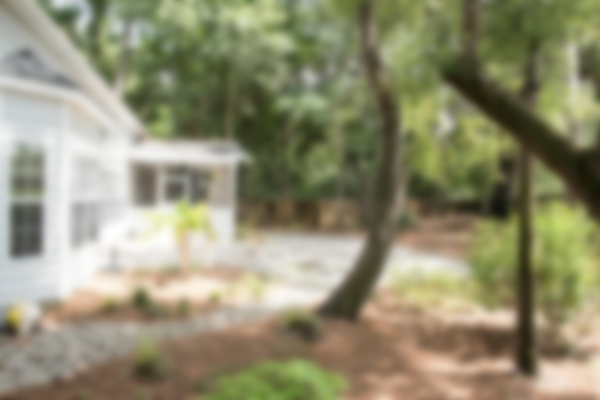
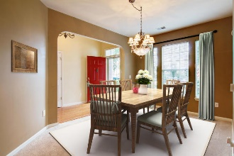
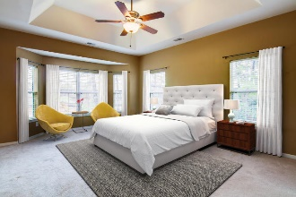
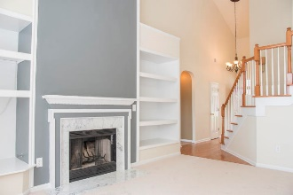
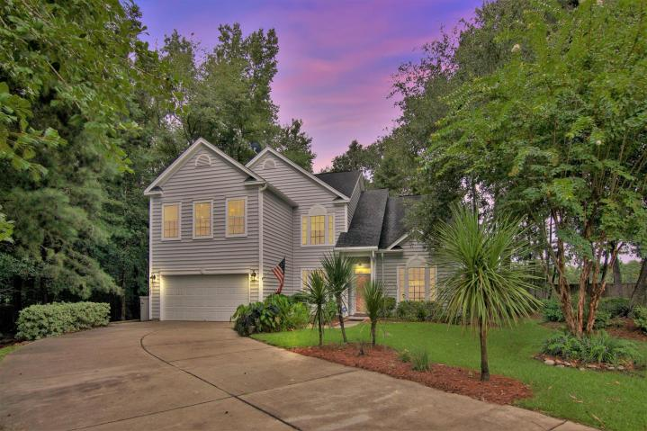
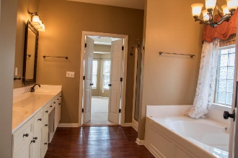
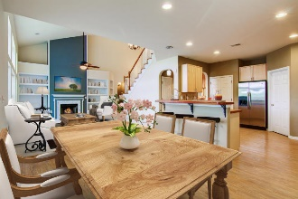
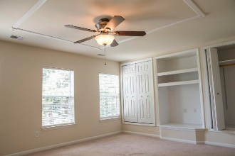
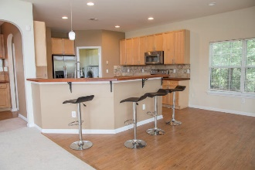

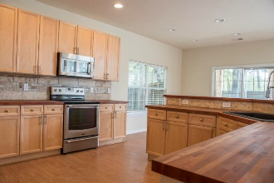
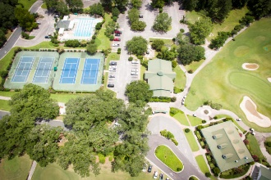

103 Sherry Court Summerville MLS# 17019237 ~ $312,500
$1000 Bonus with a Ratified Contract by 10/06/17!
As you drive up to this home with its long, driveway and lovely landscaping, you know something special is awaiting you inside. When you enter those soaring ceilings with light pouring in from those picture windows greets you. Look around and see the accented wood/gas fireplace with the built-ins on the sides and new carpet. Then check out the updated eat-in kitchen with the stunning butcher block counters, SS appliances and lots of lighting! Kitchen leads to a huge screened-in porch. The formal dining room also has new carpet. The downstairs Master has a tray ceiling and the Master bath has double sinks, Jacuzzi tub, separate shower and a large walk in closet. Upstairs has a loft area with a lighted storage area, an updated bath and 3 large bedrooms. Ask for the long list of upgrades!
Liz & Bob Simonds
843-261-7138 O | 843-437-9696 M lizandbob@agentownedrealty.com
AgentOwned Realty Co. Premier Group, Inc. | 141 A N. Main St | Summerville, SC 29483

