Slide 1
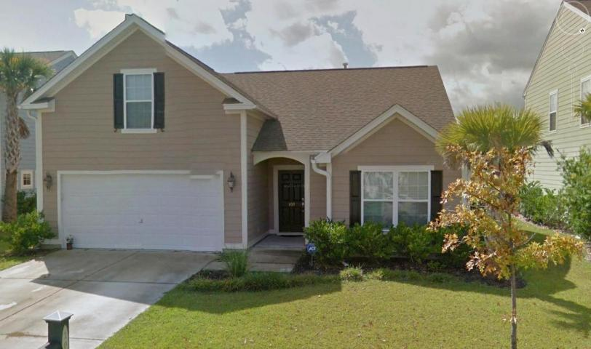
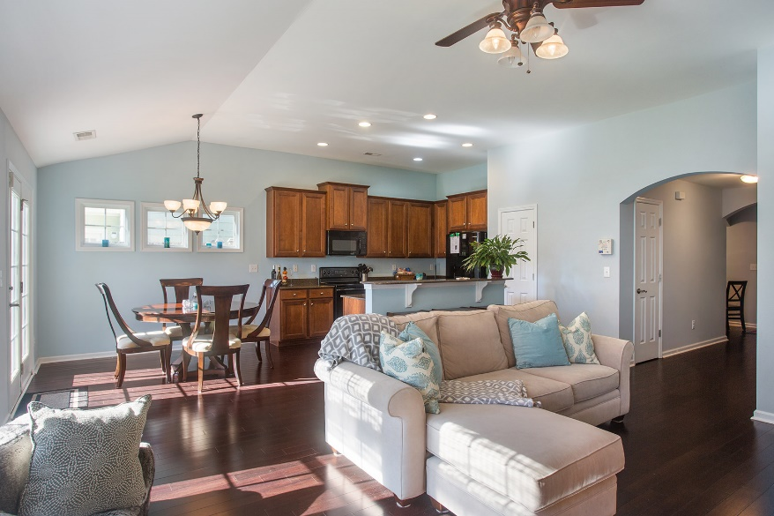
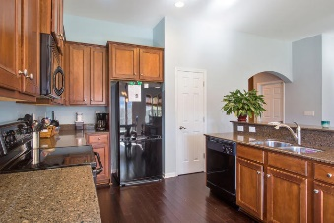



103 Tea Farm Way
Nelliefield Plantation
Wando, SC 29492
MLS# 15025856
$289,000
3 Bedrooms ▪ 2 Baths ▪ Bonus Room
2,129 sq. ft.
Open House ~ Sunday, April 10th ~ 1-3pm
Just Reduced!
Beautiful ranch in Nelliefield with a finished room over the garage. The home has an open floor plan for easy entertaining. Gorgeous foyer with rounded archways leading to spacious living room, kitchen, and dining area with dark Bamboo wood flooring. The kitchen has upgraded 42” cabinets, under mounted stainless sink, built-in microwave, Center Island with raised bar, deep pantry, with Silestone counter tops and French Doors leading to back patio. Master suite is split from the other two bedrooms with carpet, walk in closet and vaulted ceilings. Large master bath with garden tub and separate shower with glass enclosure. Main level features two other bedrooms, another full bath with tub/shower combo, and laundry room. This home also has a huge bonus room which could be used as a 4th bedroom, a den, media room, playroom, you name it! Home has high smooth ceilings, ceiling fans, storage, new paint in foyer, living room, dining and kitchen areas, with finished bonus room, large fenced backyard and so much more. Exterior of home is Hardi-plank for easy maintenance. This home was built. Nelliefield offers a neighborhood pool, conveniently located near shopping and dining. Tax records show home as 1,600 sq. ft. but that doesn't include the FROG which is 439 sq. ft. for a total of 2,039.
Jennifer Nipper, Realtor®
(843) 478-1800 | jen@AgentOwned.com
www.AgentOwned.com
The AgentOwned Realty Co | 824 Johnnie Dodds Blvd | Mt. Pleasant, SC 29464
Real Estate • Mortgage • Insurance

