Slide 1
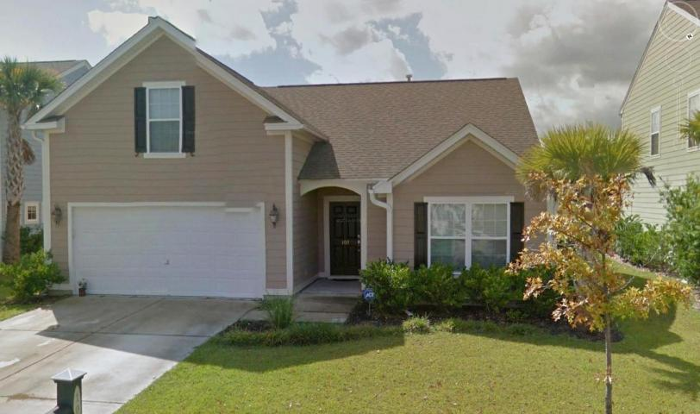
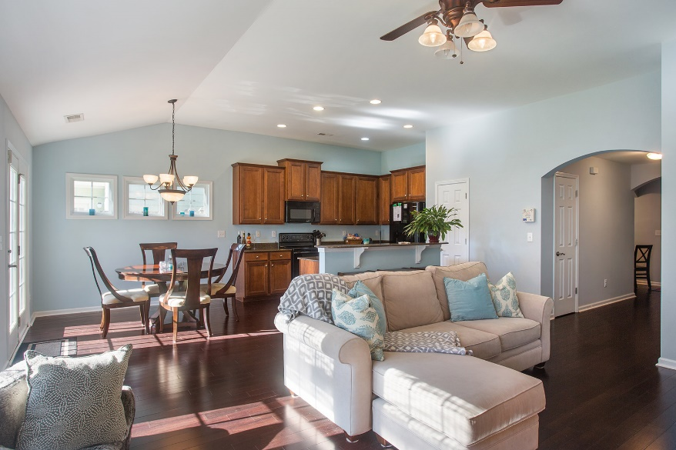
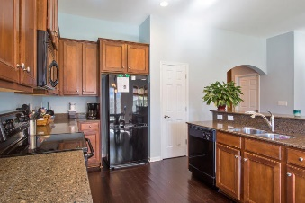



103 Tea Farm Way
Nelliefield Plantation
Wando, SC 29492
MLS# 15025856
$285,000
3 Bedrooms ▪ 2 Baths ▪ Bonus Room
2,129 sq. ft.
Final Reduction to $285,000
Just Reduced!
Home will be taken off the market at end of June
if not under contract.
This is the lowest priced home in Nelliefield. It is a beautiful ranch with a FROG. The home has an open floor plan with spacious living room, kitchen and dining area open. Dark Bamboo flooring in foyer, great room, kitchen and dining areas. The kitchen has upgraded 42” cabinets, built-in microwave, center island with raised bar, and solid surface, Silestone, counter tops. French doors leading to fenced back yard. Vaulted smooth ceilings. Upstairs FROG is finished with a closet and could be used as a 4th bedroom, upstairs playroom/den for the kids, whatever you need! Tax records show home as 1,600 sf ft. but that doesn’t include the FROG which is 439sq. ft. for a total of 2,039.
Jennifer Nipper, Realtor®
(843) 478-1800 | jen@AgentOwned.com
www.AgentOwned.com
The AgentOwned Realty Co | 824 Johnnie Dodds Blvd | Mt. Pleasant, SC 29464
Real Estate • Mortgage • Insurance

