Slide 1
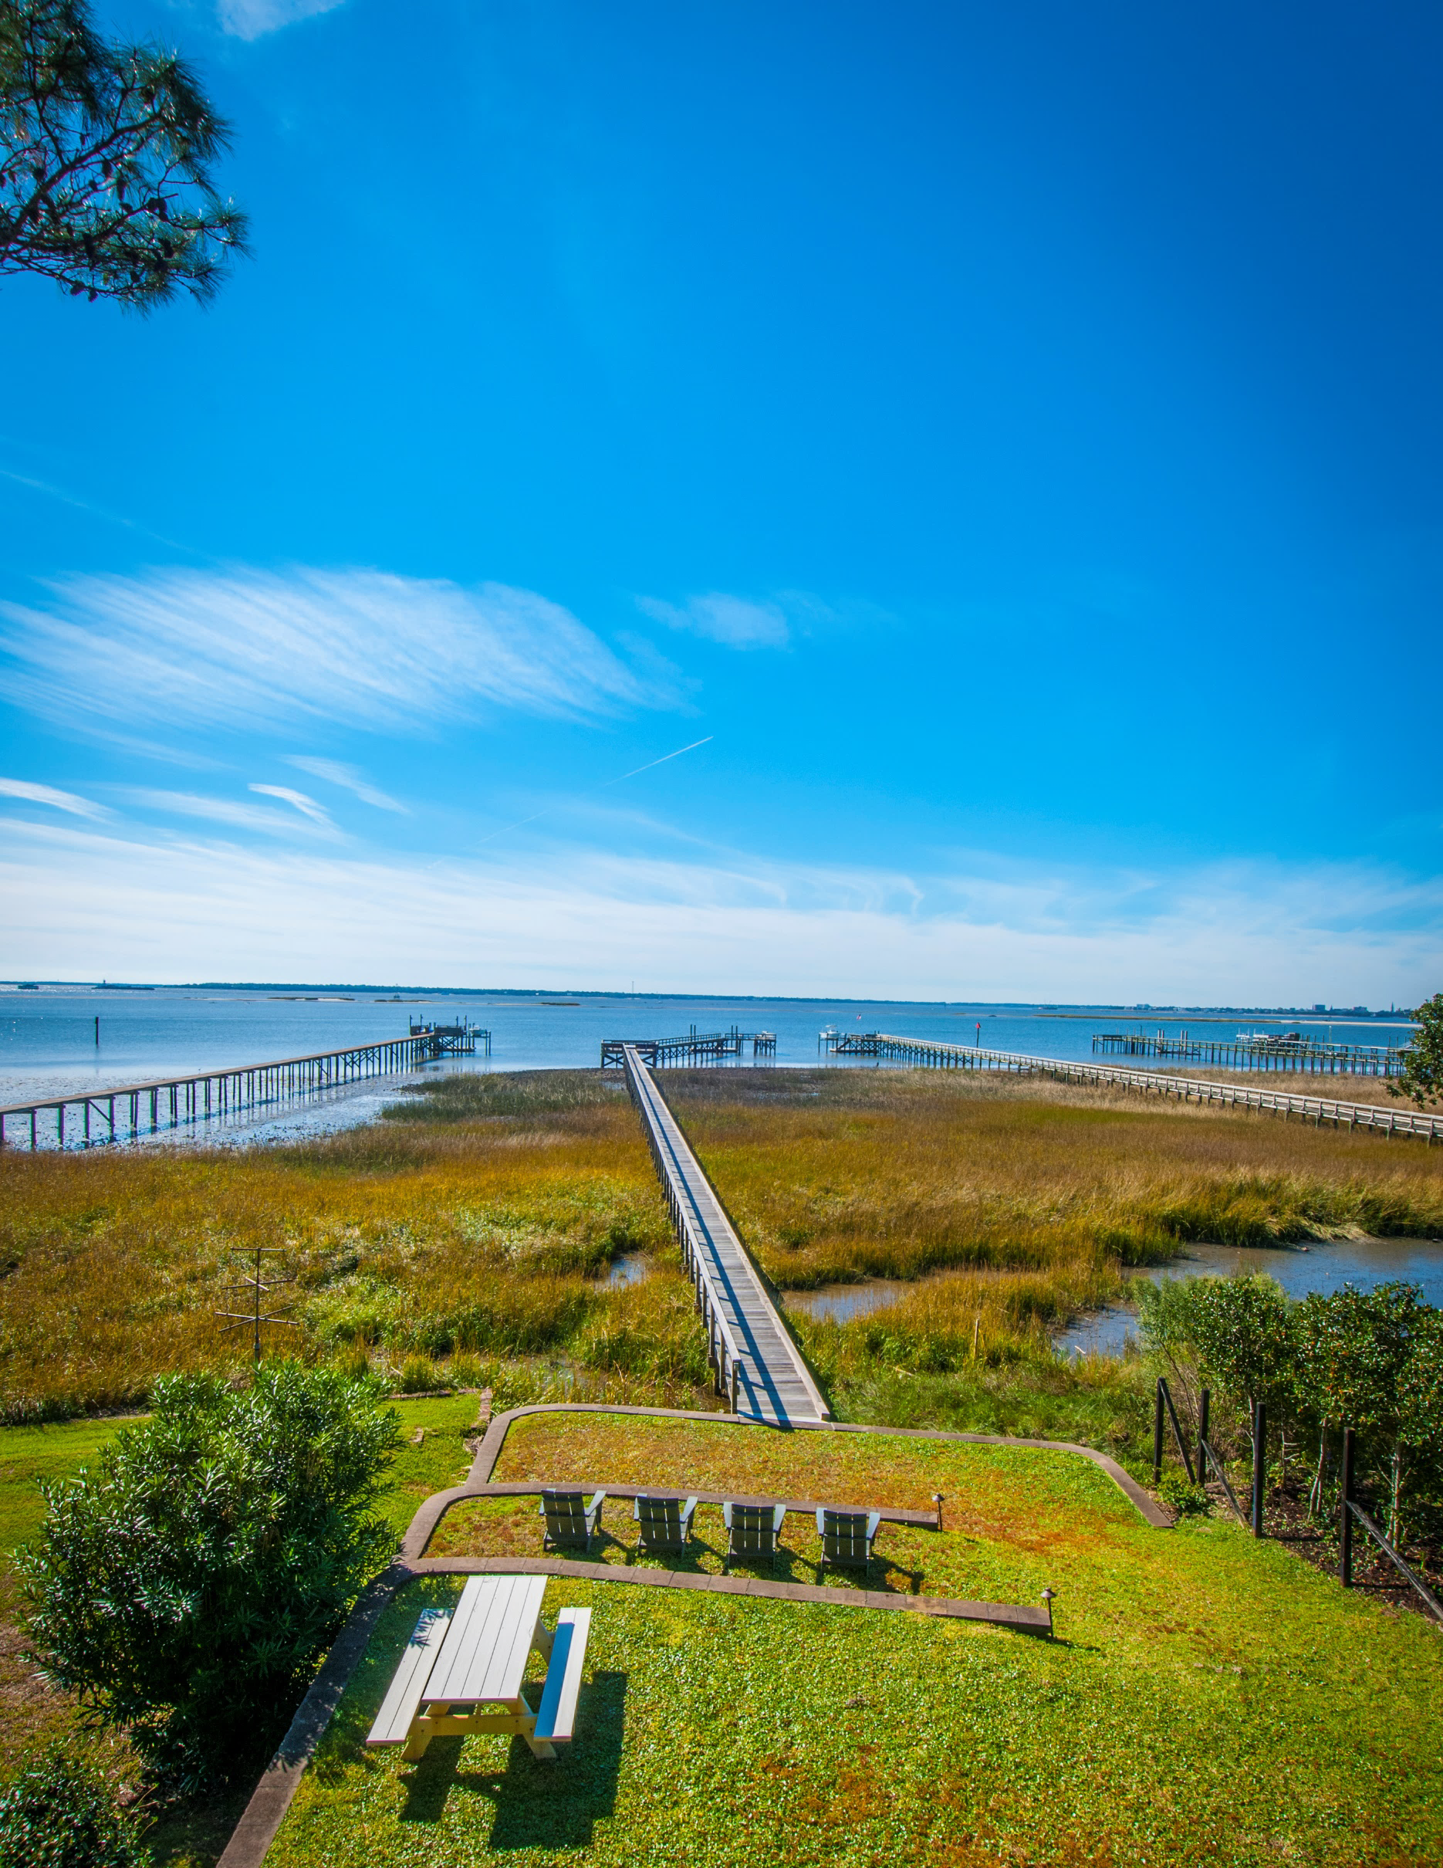
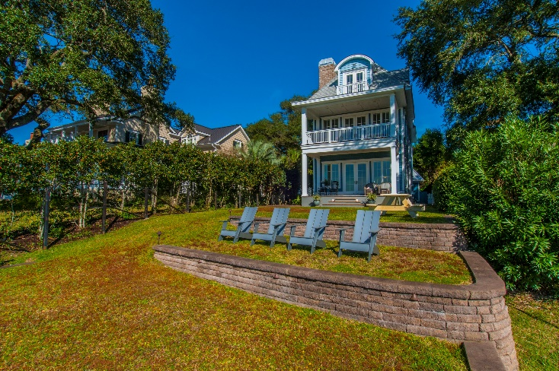
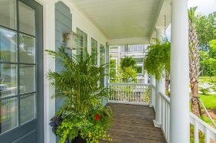
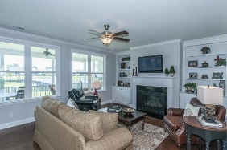
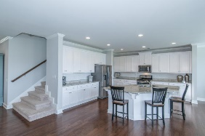
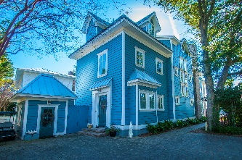
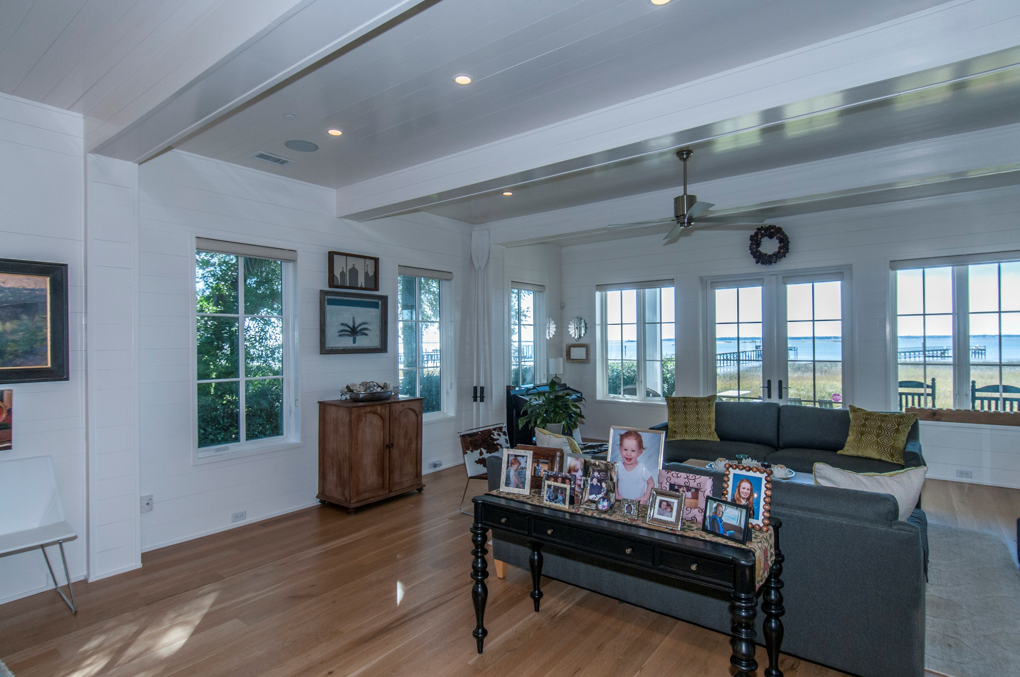
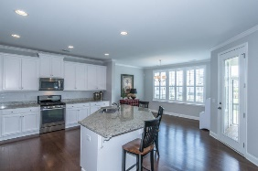
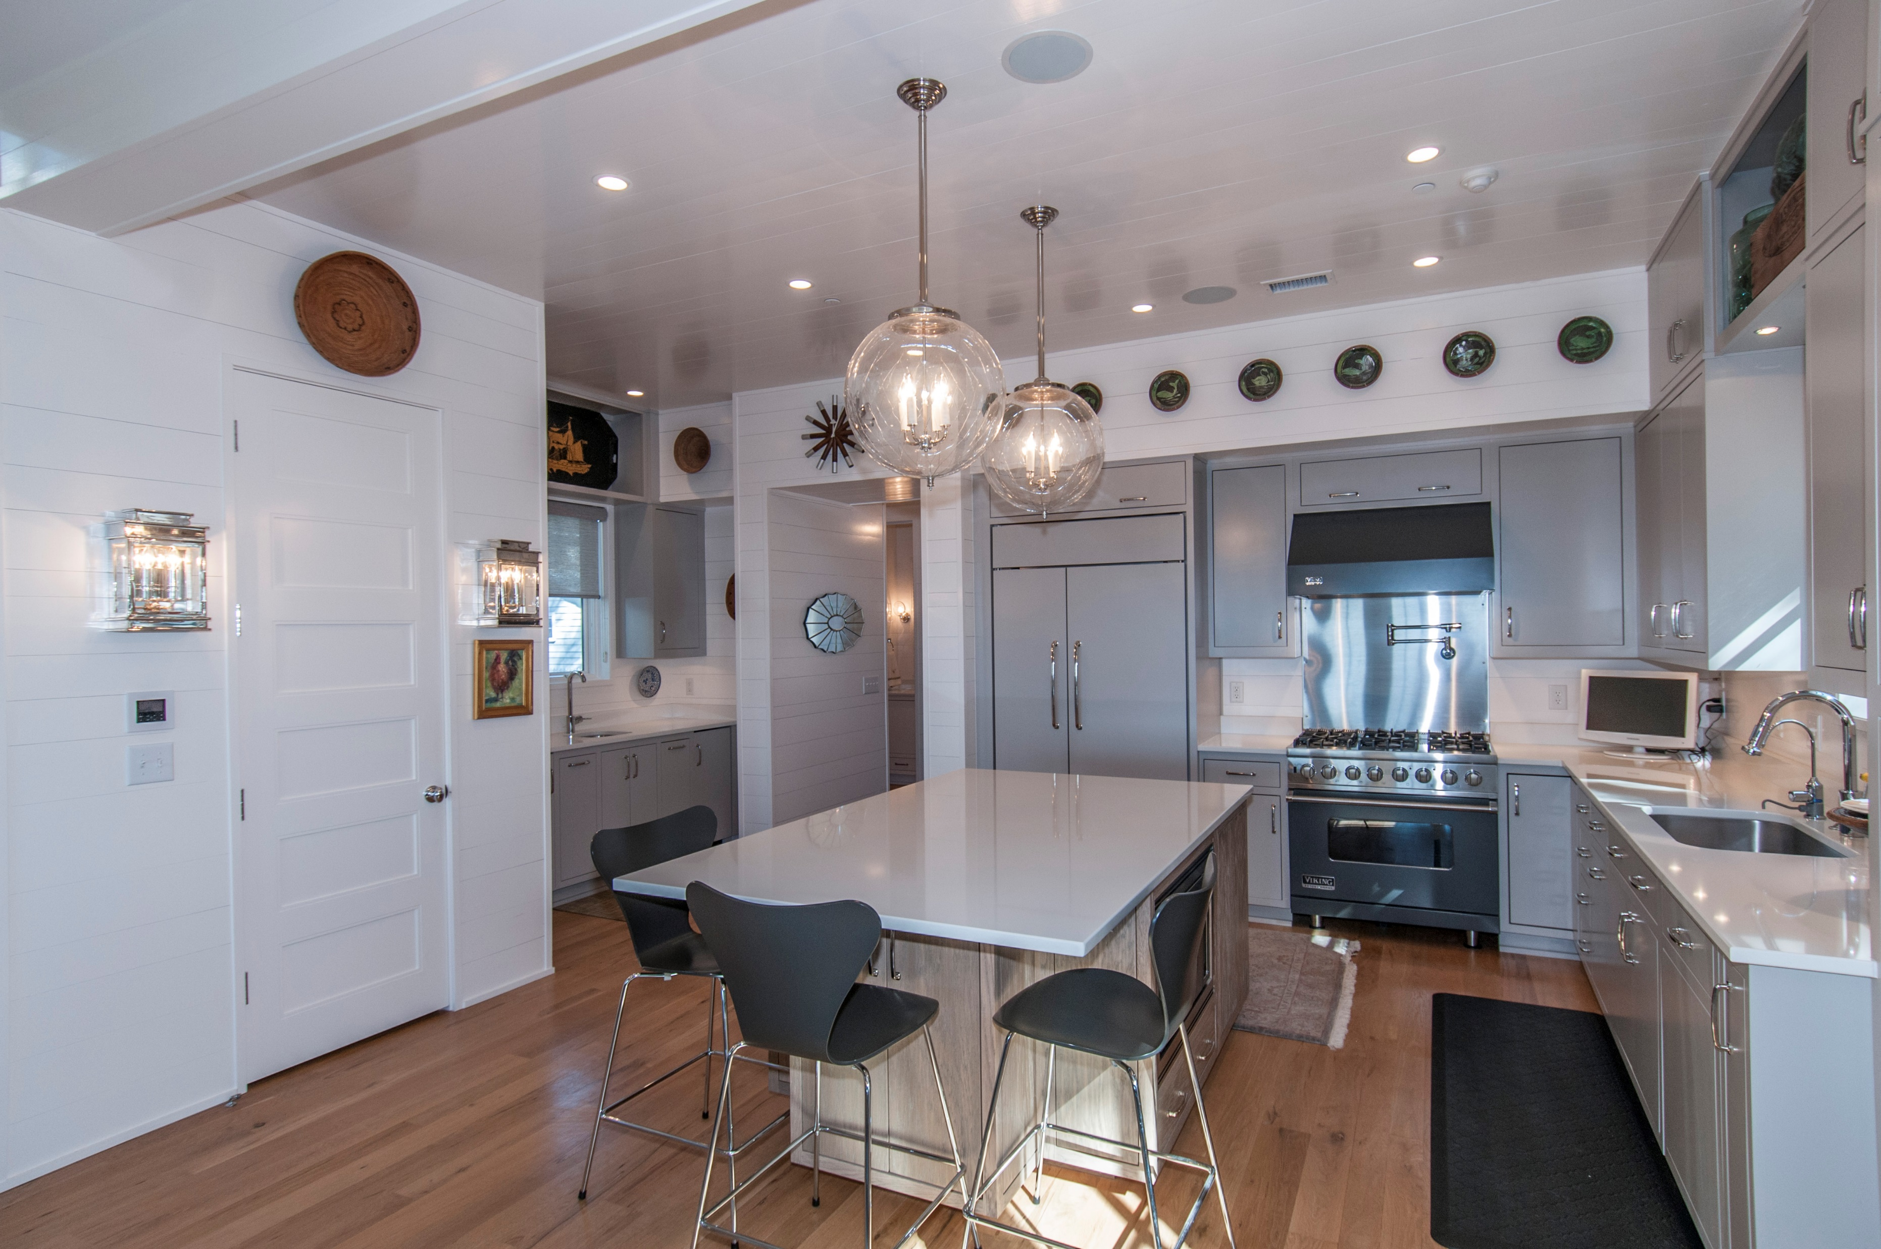
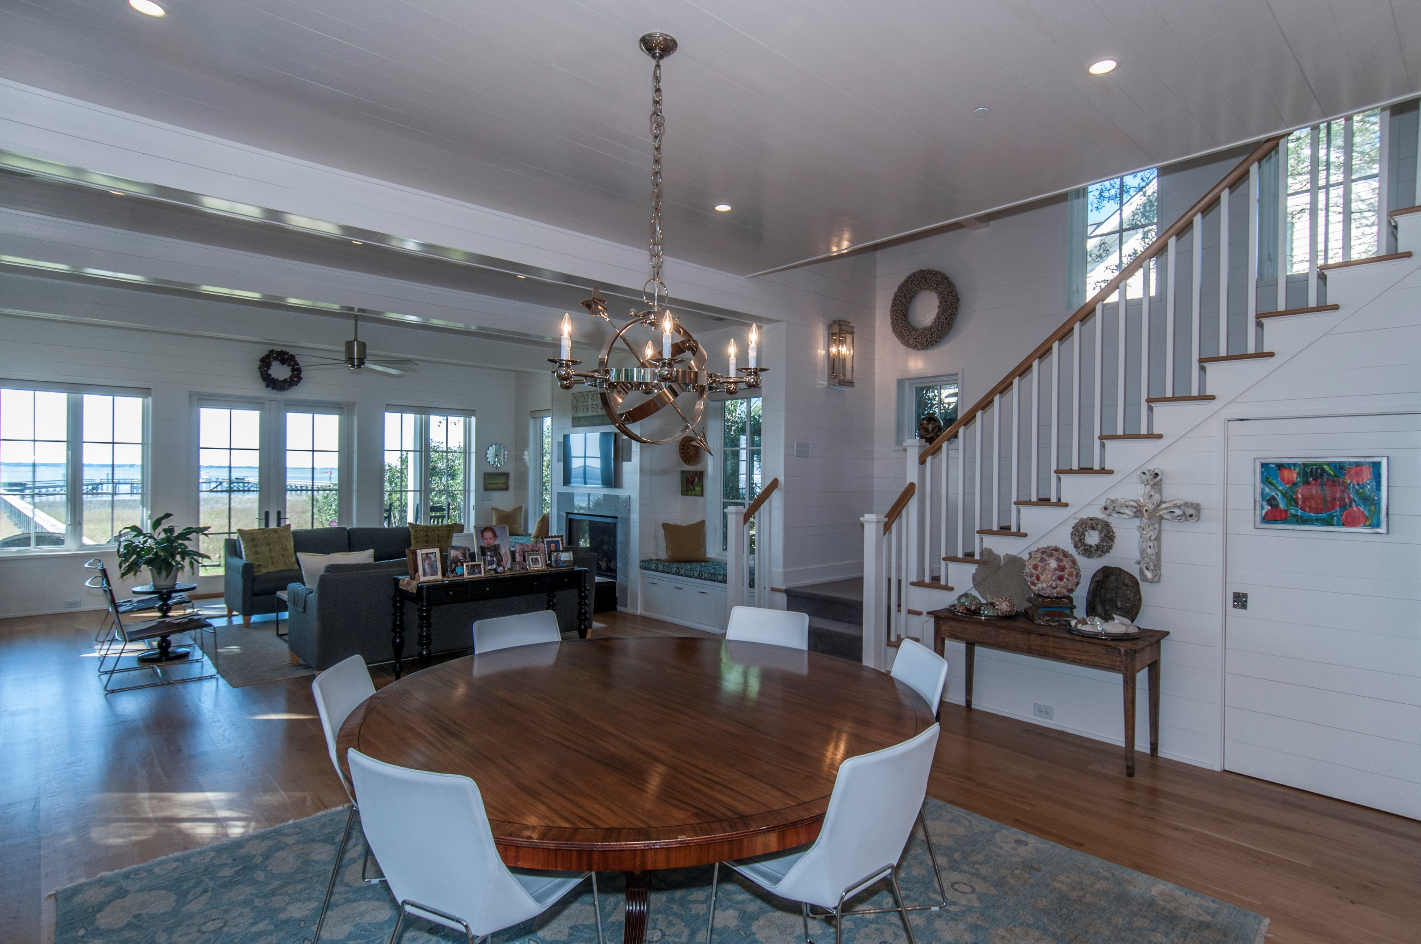
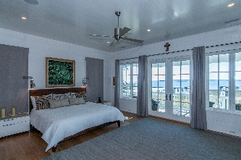
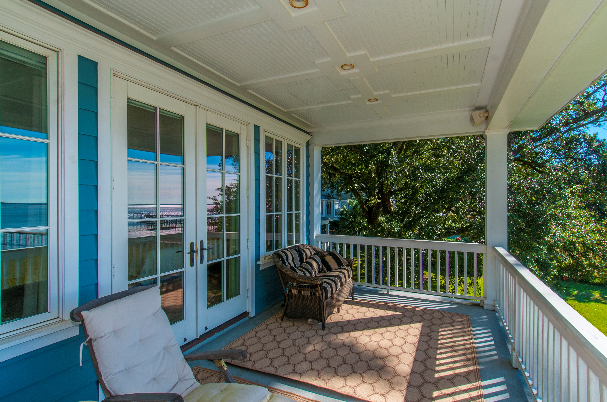
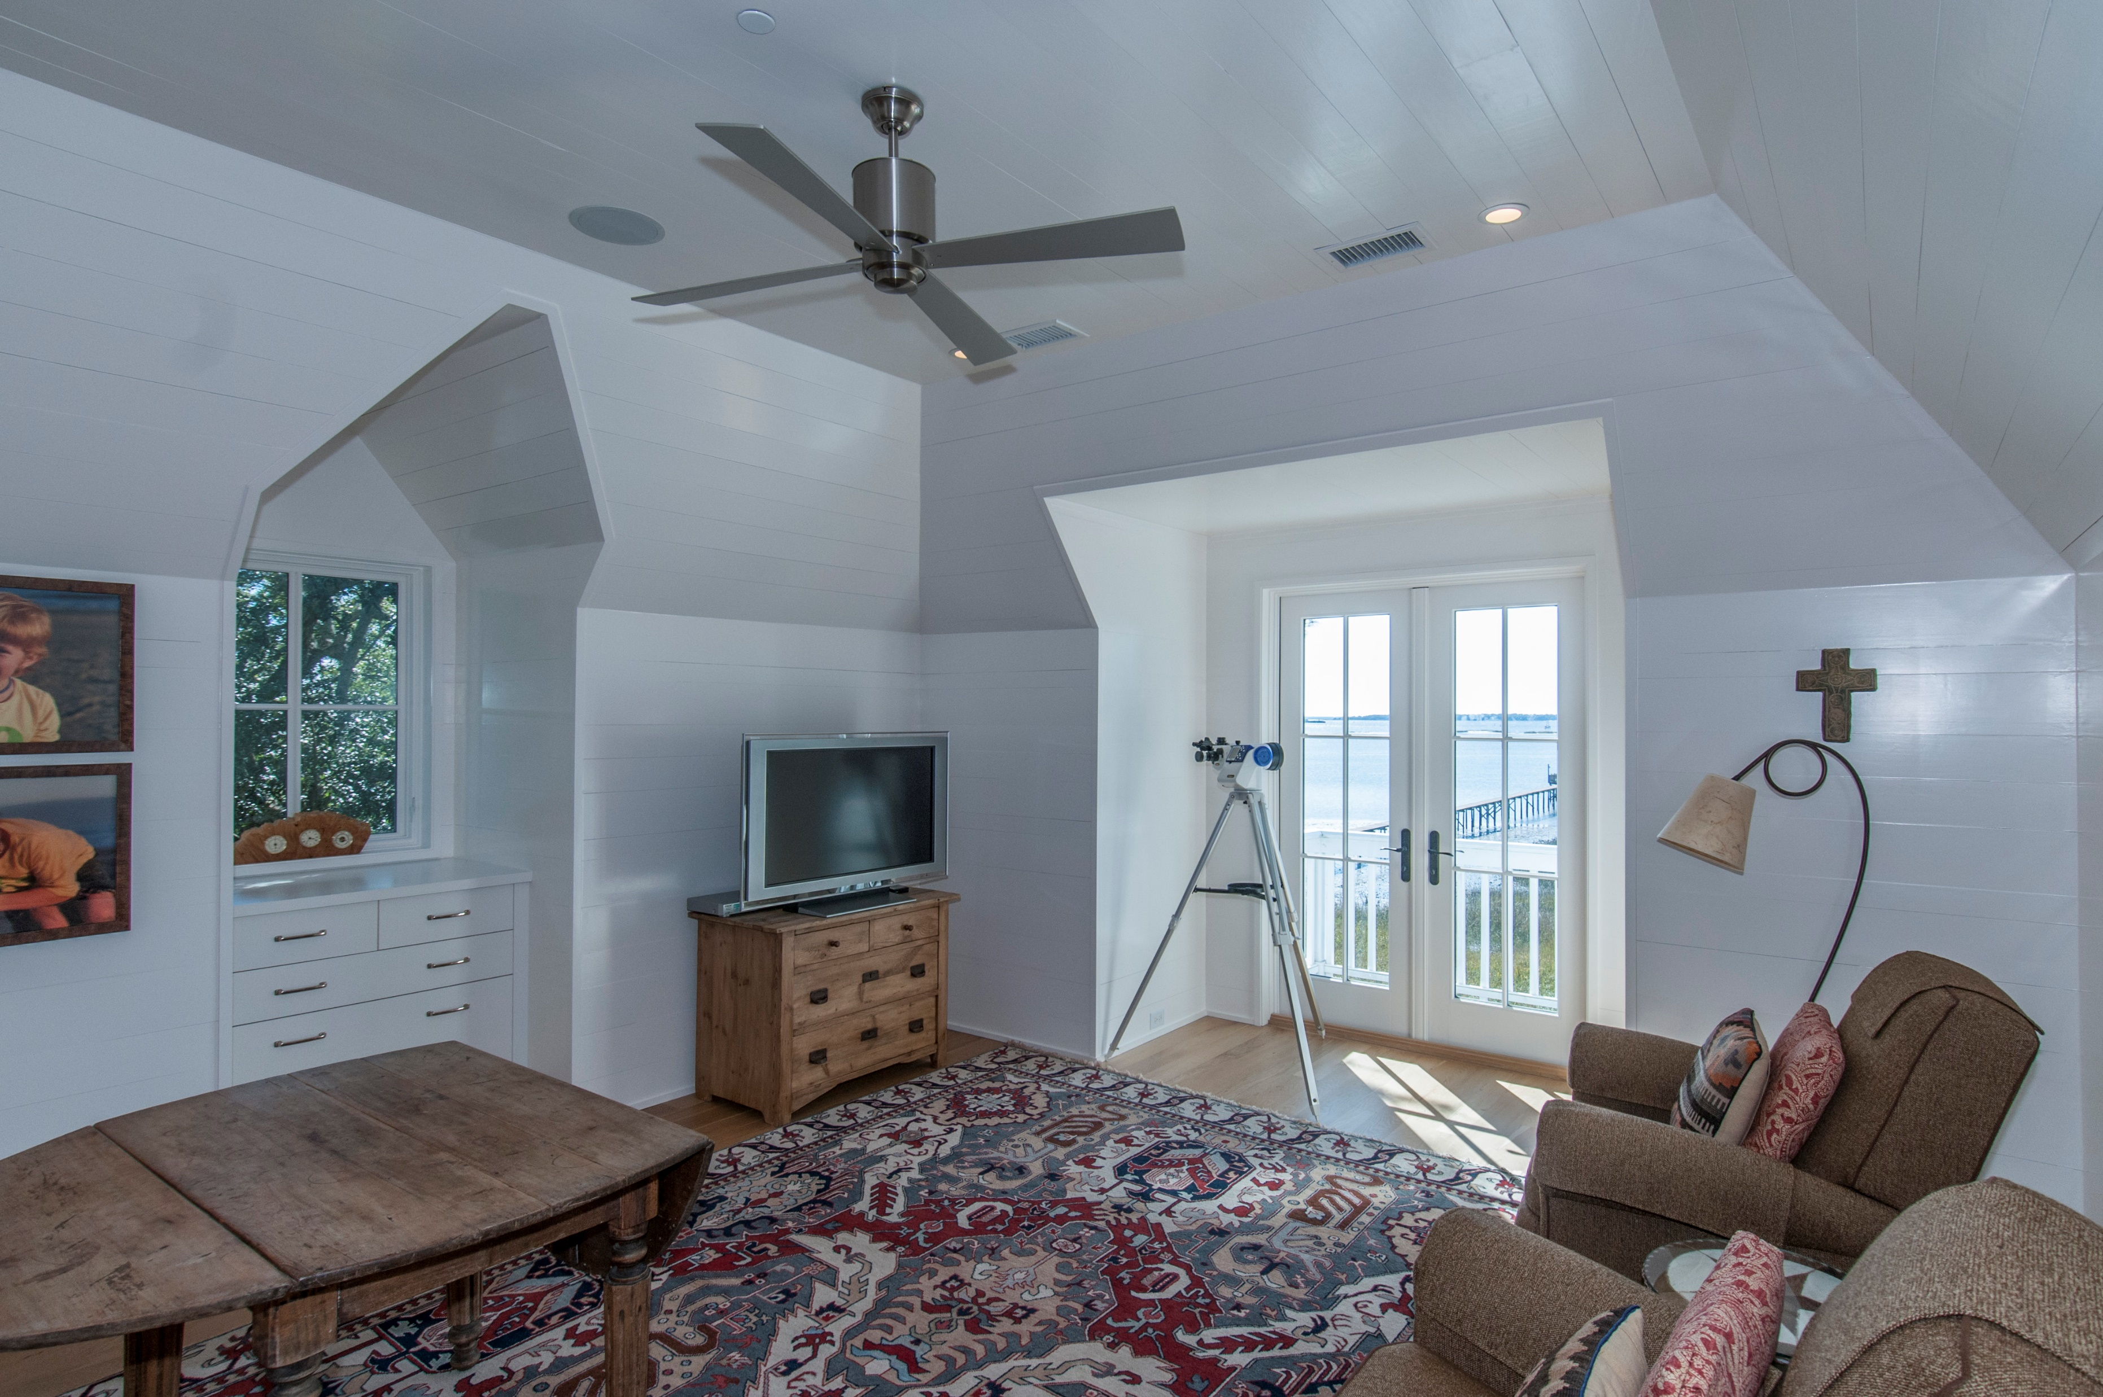
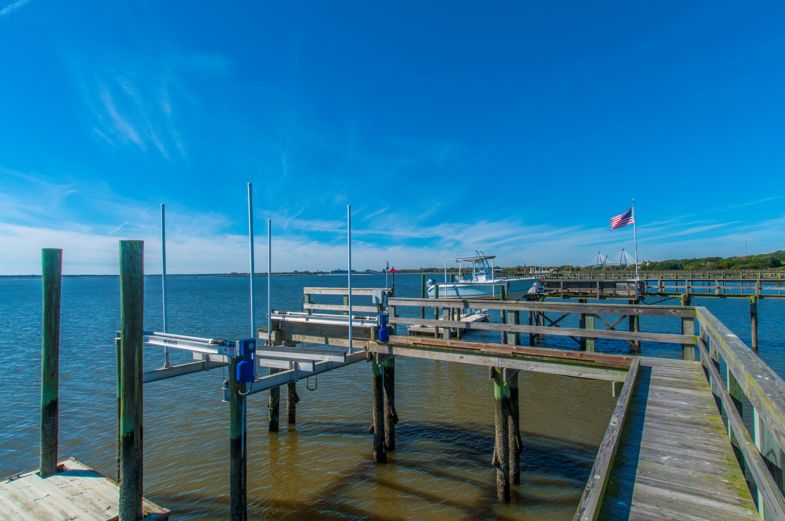


103 Venning Street Old Village ~ Mt Pleasant
Priced below market value!
Rare opportunity to own a newly built, custom home on deep water on the Charleston Harbor. This finely constructed home consists of four bedrooms plus an office or sitting room, three and a half bathrooms, and a large second floor laundry room. Nestled in a private, tranquil setting in the heart of the Historic Old Village, one block from The Pitt Street Pharmacy and The Old Village Post House Restaurant, 103 Venning Street is a tasteful home full of light with three stories, an elevator for ease of mobility, a terraced yard leading to the new dock with boat lift, floater and lovely seating area for entertaining. The dock is wide enough to accommodate a golf cart to conveniently carry your boating and fishing gear to and from your boat. There is also an outdoor shower near the back of the house to clean up in after your adventures in the sun. Homeowner and friends alike enter the property on a beautifully paved driveway that opens up to a large paved patio area. Too many details to list here!
$3,650,000
MLS# 15030141
3,682 SqFt
4 Bed/3½ Baths
Rees Johnston (843) 696-7278 rees.johnston@carolinaone.com Carolina One Real Estate • 2713 Highway 17 North • Mount Pleasant, SC 29466
www.TeamDawsonSC.com

