Slide 1


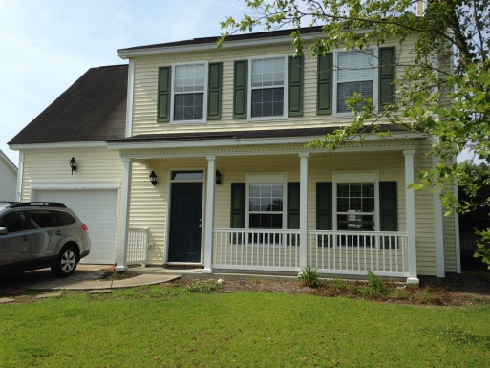
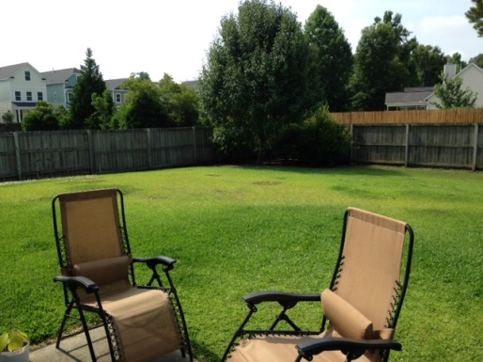
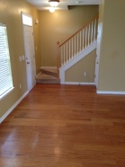
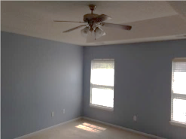
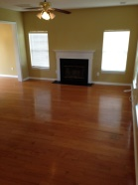
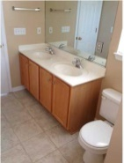
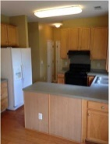
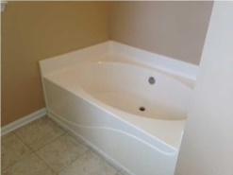
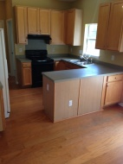
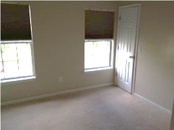
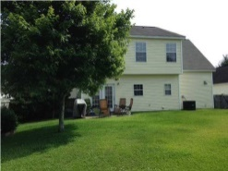
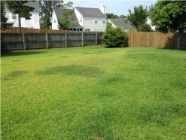


Less Expensive Than Rent
103 Walnut Creek Road
Grand Oaks Plantation - Charleston
MLS# 1415485 - $212,000
This absolutely charming home with four bedrooms, two full baths, and a half bath is vacant and easy to show! With hardwood flooring running throughout the downstairs and carpet in the four upstairs bedrooms, this house will make a great home for your family.
The entire house gets great natural light. When you enter the house you will be impressed with the large living room featuring a beautiful wood-burning fireplace. The living room opens into a roomy eat-in kitchen and dining area. Exit the French doors off of the dining area into a very spacious and private fenced yard with a grilling patio.
Downstairs there is also a half bathroom, a large laundry room, large coat closet, a pantry, and a one car garage for all of your storage and parking needs. Upstairs, the master suite features a bedroom with a tray ceiling with a ceiling fan.
There is a good sized walk-in closet, and roomy master bathroom with dual vanities, a soaking tub, and a separate shower. There are three more bedrooms and a second full bathroom upstairs.
Great for a large family or for a needed office space or playroom. The house has an alarm system in place for added security. HOA dues include the neighborhood pool and playground. Conveniently located near shopping and I-526.
Lee Lindler
leel@goldenbearrealty.com
www.GoldenBearRealty.com
Golden Bear Realty | 654 Coleman Blvd, Suite 100 | Mt Pleasant , SC 29464
Cell (843) 637-0803 | Office (855) 725-5890 | Fax (561) 721-3311

