Slide 1
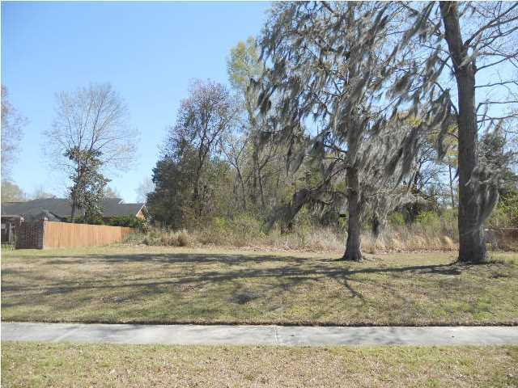
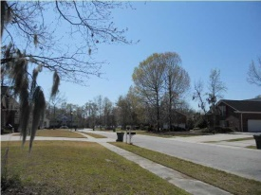
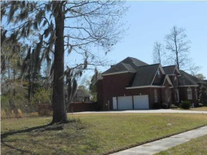
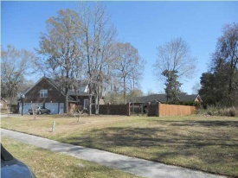


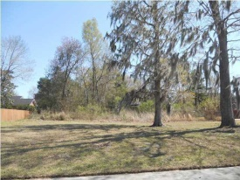
Build Your Dream Home
103 Waterstone Way
Crowfield Plantation
Goose Creek, SC 29445
MLS# 1308529 | $95,000
0.38 Acres
Take advantage of one of the remaining few lots left in beautiful Lakeview Terrace in Crowfield Plantation.
This lot is ready for the home of your dreams.
Enjoy the amenities of Crowfield such as the golf course, tennis courts, pool and fishing from the lake.
Connie White, Broker
C: 843-532-3356
conniesyouragent@gmail.com
Charleston Homes
111 Spring Hall Dr
Goose Creek, SC 29445

