Slide 1
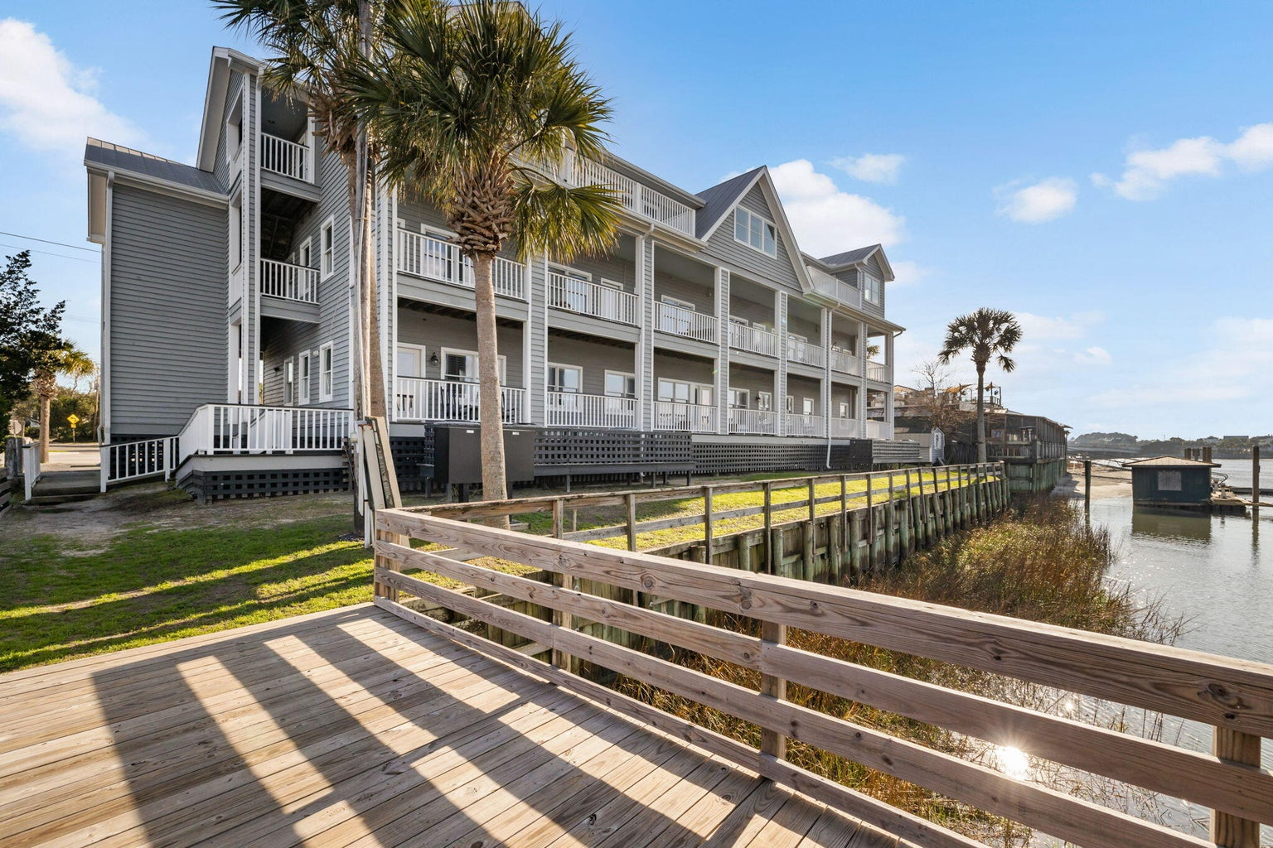
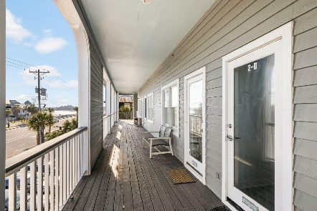
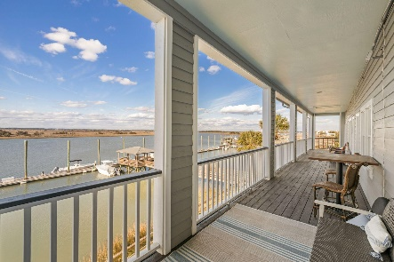
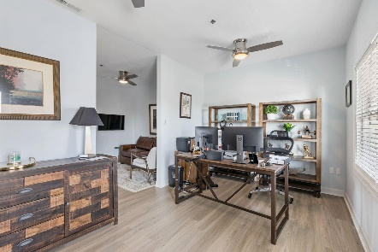
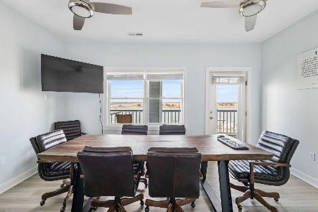
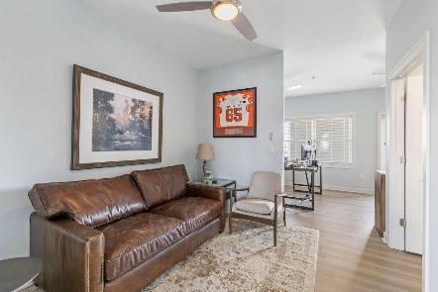
103 Palm Boulevard #2D
Isle of Palms, SC 29451
CMLS# 31000390 | $615,000
Darrell Creek Elevated Home With Elevator & Salt Pool
IOP Office Suite for Sale - An Extraordinary Place to Work!
RARE OPPORTUNITY to own a fabulous waterfront office suite on the 2nd floor of The Carroll Building on Hamlin Creek. Great visibility on the main drag between IOP and Sullivan's Island and adjacent to The Boathouse Restaurant. The building was constructed in 1991. A central sprinkler system was added in 2002 when the third floor space was finished. The building has a total of 9216 sqft and includes 12 units. This unit (2D) has 512 sqft of heated space consisting of a main office area, conference room, bathroom, and small closet. A full-light door leads from the conference room to the back porch (common space) with gorgeous views of Hamlin Creek.
Andrea Rogers
(843) 532-3010 | andrearogers1@gmail.com | www.andrearogersrealtor.com
AgentOwned Preferred Group | 1400-G Palm Blvd | Isle Of Palms, SC 29451

