Slide 1
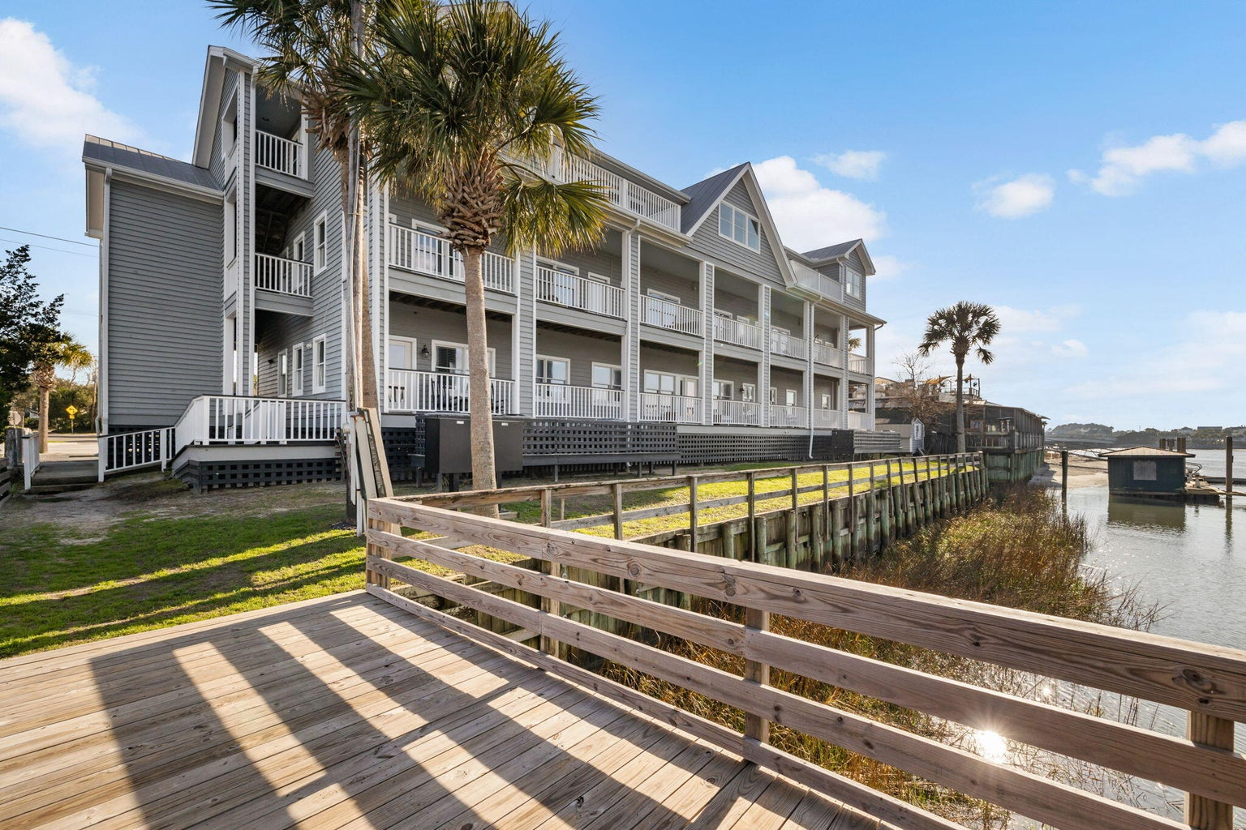
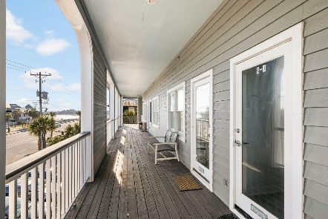
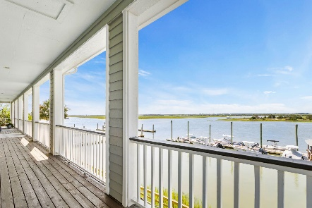
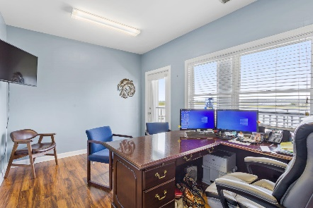
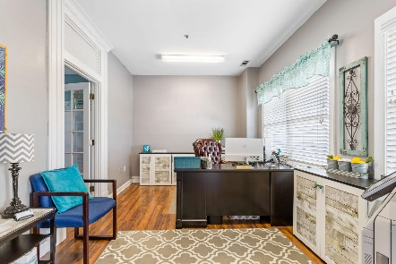
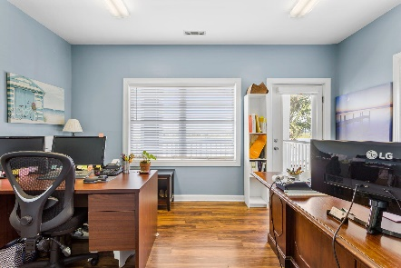
103 Palm Boulevard #2E Isle of Palms, SC 29451 CMLS# 31001694 | $1,230,000
Darrell Creek Elevated Home With Elevator & Salt Pool
IOP Office Space For Sale w/ Water Views
Fabulous waterfront, corner office suite on the 2nd floor of The Carroll Building on Hamlin Creek! Great visibility on the main road between IOP and Sullivan's Island and adjacent to The Boathouse Restaurant. The building was constructed in 1991. A central sprinkler system was added in 2002 when the third floor space was finished. The building has a total of 9216 sqft and includes 12 units. This unit (2E) has 1024 sqft of heated space consisting of a main office/reception area, 3 private offices, a break room/flex room, and 2 half baths. Two of the 3 private offices have direct access to the common porch overlooking Hamlin Creek. An extraordinary place to work!
Check out the listing for more details and photos
Andrea Rogers
(843) 532-3010 | andrearogers1@gmail.com | www.andrearogersrealtor.com
AgentOwned Preferred Group | 1400-G Palm Blvd | Isle Of Palms, SC 29451

