Slide 1
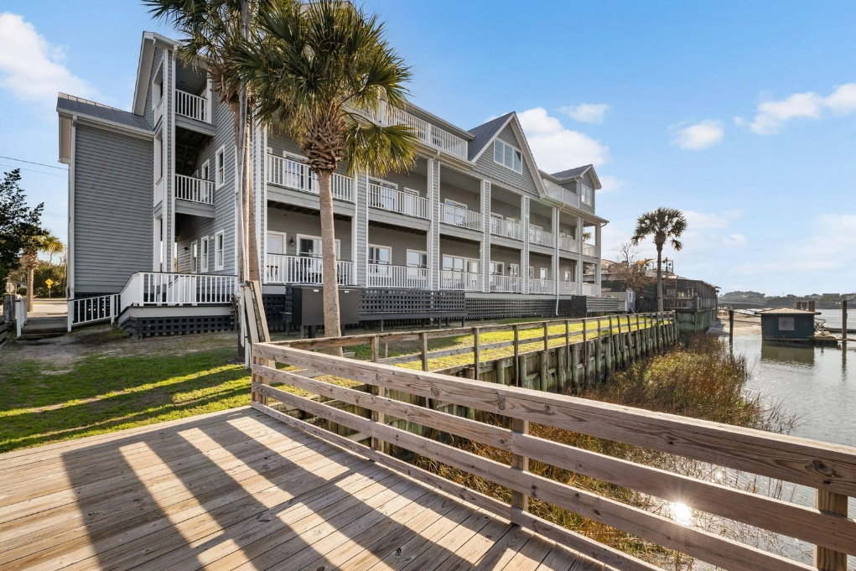
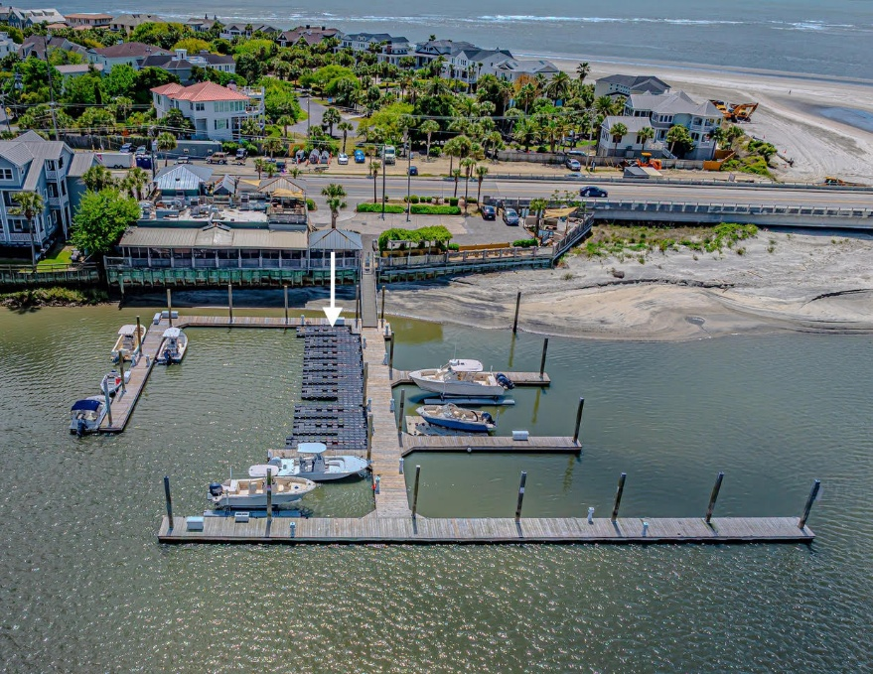
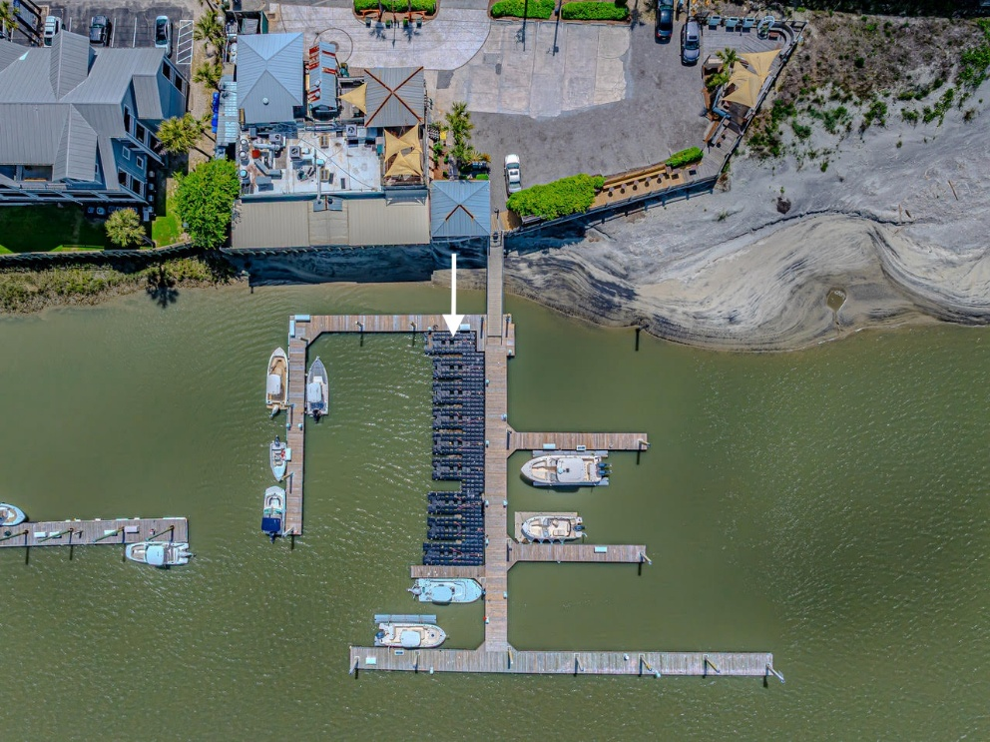
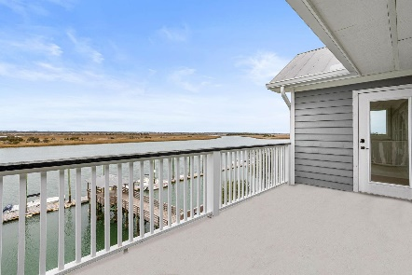
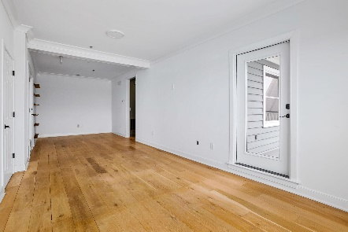
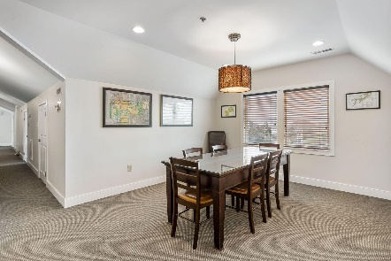
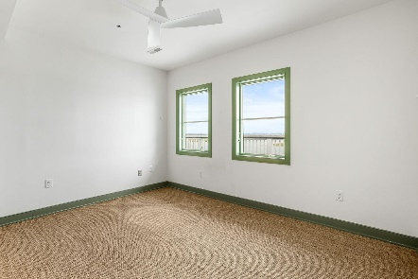
103 Palm Boulevard #3C Isle of Palms, SC 29451 | CMLS# 31004601 Office Only $779,000 | Office w/ Boat Slip $929,000 | Rental Only $3650/mo
Darrell Creek Elevated Home With Elevator & Salt Pool
Waterfront Office Suite For Sale…Now With An Optional Boat Slip!
Fabulous waterfront office suite on the 3rd floor of The Carroll Building on Hamlin Creek! Great visibility on the main road between IOP and Sullivan's Island and adjacent to The Boathouse Restaurant. The building was constructed in 1991. A central sprinkler system was added in 2002 when the third floor space was finished. The building has a total of 9216 sqft and includes 12 units. This unit (3C) has 644 sqft of heated space that includes two large offices adjoined by a small hallway. One of the offices opens to a private balcony overlooking Hamlin Creek and is big enough for 2 separate desk/working spaces. The other side has a dividing wall which makes for 2 additional work spaces. Unit has access to a shared 3rd floor conference room and bathroom. An extraordinary place to work!
VIEW LISTING
Andrea Rogers
(843) 532-3010 | andrearogers1@gmail.com | www.andrearogersrealtor.com
AgentOwned Realty Preferred Group | 1400-G Palm Blvd | Isle Of Palms, SC 29451

