Slide 1
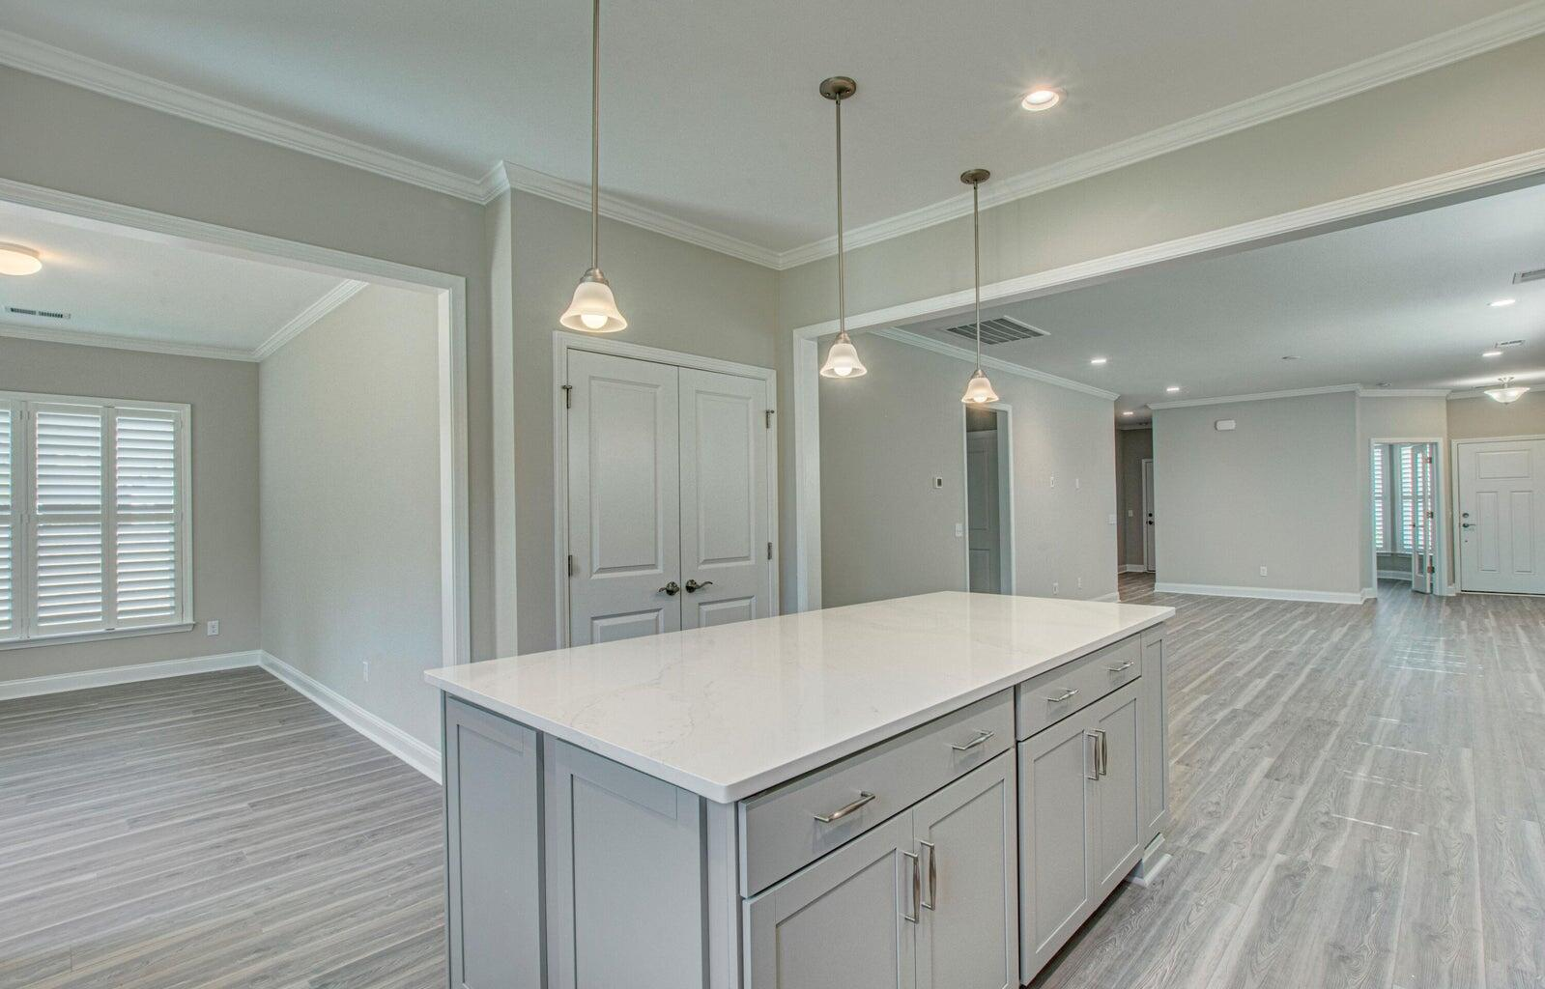
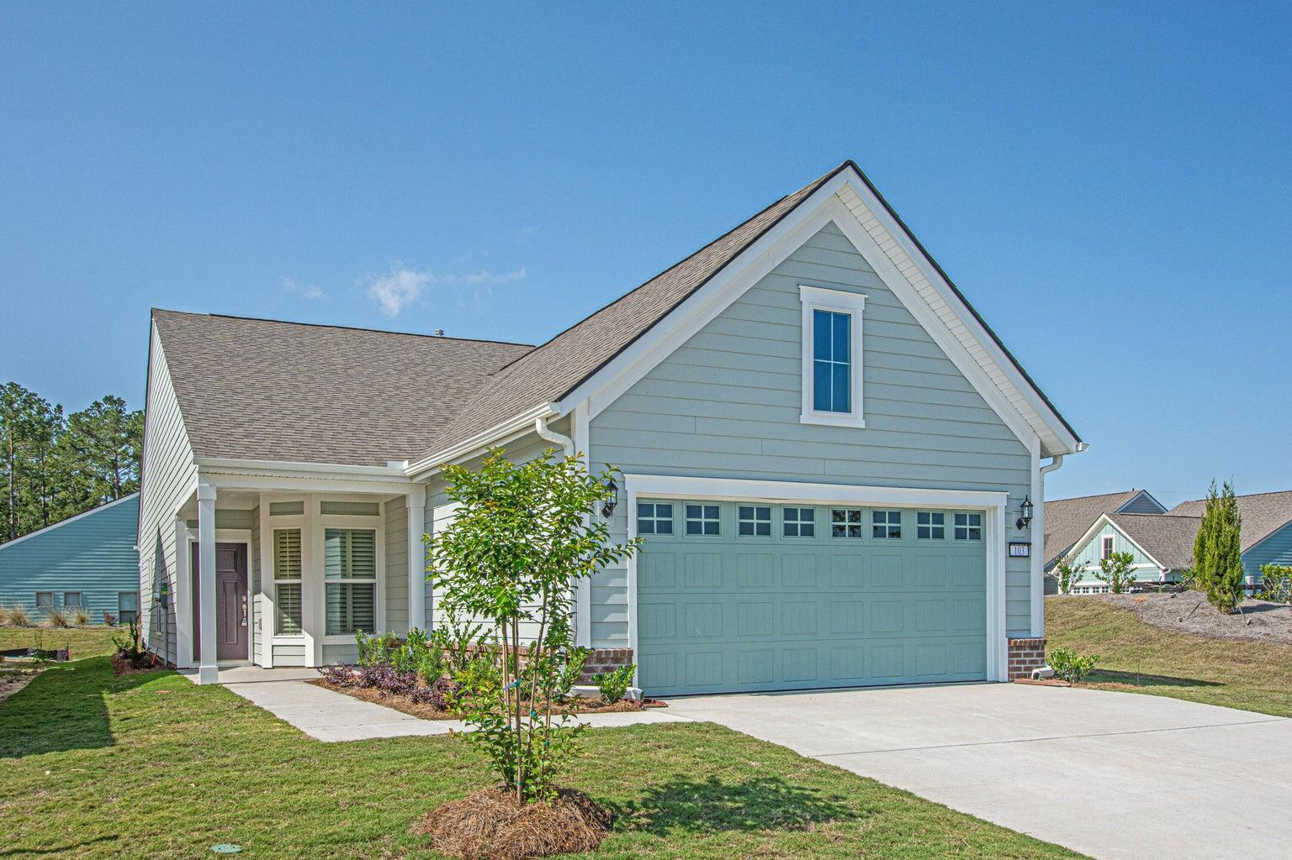
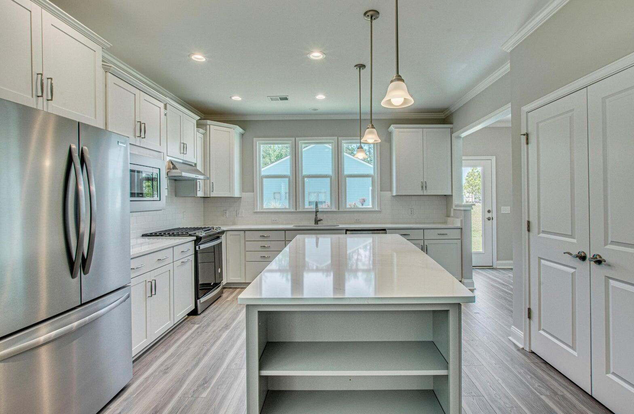
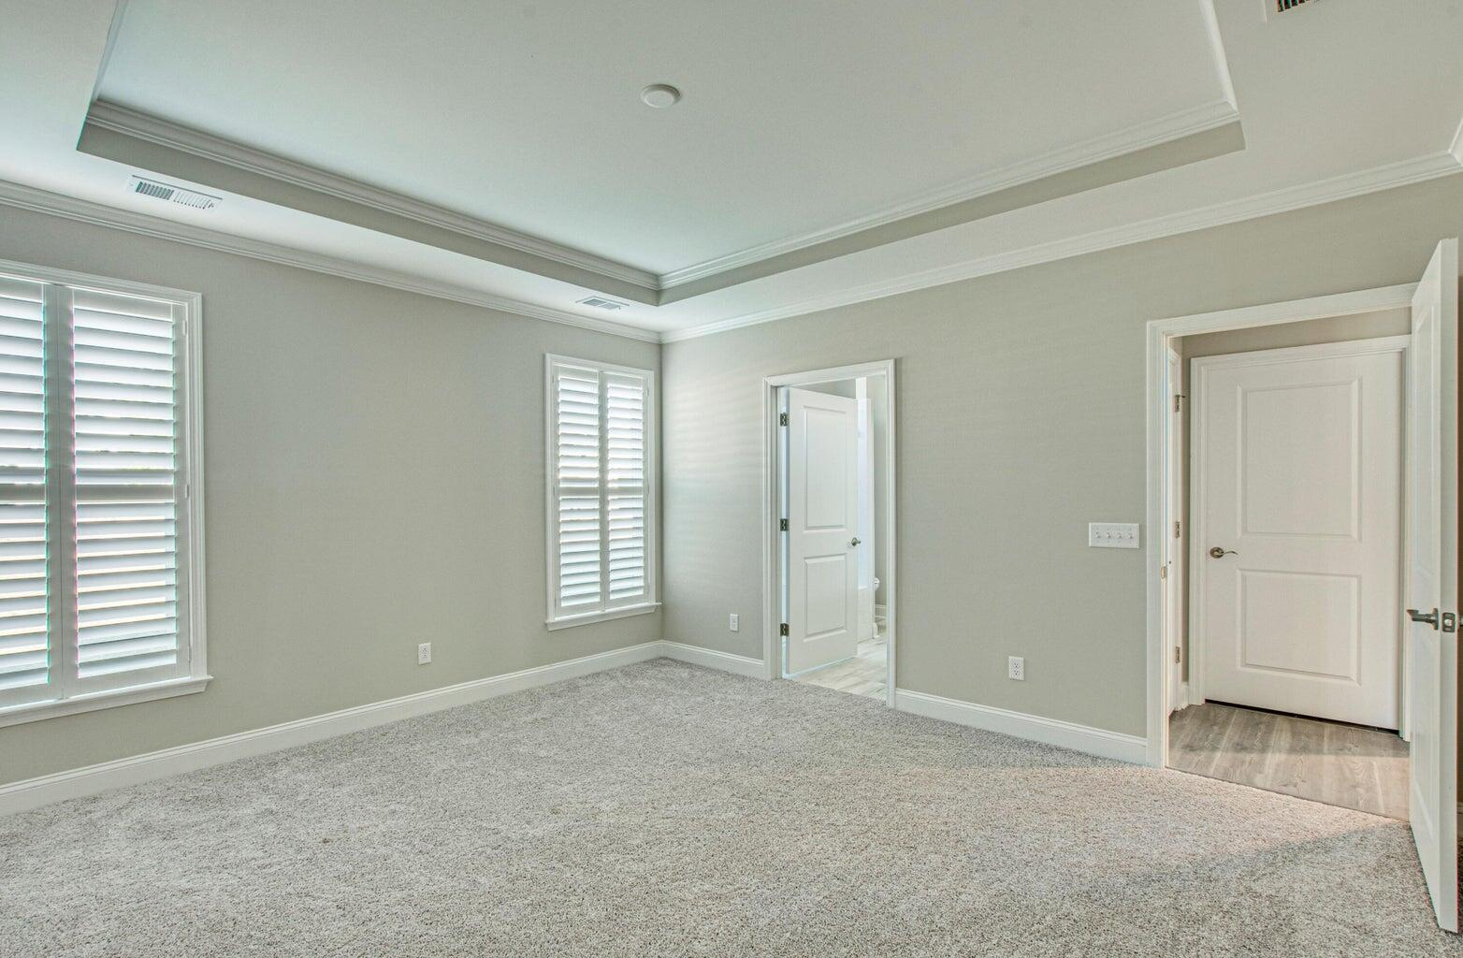


Better Than New
103 Cardinal Cove Lane
Nexton | Summerville, SC 29486
MLS# 24002522 | $479,900
No Need to Wait Months for a New Build! Listed $20,000 under Comparables, this is your Opportunity to Own in the Gated, Active Adult Community of Nexton! This location is a short walking distance to the Clubhouse/Amenities Center as well as the Dog Park and Community Garden! Halls Chophouse, Poogan's Porch, 2 upcoming grocery stores, and a variety of other shops, stores, offices, and restaurants close by make this location perfect for the Active Adult looking for their forever home! Open spaces and modern wood flooring in gorgeous hues flow throughout the entrance into the family room, the open dining space, and into an extravagant chef's kitchen! Embellished with tall, white cabinetry, a massive island with cabinets & shelving, and endless white quartz countertops, you'll love to play chef at home! Upgraded appliance package includes a gas cooktop oven w/separate hood, high end Jenn-Air dishwasher, SS French Door Fridge, Microwave, and the Washer & Dryer stays!
An abundance of windows throughout allow light to flow seamlessly through spaces with windows upgraded with plantation shutters and custom window treatments. A peaceful sunroom nestled next to the kitchen is the perfect retreat for morning coffee and afternoon relaxation! This home also features a front office/library with an additional closet! A large Master with ensuite bathroom features a beautiful white tiled shower, gorgeous cabinets, high top counters w/quartz, upgraded ceramic floors, and a large walk-in closet! Located separately and down the hall you'll find a private bedroom with a full bath for guests. Additional upgrades include an oversized 2 car garage w/4ft extension, and a finished walk-up attic with stairs located off the garage for extra storage! Finish it to make a lovely craft room/art room/sports room. Everything that you would want is in this floorplan! Schedule your private showing today!
Megan Maarouf
843-801-7777
meganmaarouf@gmail.com
www.residerealestatellc.com
Reside Real Estate LLC
155 Wingo Way Unit 421
Mt. Pleasant, SC 29464

