Slide 1
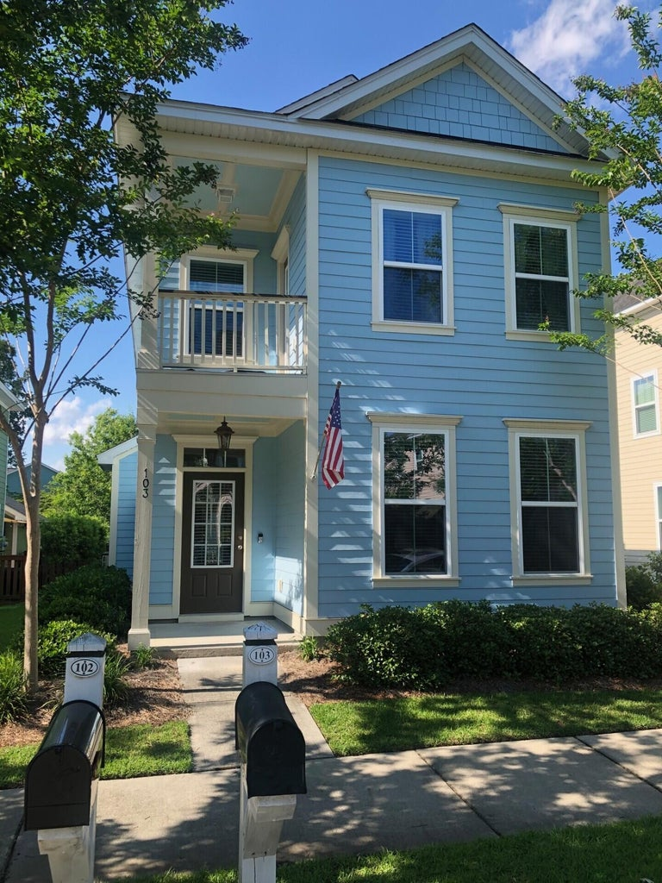
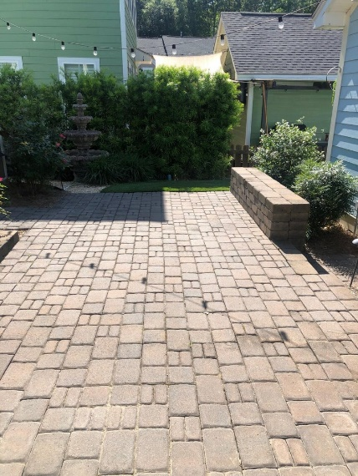
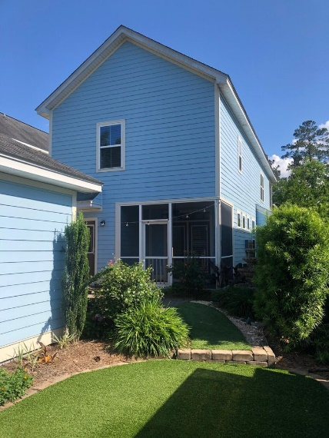
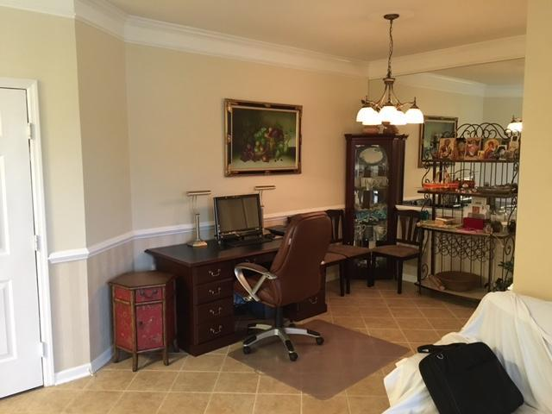
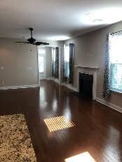
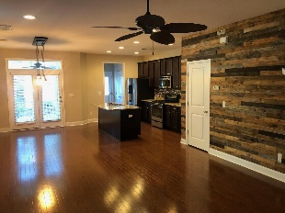
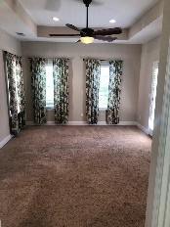
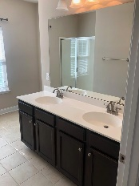
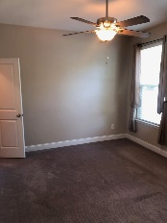
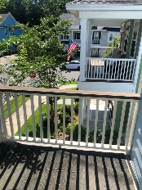
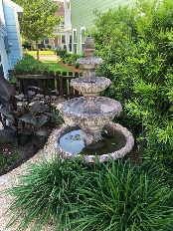
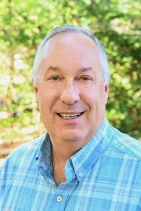

Open House Saturday, June 1
11:00 AM to 3:00 PM
103 Green Grass Road
The Ponds
Summerville, SC 29483
MLS# 24012399
$435,000
Lowcountry Living! This Charleston Single Style home is move in ready! Each bedroom has its own bathroom and walk-in closet! Enjoy summer nights on the Master balcony. The backyard is peaceful and inviting with artificial turf, a decorative fountain, paved patio, lighting, screened porch and pergola! Located on a quiet street in this sought after neighborhood featuring a pool, miles of trails, ponds to hike , fish, kayak, or enjoy in a golf cart! Neighborhood events are planned throughout the year creating a close knit community. Join The Ponds Family! Up to $2,000 Lender Credit is available and will be applied towards the buyer's closing costs and pre-paids if the buyer chooses to use the seller's preferred lender. This credit is in addition to any seller concessions.
Erik Fender
843-830-7346
erik.fender@cbrealty.com
www.coldwellbankerhomes.com
Coldwell Banker Residential Brokerage
1127 Queensborough Blvd. 103
Mt Pleasant, SC 29464

