Slide 1

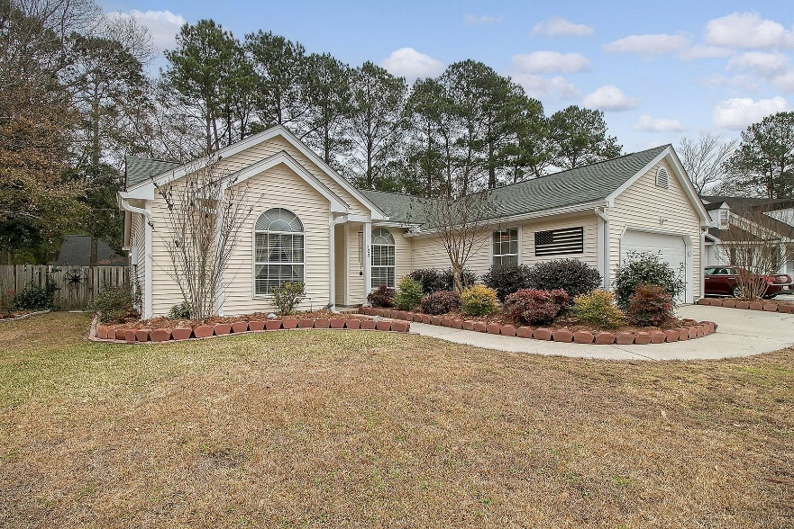
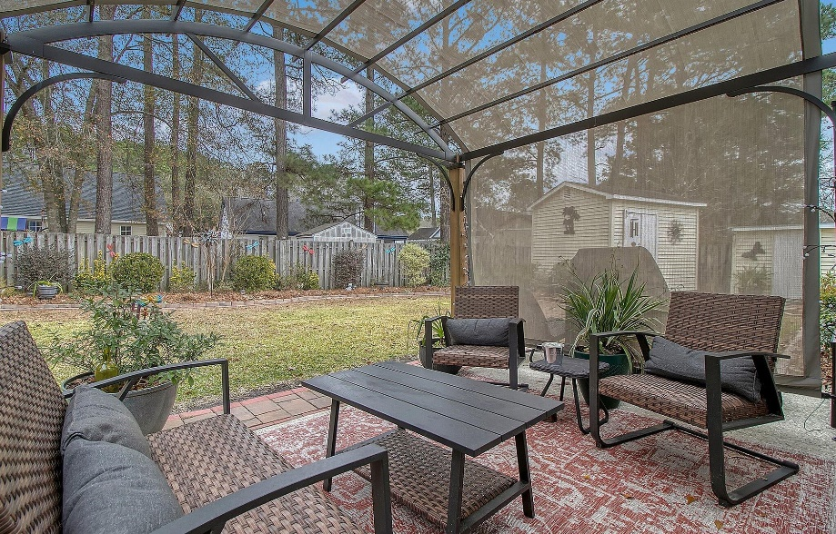
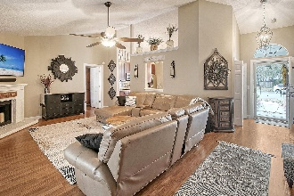
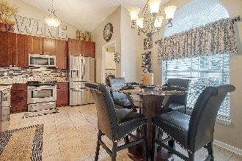
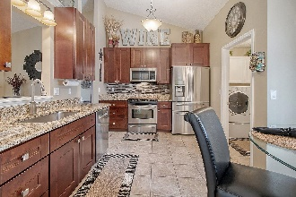
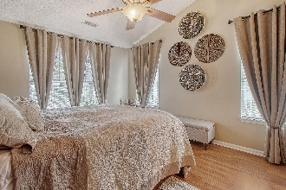
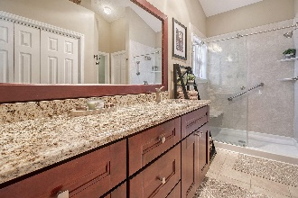

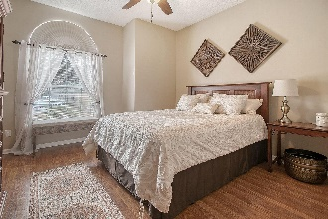
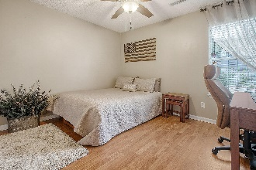
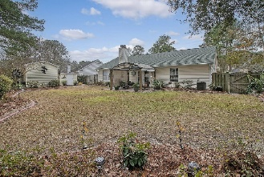
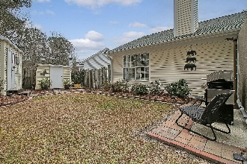
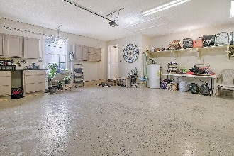
Beautifully Renovated One Story
Home in Summerville
Debbie Cromer
ABR, RSPS, REALTOR, CRS
(843) 437-6342
debbie@debbiecromer.com
www.debbiecromer.com
103 Seavington Court
Summerville Place | Summerville, SC 29485 | MLS# 24000694 | $375,000
Welcome to this beautifully renovated one-story home! The spacious living area is warmed by a cozy fireplace, and the chef's dream kitchen boasts solid wood cabinets with soft-close doors and drawers, granite countertops, a stylish tile backsplash, and stainless steel appliances. The sunny master bedroom features a renovated master bath with new cabinetry, a generous walk-in closet, and a luxurious walk-in shower. Two secondary bedrooms share a well-appointed full bath on the opposite side of the home. Outside, the large fenced backyard is an oasis with a pergola and two outbuildings, all nestled on a quiet cul-de-sac. Don't miss the impressive list of renovations/upgrades. DD2 schools! Summerville Place is located centrally to shopping, entertainment and major employers.
Recent Renovations:
Kitchen - gutted and Renovated 2017
Soft close all wood cabinets including double pull out drawers | Granite Countertops | Tile Backsplash | New appliances
Master Bath - gutted and renovated 2017/2021
Soft close all wood cabinets | Walk in shower | Water saver toilet with bidet
Guest Bathroom - renovated 2017
Soft close all wood cabinets | Water saver toilet
Hardware
All new brushed nickel door knobs and hinges
Electrical
All new electrical light switches, plugs lighting and ceiling fans. New electrical run outside house by HVAC
Garage
New garage door opener
HVAC - 2019
New HVAC and nest thermostat
Flooring and Patio doors - 2016
Old slider replaced with French Doors
Laminate flooring (exception of wet areas)
Yard - 2019 - 2023
Pergola - 2019
New cover - 2023
New sod front yard - 2023
Trees separating yard - 2019
Bricked in flower gardens surrounding home and along fences
Video Tour
Century 21 Properties Plus | 1090 Park West Blvd; Ste 103 | Mount Pleasant, SC 29466

